Slide 1
On the Complexity of the Web’s PKI: Evaluating Certificate Validation of Mobile Browsers
Published in: IEEE TRANSACTIONS ON DEPENDABLE AND SECURE COMPUTING, VOL. 21, NO. 1, JANUARY/FEBRUARY 2024
Summarized by
Sangwon Lim (sangwonlim@snu.ac.kr)
2024-12-24
Notes:
.

Slide 2
Contents
Introduction
Background
Test Suite Overview
Automatic Testing of Cert Validation
Analysis of Cert Validation Problem
Analysis of Real-World Certificates
Conclusion

Slide 3
Introduction
Transport Layer Security(TLS) protocols coupled with the Public Key Infrastructure(PKI) is pervasively used within the Web
Securing the Web’s PKI relies on not only trustworthy certificate issuance and management procedures but also reliable certificate validation mechanisms
Nonetheless, certificate validation itself is complex and error-prone, especially for mobile browsers

Slide 4
Introduction
The authors perform large-scale automated testing of certificate validation across 30 mobile browsers and 5 desktop browsers
They compile a comprehensive test suite and design and implement an automated test pipeline to identify security vulnerabilities in certificate validation across various aspects
The latest mobile browsers could Accept as many as 33.2% invalid certificates and Reject merely about 5.4% invalid ones

Slide 5
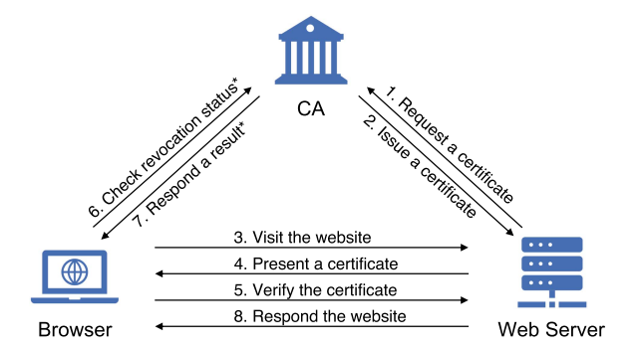
Background
The Web’s Public Key Infrastructure
  Secure issuance and management of certificates by CAs and web servers
  Certificate validation by browsers
CRL or OCSP
  * There exist multiple ways, such as Certificate Revocation List (CRL) and Online Certificate Status Protocol (OCSP)

Slide 6
Background
Certificate Validation
  Matching the identity of the leaf certificate against a website’s hostname
  Validating the chain of trust
  Checking the validity of all certificates
    Signature to verify the certificate’s integrity
    Validity to ensure the certificate does not expire
    Key Usage to guarantee the usage of the certificate follows what it intends for
    The revocation status

Slide 7
Background
Related Standards of Certificate Validation
  RFC 5280: Internet X.509 public key infrastructure certificate and certificate revocation list (CRL) profile
  CA/B baseline requirements (BR)¹⁾
  RFC 6125: Representation and Verification of Domain-Based Application Service Identity within Internet Public Key Infrastructure Using X.509 (PKIX) Certificates in the Context of Transport Layer Security (TLS)
  RFC 6960: X.509 Internet Public Key Infrastructure Online Certificate Status Protocol – OCSP
  RFC 6962: Certificate Transparency
  1) Baseline Requirements for TLS Server Certificates

Slide 8
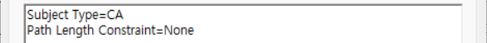
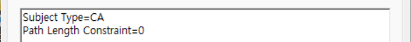
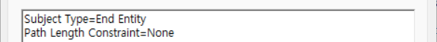
Test Suite Overview
Certificate Field Value (C1)
  Version: X.509 certificate version is either v1, v2, or v3
  Subject name: focus on the format of identity representation and the wildcard domain (illegal e.g.,∗.co.uk)
  Basic constraints: only CA certificates can have a ‘pathLenConstraint’ field Value that indicates the maximum number of subordinate CA certificates on a certificate chain
Root CA
Intermediate CA
Leaf Certificate

Slide 9
Test Suite Overview
Certificate Identity (C2)
  The website domain matches the certificate's Subject field or Subject Alternative Name extension
  Subject Alternative Name extension must contain the Subject name
  The types of values ​​covered by SAN and CN include fully qualified domain names, wildcard domain names, and IP addresses
  (Private IP addresses are not allowed)

Slide 10
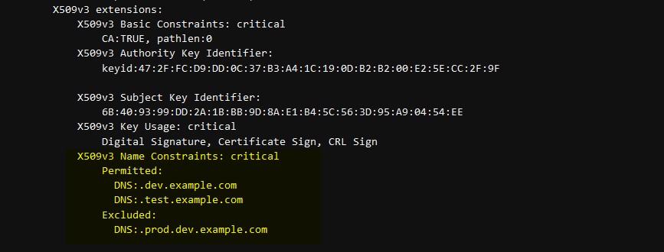
Test Suite Overview
Certificate Chain Validity (C3)
  Signature and period of validity of all certificates
  Name chaining: [Subject field…] ← [Issuer field …]
  Path length constraints: the maximum number of subordinate CA certificates following a CA certificate in the certificate chain
  Name Constraints: restrictions regarding subject namespace on any certificates sitting below that CA in the certificate chain

Slide 11
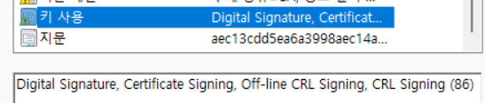
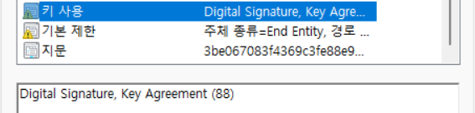
Test Suite Overview
Key Usage (C4)
  The consistency between Key Usage and Extended Key Usage
  A CA certificate can set keyUsage extension to keyCertSign to allow using the key to sign other certificates
  A leaf certificate is not permitted to do so

Slide 12
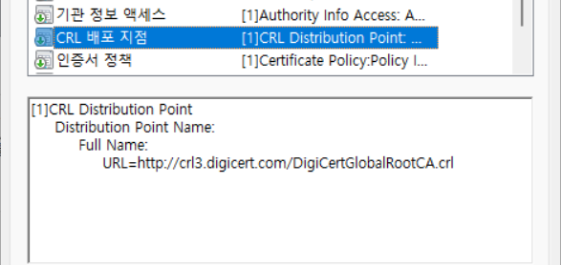
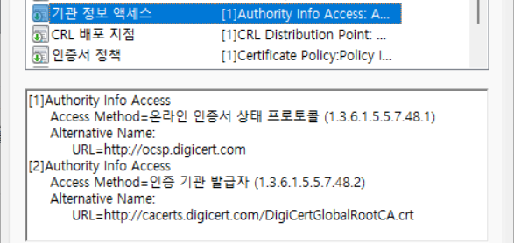
Test Suite Overview
Certificate Revocation (C5)
  Certificate Revocation List (CRL)
  Online Certificate Status Protocol (OCSP)

Slide 13
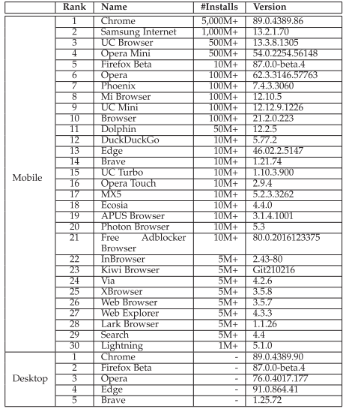
Automatic Testing of Cert Validation
Browser Dataset
  The mobile browser list
  obtained from Google Play Store
  On Android 6 and 10
  The five most popular ones
  whose mobile counterparts
  are also in browser list

Slide 14
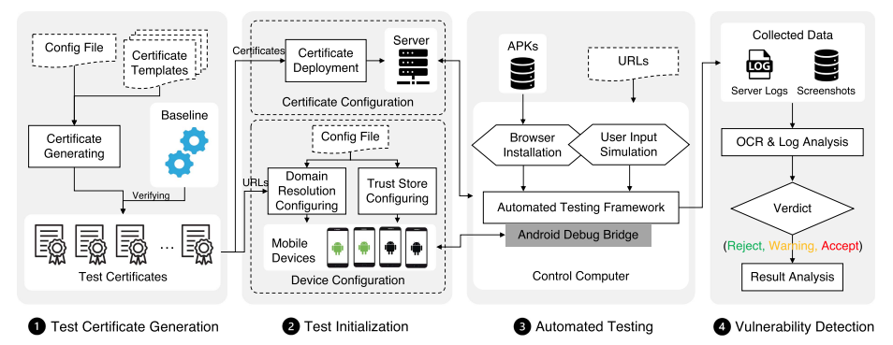
Automatic Testing of Cert Validation
Automatic Testing Pipeline

Slide 15
Analysis of Cert Validation Problem
Baseline: reject 100%
Accept / Warning / Reject:
  Mobile Android 6: 33.2% / 61.4% / 5.4%
  Mobile Android 10: 27.2% / 63.8% / 9.0%
  Desktop: 20.9% / 41.5% / 37.6%
Favoring Warning over Reject carefully
Mobile browsers becomes slightly more secure due to system updates

Slide 16
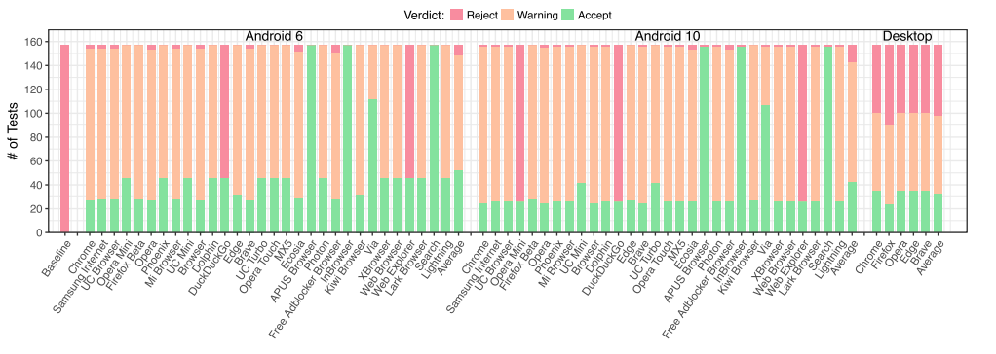
Analysis of Cert Validation Problem
Comparison of evaluation results

Slide 17
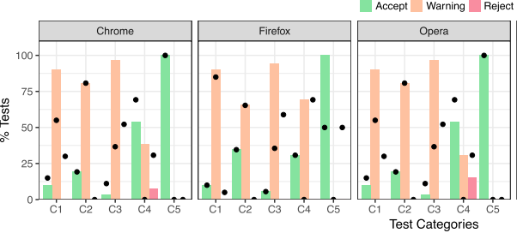
Analysis of Cert Validation Problem
Comparison of results between mobile(bars) and desktop(points) browsers
  Desktop browsers care more about the security of certificate validation

Slide 18
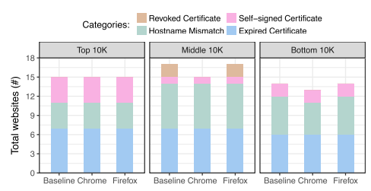
Analysis of Real-World Certificates
Distribution of problematic certificates
  Renewing expired certificates is similarly challenging for websites across all rankings
  Hostname mismatch issues are less common on high ranking websites
  * Alexa top websites by randomly choosing 10K from the top, middle, and bottom of the list, respectively

Slide 19
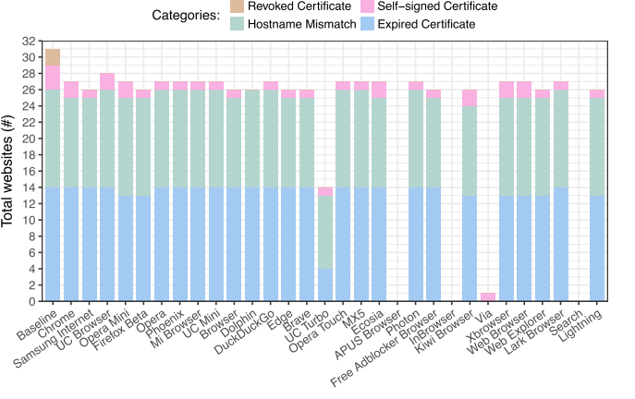
Analysis of Real-World Certificates
Behaviors of Mobile Browsers
  None of the mobile browsers can detect revoked certificates

Slide 20
Conclusion
Certificate validation plays a crucial role in establishing secure HTTPS connections
Due to the limitations of mobile platforms, it is challenging for mobile browsers to implement complete and secure certificate validation mechanisms
The evaluation reveals that desktop browsers are more secure than mobile browsers and mobile browsers can achieve significant security improvements by updating OSes

