Slide 1
On the Validation of Web X.509 Certificates by TLS Interception Products
IEEE TRANSACTIONS ON DEPENDABLE AND SECURE COMPUTING,
VOL. 19, NO. 1, JANUARY/FEBRUARY 2022
황 은 비 | Eunbee Hwang
서울대학교 컴퓨터공학부 석사 과정
인터넷 융합 및 보안 연구실 (MMLAB)

Slide 2
Table of Contents
TLS and Certificate Background
TLS Interception Products
Testing of TLS Interception Products
Subject
Key usage and extended key usage
Revocation Checking
Conclusion and Critique

Slide 3




TLS: Client - Server
Client Hello
Server Hello
Server Certificate Chain
Trusted
Root Store
Server Certificate Chain
Server
(example.com)
Client
Subject | example.com
Issuer | Intermediate CA
Signs
Subject | Intermediate CA
Issuer | Root CA
Signs
Subject | Root CA
Issuer | Root CA
Self Signed
OCSP Response for example.com
Signs

Slide 4
Certificate Validation: Certificate Content
Version: 3 (0x2)
Serial Number:
f3:c9:29:12:34:18:17:b4:12:8b:8a:31:d4:98:cc:51
Signature Algorithm: sha256WithRSAEncryption
Issuer: C=US, O=Google Trust Services, CN=WR2
Validity
Not Before: Oct 7 08:23:38 2024 GMT
Not After : Dec 30 08:23:37 2024 GMT
Subject: CN=*.google.com
Subject Public Key Info:
...
X509v3 extensions:
X509v3 Key Usage: critical
Digital Signature
X509v3 Extended Key Usage:
TLS Web Server Authentication
Authority Information Access:
OCSP - URI:http://o.pki.goog/wr2
CA Issuers - URI:http://i.pki.goog/wr2.crt
X509v3 Subject Alternative Name:
DNS:*.google.com, DNS:*.appengine.google.com, …
X509v3 CRL Distribution Points:
Full Name:
URI:http://c.pki.goog/wr2/75r4ZyA3vA0.crl
...
Signature Algorithm: sha256WithRSAEncryption
Signature Value: 0e:0d:75:66:4c:68:e9:37:...
Chain-of-Trust
Signature Validation
Validity check
Subject and Issuer
(Extended) Key Usage
And much more…

Slide 5



Standards Related to Certificates
X.509 Standard (ISO/ITU-T)
Defines certificate fields (mandatory, optional, extensions)
Extensions can be critical or non-critical
IETF PKIX (RFC 5280 and many more)
Developed an X.509 profile specifically for the Internet
Reduces complexity by defining mandatory and optional extensions
CA/Browser Forum
Established in 2007 to improve certificate issuance and management
Developed guidelines for Extended Validation (EV) certificates
Issued “Baseline Requirements”

Slide 6

TLS Interception Products
Subject | TLS Interception Product Root CA
Issuer | TLS Interception Product Root CA
Client Hello
Client Hello
Server Hello
Server Hello
Server Certificate Chain
Server Certificate Chain
Trusted
Root Store
Server
(example.com)
TLS Interception Products
Client
Subject | Intermediate CA
Issuer | Root CA
Subject | TLS Interception Product Root CA
Issuer | TLS Interception Product Root CA
Copies
Certificate Contents
Subject | example.com
Issuer | TLS Interception Product Root CA
Verified
Subject | example.com
Issuer | Intermediate CA
Revocation Checking cannot be handed over to the client
OCSP Response for example.com

Slide 7




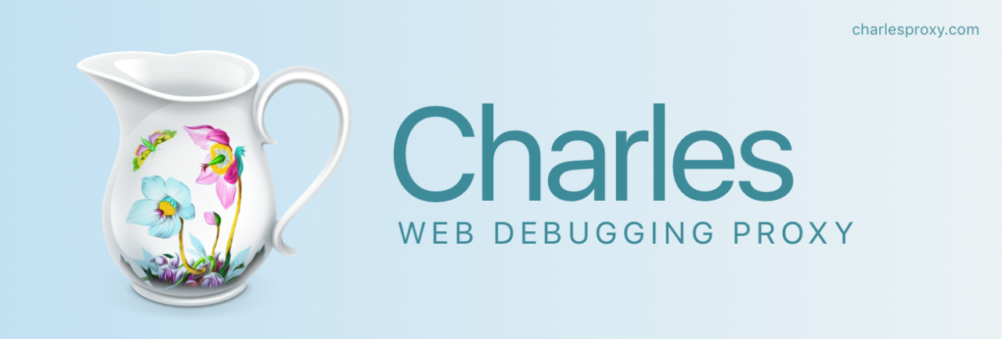



Types of TLS Interception Products
 | Certificate Validation | Revocation Checking
FV (Full Validation) | O | O
DV (Delegated Validation) | X | O
IV (Incorrect Validation) | X | X
FV
DV
IV

Slide 8
Testing TLS Interception Products
Subject Common Name (SCN), Subject Alternative Name (SAN)
4 FV products
Key Usage and Extended Key Usage extensions
4 FV products
Revocation checking
4 DV products and 3 FV products
TLS Interception Products exhibit non-standardized behaviour with respect to certificate validation and revocation checking

Slide 9
Subject Fields
Version: 3 (0x2)
Serial Number:
f3:c9:29:12:34:18:17:b4:12:8b:8a:31:d4:98:cc:51
Signature Algorithm: sha256WithRSAEncryption
Issuer: C=US, O=Google Trust Services, CN=WR2
Validity
Not Before: Oct 7 08:23:38 2024 GMT
Not After : Dec 30 08:23:37 2024 GMT
Subject: CN=*.google.com
Subject Public Key Info:
...
X509v3 extensions:
X509v3 Key Usage: critical
Digital Signature
X509v3 Extended Key Usage:
TLS Web Server Authentication
Authority Information Access:
OCSP - URI:http://o.pki.goog/wr2
CA Issuers - URI:http://i.pki.goog/wr2.crt
X509v3 Subject Alternative Name:
DNS:*.google.com, DNS:*.appengine.google.com, …
X509v3 CRL Distribution Points:
Full Name:
URI:http://c.pki.goog/wr2/75r4ZyA3vA0.crl
...
Signature Algorithm: sha256WithRSAEncryption
Signature Value: 0e:0d:75:66:4c:68:e9:37:...

Slide 10
Subject
Slightly different requirements and guidelines for CN and SAN
X.509 Standard: CN is considered as the primary entity
RFC 5280: CN and SAN can be used in combination
CA/B BR: SAN should be used
Best Practices for selecting CN and SAN
Use SAN to list all domain names and IP addresses associated with the entity.
CN can be included for compatibility, but it should mirror one of the values in SAN.
Avoid using private IPs (e.g., 192.168.*.*) in both SAN and CN for security and interoperability

Slide 11
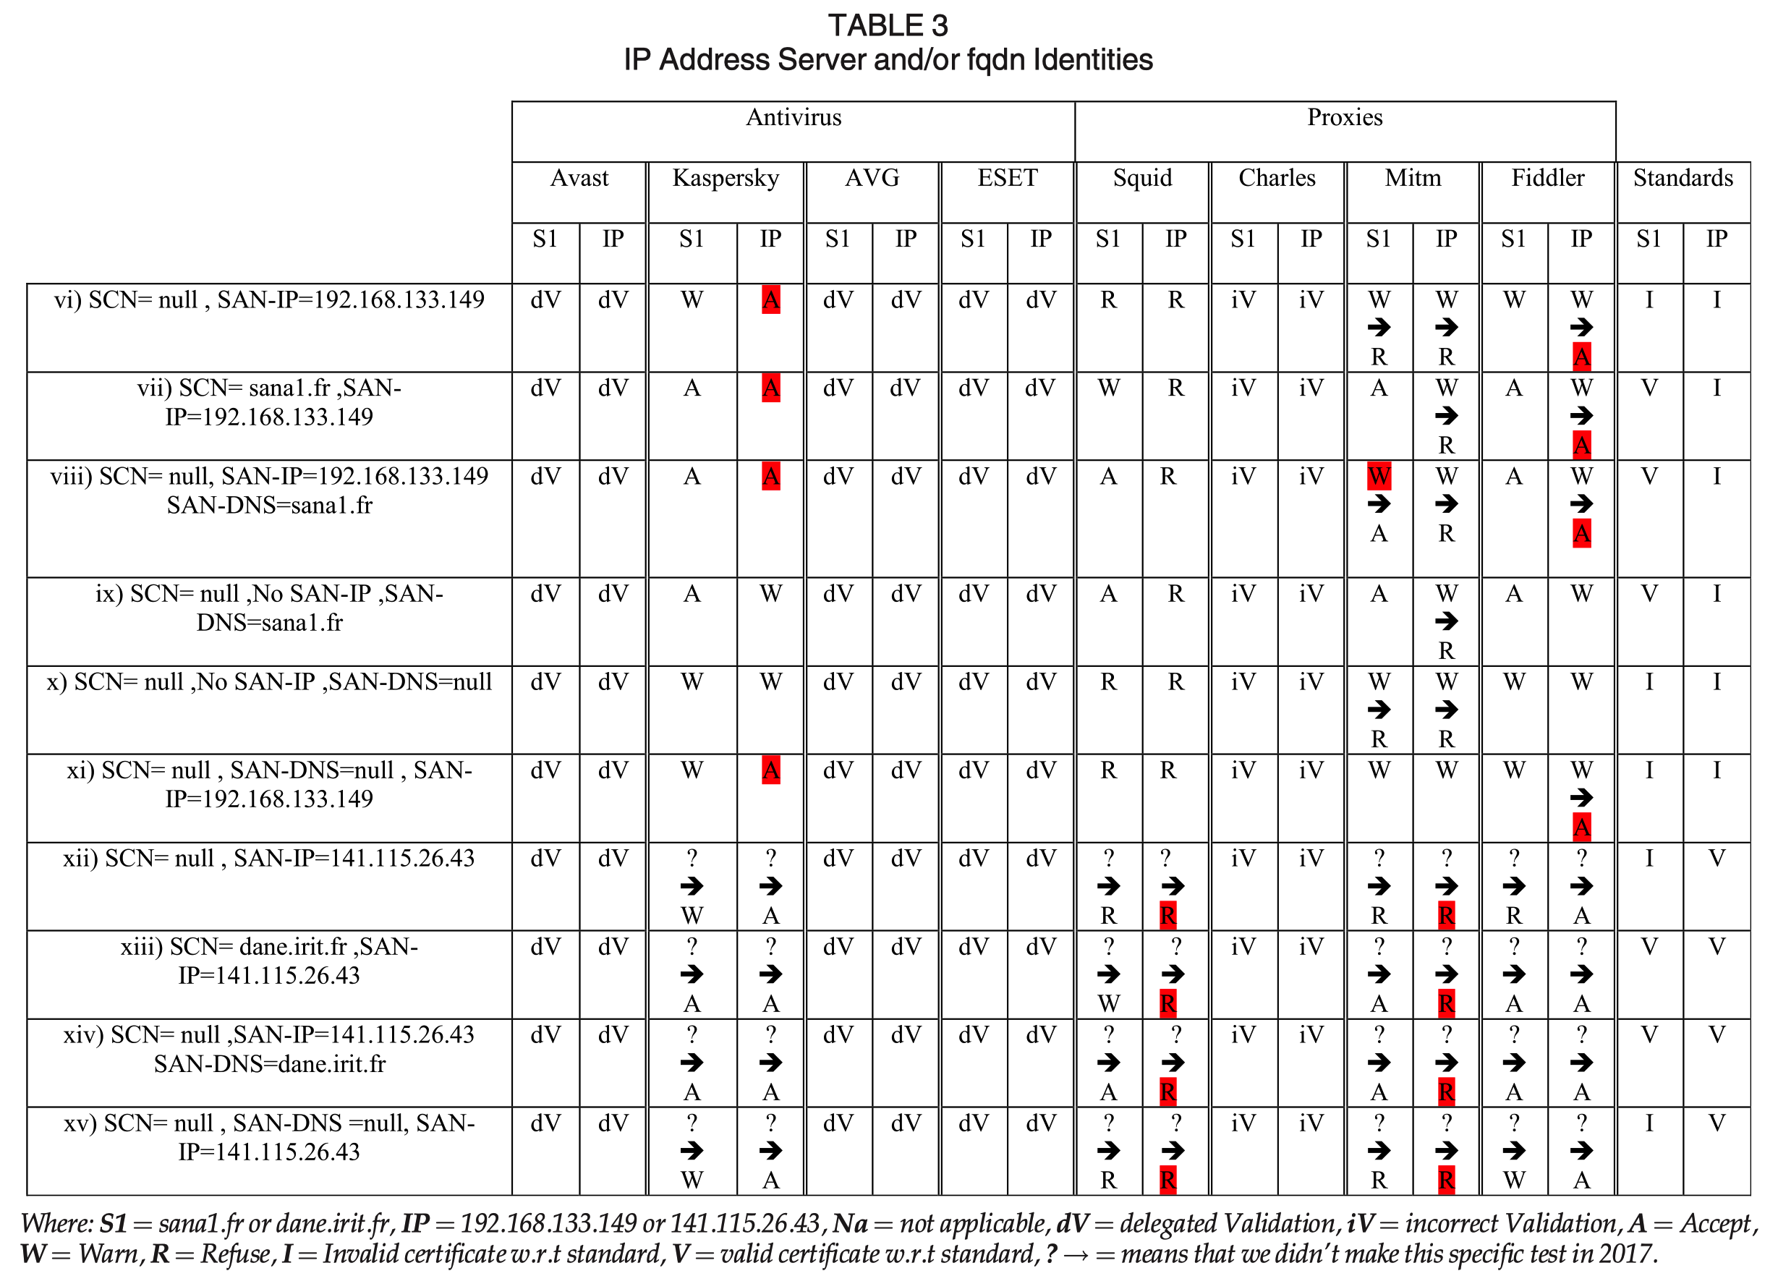
Subject Validation Test

Slide 12
Subject Validation Test: CN, SAN-DNS
.
.
.
Server Certificate Chain
Test Server
(example.com)
SCN
Ext. SAN-DNS
TLS Interception Products
3/4 FV Product Passed
Subject Common Name (SCN) | Extension Subject Alt Name (SAN-DNS) | Standards
example.com | exampler.com | X
- | exampler.com | X
example.com | - | ?
- | - | X
- | example.com / exampler.com | O

Slide 13
Subject Validation Test: CN, SAN-DNS
.
.
.
Server Certificate Chain
Test Server
(exampler.com)
SCN
Ext. SAN-DNS
TLS Interception Products
4/4 FV Product Passed
Subject Common Name (SCN) | Extension Subject Alt Name (SAN-DNS) | Standards
example.com | exampler.com | O
- | exampler.com | O
example.com | - | X
- | - | X
- | example.com / exampler.com | O

Slide 14
Subject Validation Test: CN, SAN-DNS/IP
.
.
.
Server Certificate Chain
SCN
Ext. SAN-DNS
Ext. SAN-IP
Test Server
(192.168.3.22)
TLS Interception Products
2/4 FV Product Passed
Subject Common Name (SCN) | Extension Subject Alt Name (SAN) | Extension SAN IP (SAN-IP) | Standards
- | - | 192.168.3.22 | X
example.com | - | 192.168.3.22 | X
- | example.com | 192.168.3.22 | X
- | example.com | - | X
- | - | - | X
- | - | 192.168.3.22 | X

Slide 15
Key Usage, Extended Key Usage Fields
Version: 3 (0x2)
Serial Number:
f3:c9:29:12:34:18:17:b4:12:8b:8a:31:d4:98:cc:51
Signature Algorithm: sha256WithRSAEncryption
Issuer: C=US, O=Google Trust Services, CN=WR2
Validity
Not Before: Oct 7 08:23:38 2024 GMT
Not After : Dec 30 08:23:37 2024 GMT
Subject: CN=*.google.com
Subject Public Key Info:
...
X509v3 extensions:
X509v3 Key Usage: critical
Digital Signature
X509v3 Extended Key Usage:
TLS Web Server Authentication
Authority Information Access:
OCSP - URI:http://o.pki.goog/wr2
CA Issuers - URI:http://i.pki.goog/wr2.crt
X509v3 Subject Alternative Name:
DNS:*.google.com, DNS:*.appengine.google.com, …
X509v3 CRL Distribution Points:
Full Name:
URI:http://c.pki.goog/wr2/75r4ZyA3vA0.crl
...
Signature Algorithm: sha256WithRSAEncryption
Signature Value: 0e:0d:75:66:4c:68:e9:37:...

Slide 16
Key Usage, Extended Key Usage
X.509: Key usage and extended key usage must be consistent; if not, the certificate is invalid
RFC 5280: Recommends TLS certificates with:
Key Usage: "digital signature," "key encipherment," or "key agreement."
Extended Key Usage: "Server Authentication."
Testing Method
Certificates generated with RSA algorithm.
TLS_ECDHE_RSA_* ciphersuite is selected during TLS handshake which requires ”digitalSignature” key usage
Tested TLS Interception Product’s response to mismatched key usage values

Slide 17
Key Usage, Extended Key Usage Tests
Client Hello
Server Hello
TLS_ECDHE_RSA_*
“Digital Signature”
Server Certificate Chain
Test Server
(192.168.3.22)
Ext. Key Usage
Ext. Extended Key Usage
TLS Interception Products
0/3 FV Product Passed
Key Usage | Extended Key Usage |  | Standards
Key Agreement | - | SA | X | X
Data Encipherment | - | SA | X | X
Key Encipherment | - | SA | X | X
Digital Signature | - | SA | O | O
- | Client Authentication |  | X
Digital Signature | Client Authentication |  | X

Slide 18
Revocation Checking Fields
Version: 3 (0x2)
Serial Number:
f3:c9:29:12:34:18:17:b4:12:8b:8a:31:d4:98:cc:51
Signature Algorithm: sha256WithRSAEncryption
Issuer: C=US, O=Google Trust Services, CN=WR2
Validity
Not Before: Oct 7 08:23:38 2024 GMT
Not After : Dec 30 08:23:37 2024 GMT
Subject: CN=*.google.com
Subject Public Key Info:
...
X509v3 extensions:
X509v3 Key Usage: critical
Digital Signature
X509v3 Extended Key Usage:
TLS Web Server Authentication
Authority Information Access:
OCSP - URI:http://o.pki.goog/wr2
CA Issuers - URI:http://i.pki.goog/wr2.crt
X509v3 Subject Alternative Name:
DNS:*.google.com, DNS:*.appengine.google.com, …
X509v3 CRL Distribution Points:
Full Name:
URI:http://c.pki.goog/wr2/75r4ZyA3vA0.crl
...
Signature Algorithm: sha256WithRSAEncryption
Signature Value: 0e:0d:75:66:4c:68:e9:37:...

Slide 19
Revocation Checking – CRL
A list of all certificates that a CA has revoked before their expiration
Clients are required to update/check before each HTTPS connection
출처: 2023 인터넷 보안 프로그래밍 과제. 김현수, 강상위

Slide 20
Revocation Checking – OCSP
CAs maintain simple HTTP servers called OCSP responders
OCSP responses provide real-time certificate status
출처: 2023 인터넷 보안 프로그래밍 과제. 김현수, 강상위

Slide 21
Revocation Checking – OCSP Stapling
OCSP queries introduce additional round-trip time (RTT)
Web servers obtain and cache signed OCSP responses (for up to 7 days), which are sent during the TLS handshake
출처: 2023 인터넷 보안 프로그래밍 과제. 김현수, 강상위

Slide 22
Revocation Checking
X.509 Standard
CRL Distribution Points (CDP) is recommended as non-critical for interoperability.
If critical, the certificate must not be used until revocation check is done
RFC 5280
CDP and AIA Extensions are recommended as non-critical but should be supported by CAs and applications
CA/Browser Forum and OCSP Stapling
OCSP Protocol: Required since January 2013
OCSP Stapling: For high-traffic domains, the domain owner must "staple" OCSP responses in the TLS handshake, enforced by contract or technical review

Slide 23
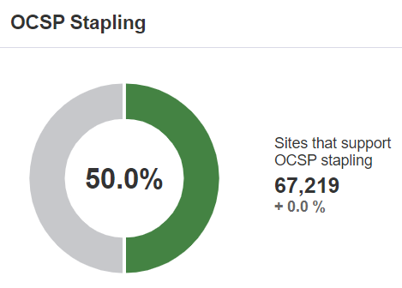
OCSP Stapling Survey
Year | OCSP Stapling | OCSP Must-Staple
2018 | 19% | 0.04%
2019 | 27% | 0%
2022* | 31% | 0%
2024** | 50% | -
Alexa Top 1M websites
Establishes a TLS connection and checks OCSP Stapling and Must-Staple extension usage
Decline in OCSP Must-Staple extension may be due to its implementation challenges
* Berbecaru, Diana Gratiela, and Antonio Lioy. "An evaluation of X. 509 certificate revocation and related privacy issues in the web PKI ecosystem." IEEE Access (2023).
** www.ssllabs.com/ssl-pulse/

Slide 24
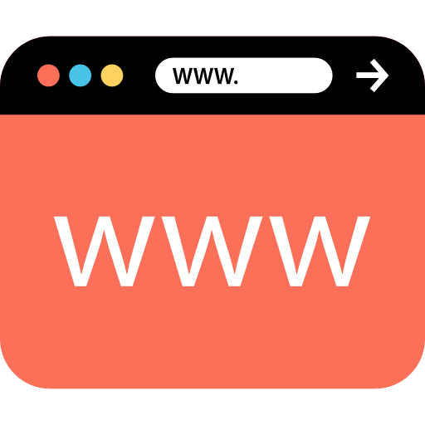





Web Browser’s Revocation Tests
.
.
.
Server Certificate Chain with Stapled OCSP Response
Test Server
Web Browsers
Stapled OCSP Response | Must-Stapled | Opera | FireFox | Chrome | IE | Edge
Good | TRUE | O | O | O | O | O
Revoked | TRUE | X | X | X | X | X
- | TRUE | O | X | O | O | O

Slide 25
Interception Products Revocation Tests
Revocation Checking Support | Avast | Kaspersky | AVG | ESET | Fiddler
CRL | O | X | O | O | X
Test: CRL Unretrievable | Accept (Soft-Fail) | - | Accept (Soft-Fail) | Accept (Soft-Fail) | -
OCSP | X | O | X | O | O
Test: OCSP Server is down | - | Accept (Soft-Fail) | - | Accept (Soft-Fail) | Accept (Soft-Fail)
OCSP Stapling | O | X | O | X | X
Test: Stapled OCSP response is revoked | Refuse | - | Refuse | - | -
OCSP Must-Stapled | X | X | X | X | X

Slide 26
Conclusion and Critique
The certificate validation performed by TLS interception products is even worse than that performed by web browsers
Compared to their 2017 study on web browsers
None of the existing revocation checking techniques work consistently or effectively today (as of 2020)
This remains true even now in 2024
Still, the usage of OCSP stapling has increased to 50%
The selection of TLS interception products is questionable
Why include the Charles proxy, an IV product, in the list of 8 products?
Shouldn’t other FV or DV products (7 in total) perform revocation checking based on their categorization? Only 5 of them do

