Slide 1
OpenVPN is
Open to VPN Fingerprinting
2022 USENIX Security Symposium
Eunbee Hwang

Slide 2
Contents
OpenVPN is Open to VPN Fingerprinting
Recent Perception of VPN
VPN Background
OpenVPN Fingerprinting
  Overview
  Phase 1: Filter
  Phase 2: Probe
Evaluation
Mitigation
Conclusion

Slide 3
Recent Perception of VPN
Introduction
VPN adoption rate has been growing rapidly to protect their privacy on untrusted networks to circumventing censorship
  In Hong Kong, VPN providers observed a 120-fold surge in VPN downloads
ISPs and governments are now seeking to track or block VPN traffic
Research question
  Can ISPs and governments identify traffic flows as OpenVPN connections in real time?
  Can they do so at-scale without incurring significant collateral damage from false positive?
VPN Traffic 인 줄 알았으나 아닌 경우

Slide 4
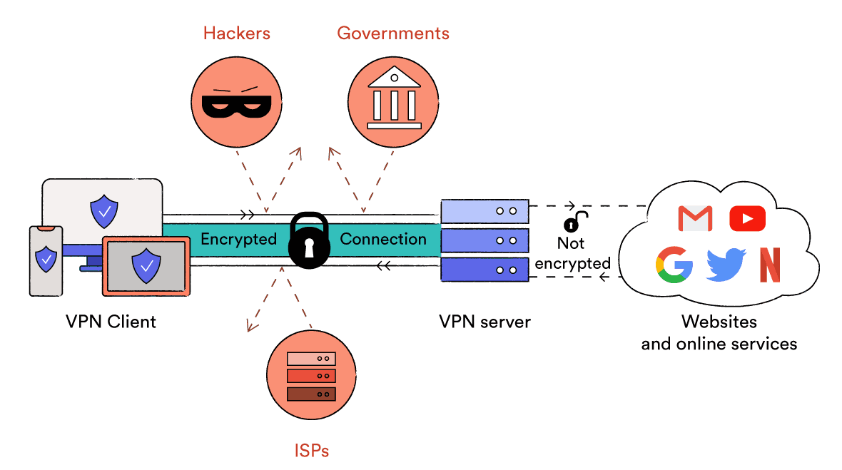
Virtual Private Network (VPN)
Background
Not protected by VPN encapsulation, can still be protected by TLS/HTTPS between VPN client and websites
VPN Protocol
VPN Protocol | Speed | Encryption | Streaming | Stability
OpenVPN (SSL) | Fast | Very Good | Good | Good
IPSec | Fast | Good | Good | Very Good
WireGuard | Very Fast | Good | Medium | Poor

Slide 5



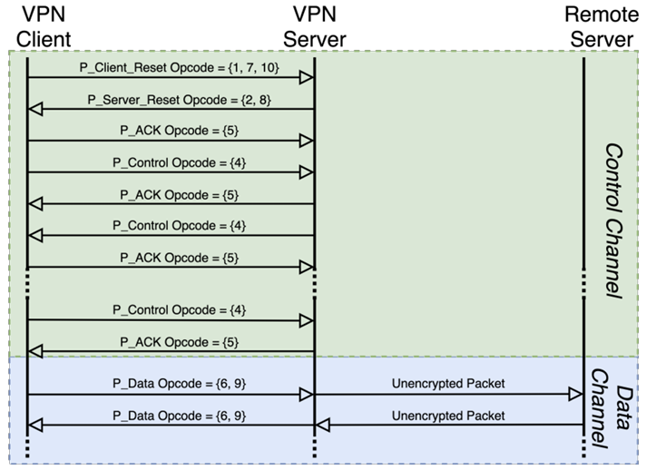
OpenVPN TCP/UDP
Background
Authentication and key exchange method
  Pre-shared static key
  TLS-based negotiation
Two communication channels during a VPN session
  Control channel: Authentication, Key negotiation, and configuration
  Data channel: Encrypts and transports packets
P_ACK to operate reliable over UDP
Majority of commercial VPN services has adopted
TCP / UDP

Slide 6
Obfuscated OpenVPN
Background
Vanilla OpenVPN is easily detected
OpenVPN with an additional obfuscation layer to avoid detection
  Due to increasing interference from ISPs and censors, obfuscated VPN services have started to gain traction
Common obfuscation strategy
OpenVPN XOR Patch
OpenVPN over Encrypted Tunnels
Proprietary Protocols
XOR patch scrambles a packet
XOR bytes with a pre-shared key
Reversing the order of the bytes
XOR each byte with its position
Wrap OpenVPN traffic inside encrypted tunnels to prevent DPI fingerprinting
Obfsproxy
Stunnel
A few VPN providers have developed proprietary obfuscated protocols
VyprVPN
Astrill
OpenVPN developers discourage its use

Slide 7
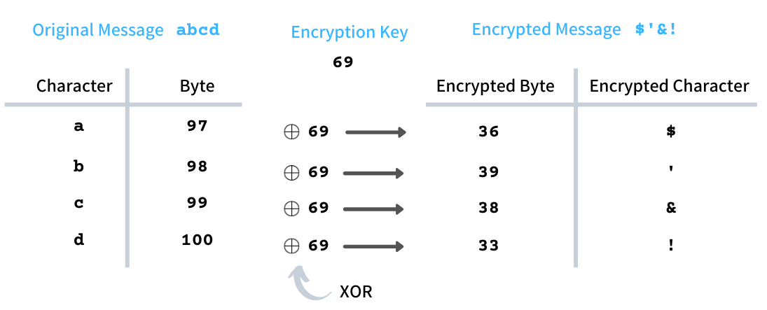
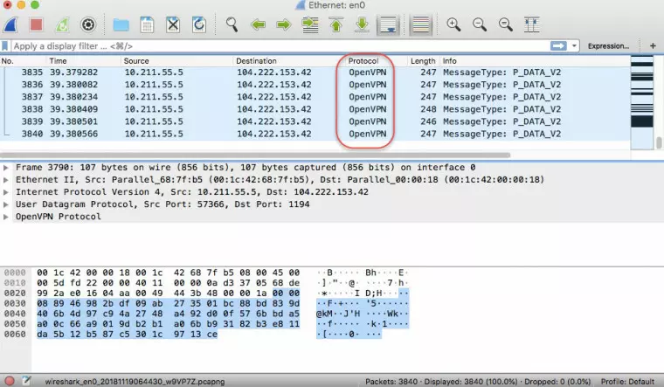
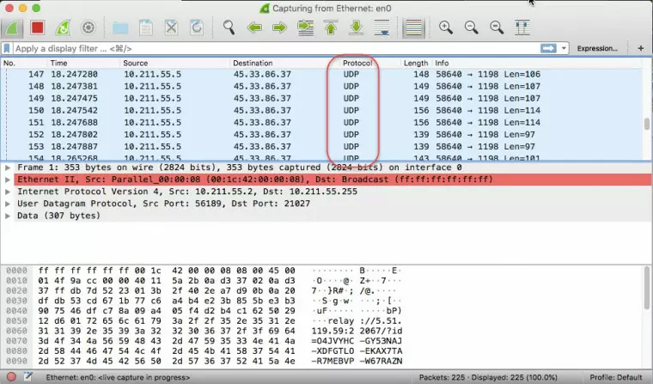
Obfuscated OpenVPN
Background
Before using obfuscated OpenVPN
After using obfuscated OpenVPN

Slide 8



OpenVPN Fingerprinting Overview
OpenVPN Fingerprinting
Server A
Hwang
Server B
Phase 1: Filter
Server C
Suspected VPN Server
1
Hwang connects to three different servers
2
VPN connections, along with passing traffic, are being mirrored to the Filter

Slide 9


OpenVPN Fingerprinting Overview
OpenVPN Fingerprinting
Server A
VPN
VPN Server found via active probing
Hwang
Server B
Phase 1: Filter
Server C
Phase 2: Probe
Suspected VPN Server
1
Hwang connects to three different servers
4
Targets are sent to each dedicated Probers
Probers send probes asynchronously
2
VPN connections, along with passing traffic, are being mirrored to the Filter
5
Filter forward server IP of suspected connections to the probing system
6
Connections confirmed by probing are logged
3

Slide 10
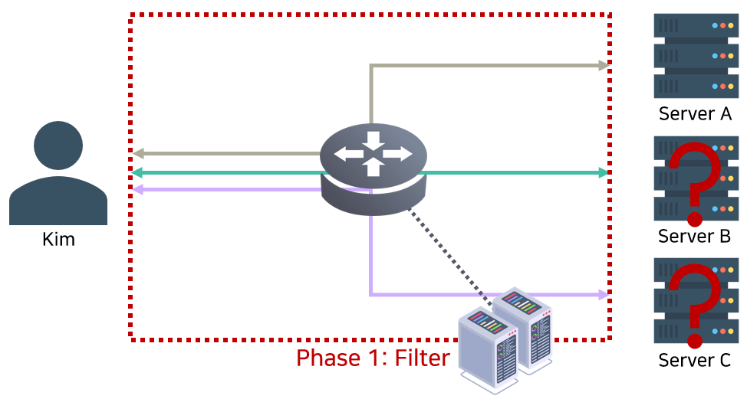
Phase 1: Filter
OpenVPN Flow Fingerprinting
Hwang
Passive fingerprinting over raw packets, exploiting traffic features of OpenVPN
  Opcode
  ACK

Slide 11
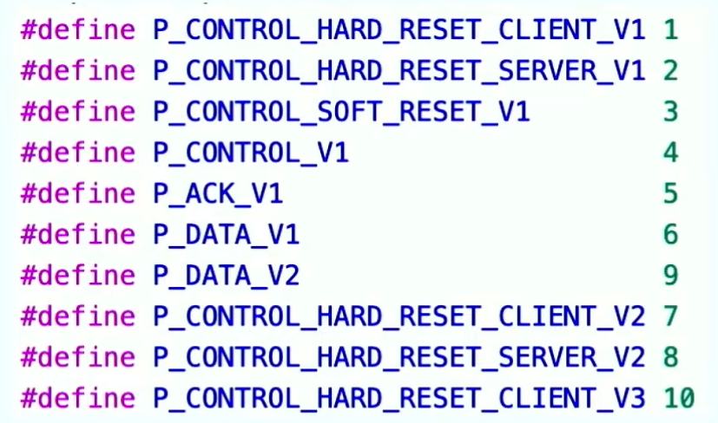
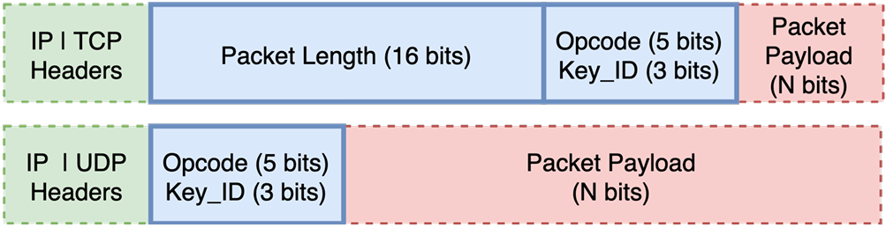
Opcode-based Fingerprinting
OpenVPN Flow Fingerprinting
Opcode specifies the message type of the current packet
  P_Control carries the TLS handshake message
A packet field with fixed set of Opcodes is easy to fingerprint

Slide 12
ACK-based Fingerprinting
OpenVPN Flow Fingerprinting
Group packets into 10-packet bins
Count the number of packets that have the same size
OpenVPN flows have a high number of ACK packets in early bins
Already 3 P_ACKs in the first few packets
OpenVPN has explicit ACK packets that provides another fingerprintable feature
  P_ACK packets are uniform in size
  P_ACK packets are seen mostly only in the early stage of a flow

Slide 13
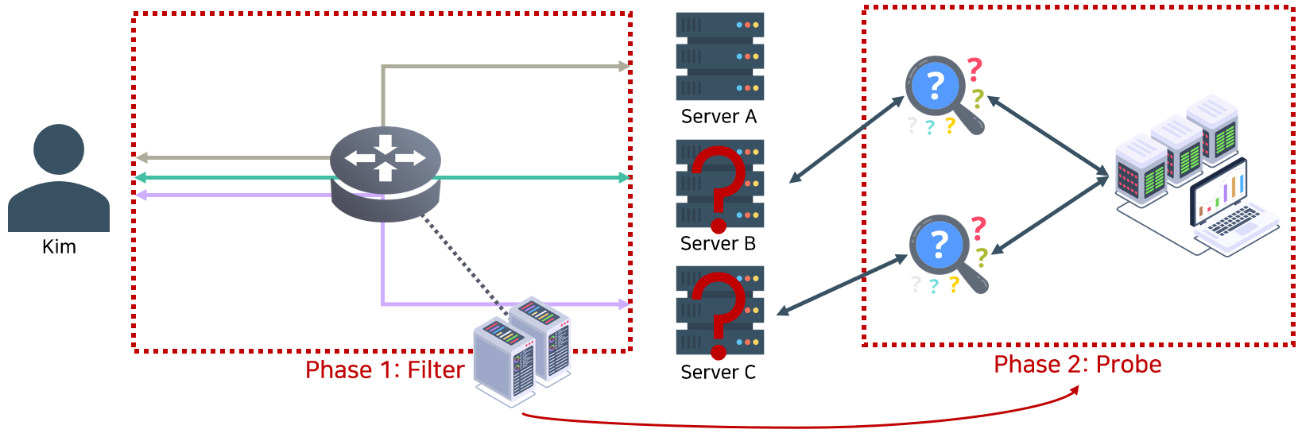
Phase 2: Probe
OpenVPN Server Fingerprinting
Hwang
Active fingerprinting over OpenVPN server

Slide 14
OpenVPN TCP Server
OpenVPN Server Fingerprinting
Typical OpenVPN Servers
OpenVPN servers respond to a Client Reset with an explicit Server Reset
  Giving away their identity
SYN
SYN + ACK
ACK
Client Reset
ACK
OpenVPN
TCP
Server Reset
ACK
Unauthorized Client
Server

Slide 15
OpenVPN TCP Server
OpenVPN Server Fingerprinting
OpenVPN
SYN
TCP
SYN + ACK
ACK
Latest OpenVPN Servers
TLS-Auth or TLS-Crypt options
  Options that add an additional HMAC signature
  OpenVPN server would not respond to an unauthenticated client reset with a Server Reset
Client Reset + Valid HMAC
ACK
Server Reset
Unauthorized Client
Server

Slide 16
OpenVPN TCP Server
OpenVPN Server Fingerprinting
OpenVPN
SYN
TCP
SYN + ACK
ACK
Latest OpenVPN Servers
TLS-Auth or TLS-Crypt options
  Options that add an additional HMAC signature
  OpenVPN server would not respond to an unauthenticated client reset with a Server Reset
Client Reset + Invalid HMAC
FIN/ACK
Unauthorized Client
Server

Slide 17
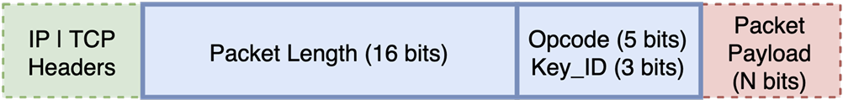
Probe #1
OpenVPN Server Fingerprinting
Client Reset + Invalid HMAC
FIN/ACK
Unauthorized Client
Short Close
Server
Packet Complete !
Invalid HMAC
Server Close
Packet Length: x00x0e (14 Byte)
Opcode & Key_ID: x38 (1 Byte)
OpenVPN Server
Packet Payload: .{8}x00x00x00x00x00 (13 Byte)
Base Probe 1 carries a typical 16-byte OpenVPN Client Reset
Server Reset / Immediate packet drop

Slide 18
Probe #2
OpenVPN Server Fingerprinting
Client Reset + Invalid HMAC
Waiting for
fragments
FIN/ACK
Unauthorized Client
Long Close
Server
Packet Incomplete …
Handshake
Timeout
Server Close
Packet Length: x00x0e (14 Byte)
Opcode & Key_ID: x38 (1 Byte)
OpenVPN Server
Packet Payload: .{8}x00x00x00x00 (12 Byte)
Base Probe 2 carries a typical 16-byte OpenVPN Client Reset with the last byte stripped off
Handshake timeout, packet drop

Slide 19
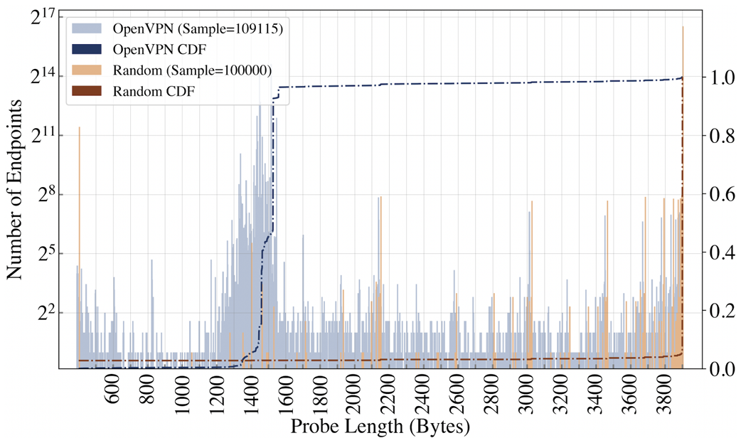
2K Random Probe
OpenVPN Server Fingerprinting
OpenVPN
RST Threshold: 1550 – 1660 Bytes
98%
Random
RST Threshold: 4000 Bytes
3%
OpenVPN validates “Packet Length” and drops connection with invalid length
  OpenVPN does not wait for the next packet to be reassembled

Slide 20
OpenVPN UDP & Obfuscated Server
OpenVPN Server Fingerprinting
TCP-based probing is not effective to
  UDP-based OpenVPN → No explicit closing mechanism, length field is non-existent
  Obfuscated OpenVPN → Length field is encrypted, cannot differentiate Probe #1 and #2
Solution?
Most VPN providers usually offer TCP servers along with UDP/Obfuscated variants
  Same host (IP), but listening on different ports
  Located in adjacent IPs in the same subnet

Slide 21
Deployment Setup
Evaluation & Findings
Two-fold evaluation
Control flow
  2,000 VPN flows generated from vanilla (no obfuscation, TCP or UDP) configurations
  2,020 obfuscated VPN flows generated
  ➔ Will their filter + probe successfully identify all 4,020 VPN flows?
All flow
  Collected 23Billion normal flows from a real-world ISP Merit
  Manually identify flagged flows in order to estimate the false positive rate

Slide 22
Results for Control VPN Flows
Evaluation & Findings
85.90%
72.67%
Vanilla VPN Flows
Obfuscated VPN Flows
Majority of OpenVPN traffic and servers are vulnerable to passive filtering and active probing
  Able to identify 1,718 out of 2,000 vanilla flows
  Able to identify 1,468 out of 2020 obfuscated flows

Slide 23
Results for All Flows
Evaluation & Findings
23 billion
75850
3638

Slide 24
Results for All Flows
Evaluation & Findings
23 billion
75850
3638
Probing outputs: 3638
  Single IP Pair (Smart Locker): 2580
  TLS Handshake: 40
  WHOIS, DNS PTR: 41
  IP Database: 124
Confirmed OpenVPN flows:3245
Unclassified flows: 384 (0.0039%)
0.0039%
99.9%
Confirmed OpenVPN Flows

Slide 25
Mitigation
Short Term Mitigation
Avoid co-locating vanilla and obfuscated OpenVPN services
Avoid static closing time
Long Term Mitigation
Adopt more standardized obfuscation solutions
Be more transparent about the techniques used by obfuscated services

Slide 26
Conclusion
Research question
  Can ISPs and governments identify traffic flows as OpenVPN connections in real time?
  Can they do so at-scale without incurring significant collateral damage from false positive?

Slide 27
Conclusion
OpenVPN, even with widely applied obfuscation techniques, can be reliably detected and blocked at-scale by network-based adversaries
OpenVPN Fingerprinting
  Phase 1: Filter (Opcode and ACK)
  Phase 2: Probe
    Base Probe #1 for typical OpenVPN server
    Base Probe #2 for latest OpenVPN server with TLS-Auth / TLS-Crypt
    2K-Random to identify OpenVPN server via packet length
0.0039% false positive rate
Adopt more resilient and better standardized obfuscation approaches

Slide 28
Thank You

