Slide 1
Post-Quantum Authentication in TLS 1.3: A Performance Study
Dimitrios Sikeridis*, Panos Kampanakis†, Michael Devetsikiotis*
*University of New Mexico, †Cisco Systems
NDSS 2020
2020. 4. 1.
Joonhee Lee
jhlee2019@mmlab.snu.ac.kr

Slide 2
Outline
Introduction
Background
Post-Quantum Signature and TLS
Evaluation
Conclusion
/ 21

Slide 3
Introduction
The two most popular digital signature algorithms
Elliptic Curve Digital Signature (ECDSA) based on the Elliptic Curve Discrete Logarithm (ECDL) problem
Rivest-Shamir-Adleman (RSA) based on the Integer Factorization (IF) problem
A large scale quantum computer (QC) has become a reality
Shor’s algorithm would solve ECDL and IF problems in polynomial time
Researching quantum-resistant public key algorithms
NIST’s Post-Quantum Cryptography project: 26 candidate algorithms
Performance was treated as a future goal
/ 21

Slide 4
Post-Quantum Algorithms and TLS
Performance issues arising from integrating PQ algorithms into TLS
Additional latency due to heavy operations
Communication overhead from increased public key and signature size
Quantum-resistant encryption for critical data is a priority
QC-equipped attacker would be able to decrypt stored communications retroactively
Early study of Post-Quantum authentication is also required
Migration to new primitives can take years (Ex. a decade for ECDSA)
Performance of PQ algorithms will impact the TLS handshake by worsening user experience
/ 21

Slide 5
Quantum-Resistant Families of Problems
Hash-based Cryptography
Merkle trees and Few- or One-Time-Signature (FTS/OTS)
Secure cryptographic hash functions
Merkle Signature Scheme (MSS), LMS, XMSS
NIST PQ signature candidate: Stateless SPHINCS+
Lattice-based Cryptography
Lattice-related NP-hard problems such as shortest vector, closest vector
Learning With Errors (LWE), RLWE, MLWR/MLWE, NTRU
NIST PQ signature candidates: Dilithium, qTesla, Falcon
/ 21

Slide 6
Quantum-Resistant Families of Problems
Multivariate Cryptography
Multivariate quadratic equations over finite fields (NP-hard)
Often lead to excessive key or signature size
NIST PQ signature candidates: Rainbow, MQDSS, LUOV, GeMSS
Zero-Knowledge Proofs
Not depending on structure hardness
Zero-knowledge proofs & symmetric key primitives (hash, block cipher)
NIST PQ signature candidate: Picnic
/ 21

Slide 7
NIST Signature Algorithm Candidates
Name | Family | Parameter Set | NIST Security Level | Implementation
SPHINCS+ | Hash-based | SHA256-128f-simple | 1 | PQClean
Dilithium II | Lattice-based | - | 1 | PQClean
Dilithium IV | Lattice-based | - | 3 | PQClean
Falcon | Lattice-based | 512 | 1 | liboqs
Falcon | Lattice-based | 1024 | 5 | liboqs
Picnic | ZKP | L1FS | 1 | OQS OpenSSL
MQDSS | Multivariate | MQDSSS-31-48 | 1 | liboqs
Rainbow | Multivariate | Ia-Cyclic | 1 | PQClean
qTesla, GeMSS: Too large public key size to be used in a TLS handshake
LUOV: A new attack was presented
/ 21

Slide 8
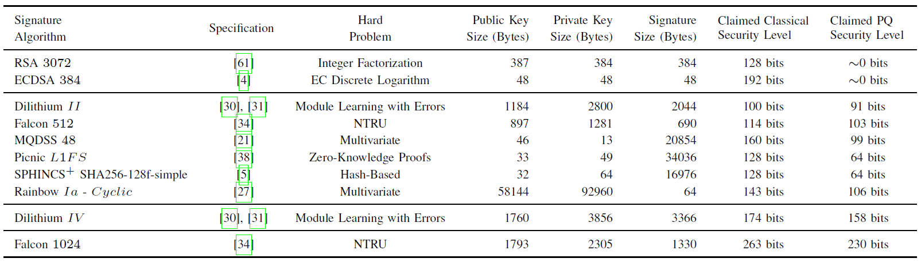
Conventional & Post-Quantum Algorithms
Algorithms with Parameter Sets used in this study
/ 21

Slide 9


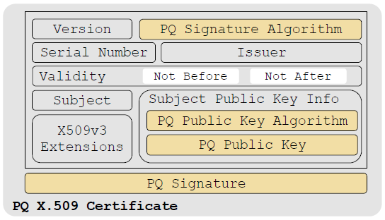
Integration of PQ Authentication into TLS
OQS (Open Quantum Safe) OpenSSL Library
A fork of OpenSSL + PQ algorithms from liboqs
Based on OpenSSL 1.1.1c
Migrating to PQ authentication
PQ public key and PQ signature are added to the X.509 certificate format
Size of certificate (and certificate chain) will increase
/ 21

Slide 10
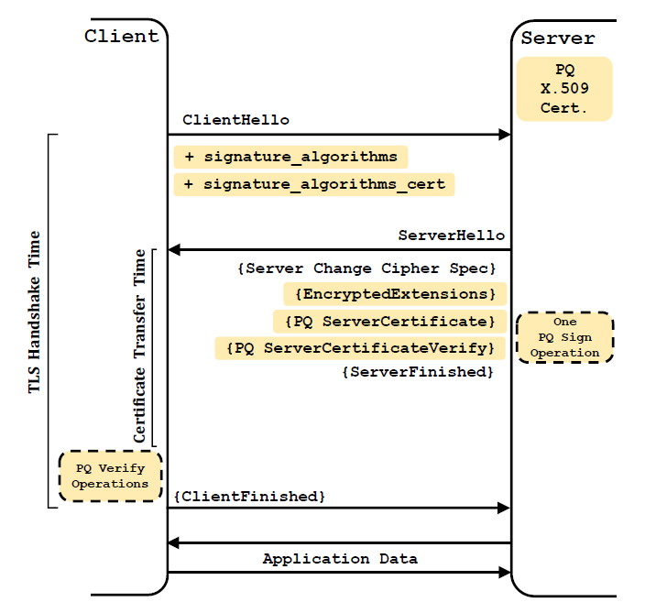
Post-Quantum TLS 1.3 Handshake
ClientHello
Desired PQ algorithms by extensions
Server Certificate
PQ X.509 certificate/chain
Server CertificateVerify
PQ signature
Server Finished
PQ signature is verified by the client
/ 21

Slide 11
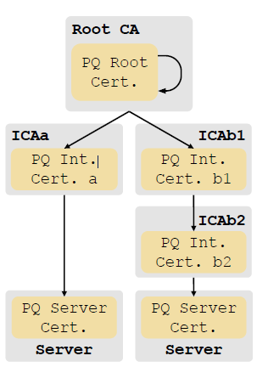
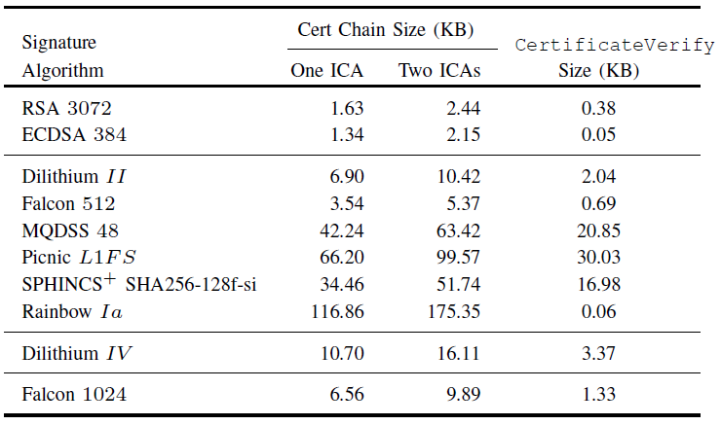
Experiment Setup
Certificate Chain
One or two Intermediate CA (ICA): 77% of the Internet
Chain size: 3 to 175 KB
Out of scope
Cert validation: CRL, OCSP
SCT checking
Extensions
Location
North Carolina (Client) ↔ North Virginia (Server)
/ 21

Slide 12
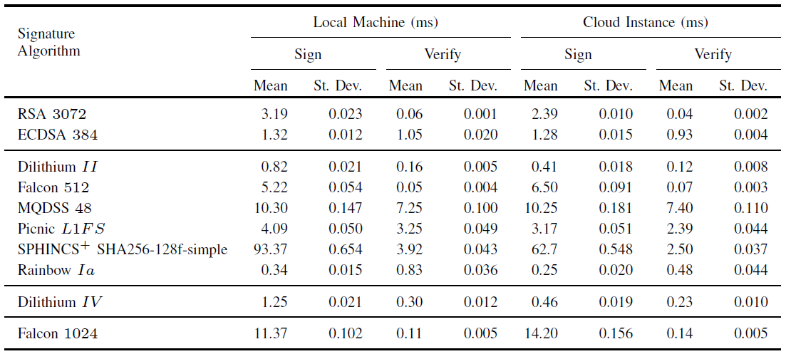
Speed of Cryptographic Operations
Available optimization by hardware acceleration
Optimized version can make signing and verification greatly faster
Certificate and signature size will be the bottleneck of PQ authentication
/ 21

Slide 13
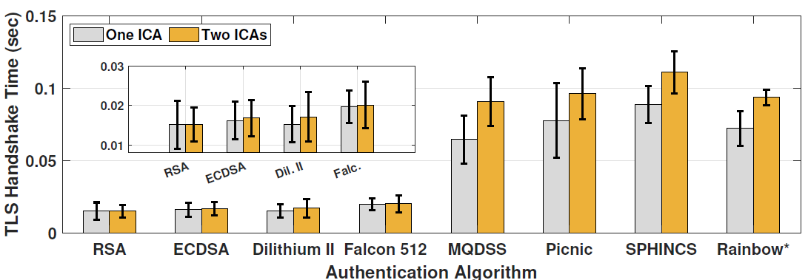
NIST Security Level 1 Algorithms
Average TLS handshake time over 1,000 attempts
Conventional and NIST security level 1 algorithms
Rainbow: excessive message size error
Certificate public key size
Client issued an SSL Alert
* denotes partial handshake (without ClientFinish message)
/ 21

Slide 14
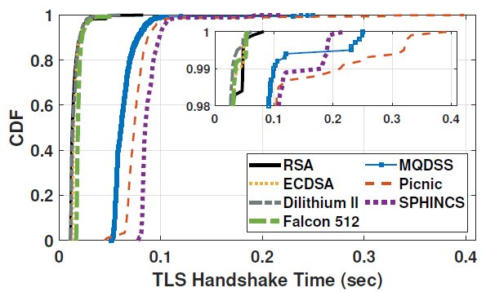
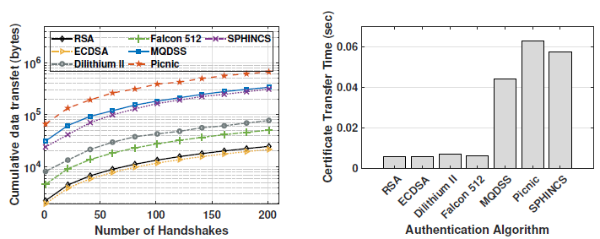
NIST Security Level 1 Algorithms (Cont.)
Cumulative Density Function (CDF) Graph
Long tails: Due to the network transmission path
Large certificates and slow operations significantly reduce the authentication performance (MQDSS, Picnic, SPHINCS)
Certificate & Signature Transmission
Bigger public keys and signatures lead to longer time to transfer
Dilithium, Falcon: ~ 5 ms
Others: 35 ~ 55 ms
/ 21

Slide 15
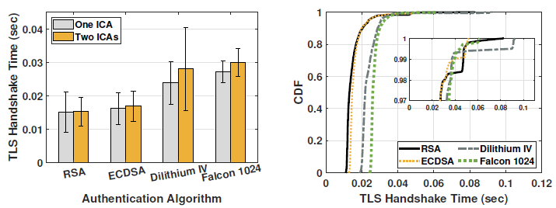
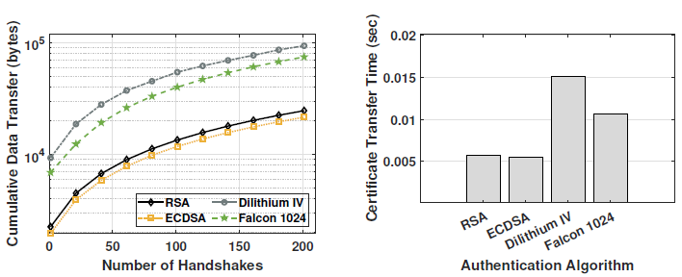
NIST Security Level 3 & 5 Algorithms
Higher security level algorithms
Significantly larger public keys and signatures
Message size exceeded the TCP initcwnd
Extra round-trip(s)
Two algorithms are examined
Most promising results at Level 1
Dilithium IV (Level 3), Falcon 1024 (Level 5)
Added handshake latency: 10~15 ms
Dilithium IV certificate size triggers an extra round-trip
/ 21

Slide 16
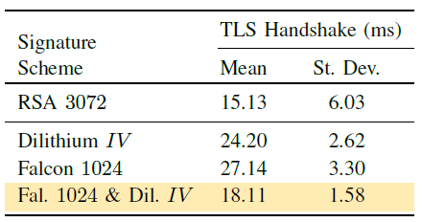
Combination of PQ Signature Algorithms
Use different algorithms along the certificate chain
Dilithium IV: Signing is fast, but public key is big
Falcon 1024: Public key is small, but signing is slow
Root CA & ICA: Falcon 1024 public key and signature
Server cert: Dilithium IV public key and ICA’s Falcon 1024 signature
Handshake CertificateVerify message: Dilithium IV signature
Client is required to support both algorithms
Combined case results
25~33% improvements in handshake time
/ 21

Slide 17
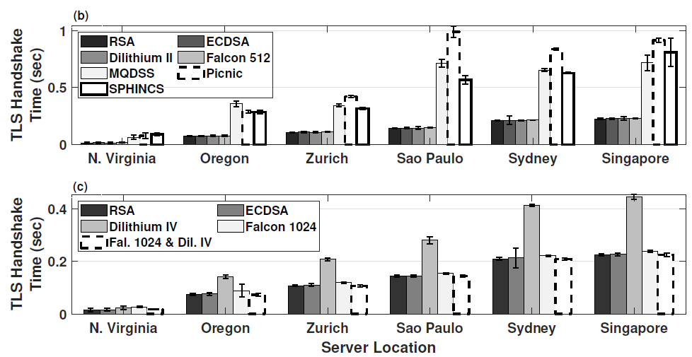
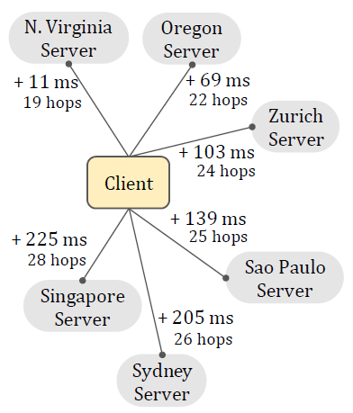
Global Scale Analysis
/ 21

Slide 18
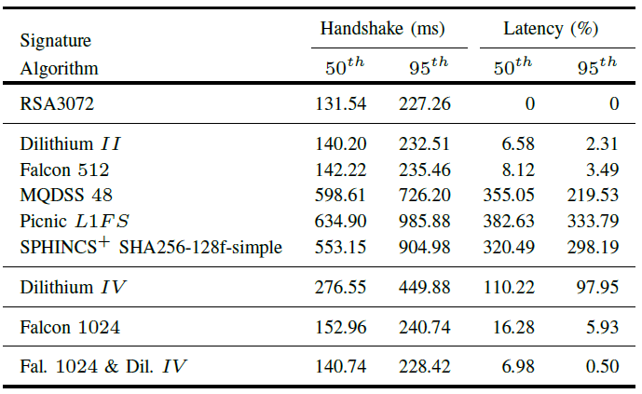
Global Scale Analysis (Cont.)
Uniformly performed 3,000 handshakes in the course of a whole day
Measuring handshake latency in diverse topologies across longer time-frames
Analysis result
Level 1: Dilithium II and Falcon 512 showed small overhead
Level 3/5: Dilithium IV nearly doubled the handshake time (data size triggered an extra round-trip)
Dilithium+Falcon combination reduced the latency by 8~50%
/ 21

Slide 19
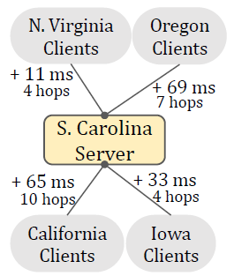
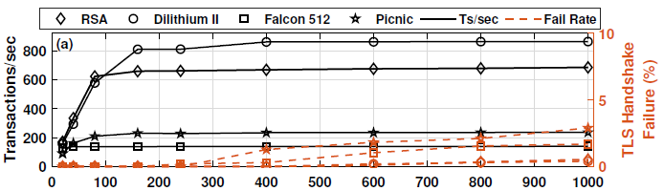
Server-Side Performance
Experiment Setup
Nginx web server with OQL OpenSSL library
4 clients placed in close proximity to each other
Attempting simultaneous TLS connections for 60 seconds
Results of Level 1 Algorithms
Dilithium II allows 25% more connections than RSA 3072 during the server saturated
Picnic L1FS outperforms Falcon 512 despite of much bigger certificate size
Depends on the sign operation performance
/ 21

Slide 20
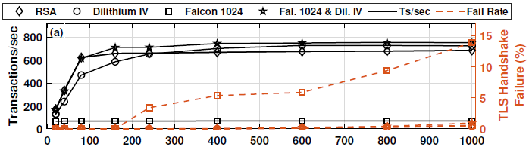
Server-Side Performance (Cont.)
Results of Higher Level Algorithms
Falcon 1024: Saturated early, high failure rate – due to slow signing
Dilithium IV is better than RSA 3072 and Falcon 1024
Dilithium+Falcon combination is the best: Computationally lighter signing
/ 21

Slide 21
Conclusion & Future Work
Performance Comparison of NIST Post-Quantum Project algorithms
Large-scale TLS handshake measurement
Analyzing the impact of larger certificates or slower sign/verify operations
Viability of two PQ candidate signature algorithms: Dilithium, Falcon
Use of different PQ signature scheme combinations in the same cert chain
Discussion of PQ authentication challenges & optimization
Future Work
Evaluating PQ authenticated VPNs, QUIC, DTLS
Testing PQ Key Encapsulation Methods (KEMs) along with PQ signatures
Quantifying the impact on TLS under realistic conditions
/ 21

