Slide 1
Post-Quantum TLS on Embedded Systems
(Integrating and Evaluating Kyber and SPHINCS⁺ with mbed TLS)
Published in: ASIA CCS '20
Summarized by
Sangwon Lim (sangwonlim@snu.ac.kr)
2024-08-27

Slide 2
Contents
Introduction
Background
Integration of PQC into the mbed TLS
Target Platform
Evaluation
Conclusion

Slide 3
Introduction
The interest in post-quantum cryptography (PQC) has been increasing, not only in academia, but also in industry
In our modern world, security needs to be integrated into small embedded devices that surround us in our daily live
It is not easy to replace cryptographic algorithms in productive systems, and software (and cryptographic) updates of embedded devices are even harder to install

Slide 4
Introduction
It is required to invest in research for migrating IT systems to post-quantum primitives, especially on embedded systems
In this work, the authors combine all three fields — PQC, TLS, and embedded devices
They enable an embedded TLS library (mbed TLS) with post-quantum key exchange and post-quantum digital signatures

Slide 5

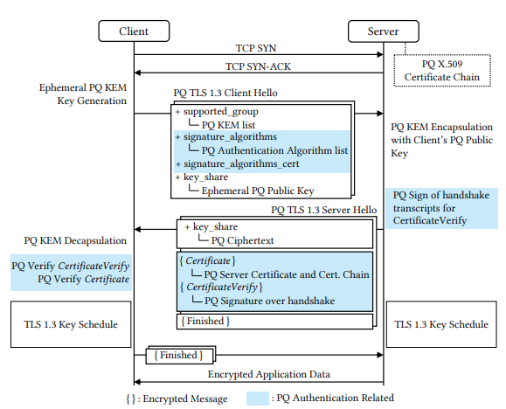
Background
from external articles
TLS 1.3 is independent of
concrete (1) Key Agreements
or (2) Signature Algorithms
What's changing in PQ-TLS
  (1) ephemeral key exchange
  (2) authentication

Slide 6
Background
TLS Libraries
  OpenSSL, LibreSSL, mbed TLS, and wolfSSL
Suitable for embedded systems
  mbed TLS, and wolfSSL
No problem with the license
  mbed TLS
The authors chose mbed TLS for their implementation

Slide 7
Background
Currently popular asymmetric algorithms based on
  the integer factorization problem (e.g., RSA)
  the discrete logarithm problem (e.g., DH)
  the elliptic-curve discrete logarithm problem (e.g., ECDH)
PQC schemes
  Code-based, lattice-based, hash-based, multivariate, and supersingular elliptic-curve isogeny cryptography

Slide 8
Background
The authors chose PQC schemes for the evaluation
  Lattice-based Kyber for key exchange scheme
  Hash-based SPHINCS⁺ as signature scheme
  Promising on embedded devices
Security parameter sets for the PQC schemes
  NIST security level 1 corresponding to AES-128
  In order to achieve a fairer comparison with classical schemes at 128-bit (classical) security

Slide 9
Background
from external articles
Post-Quantum Cryptography PQC Selected Algorithms 2022¹⁾
  Key Agreement Algorithms (KAs)
    CRYSTALS-KYBER
  Digital Signature Algorithms (SAs)
    CRYSTALS-DILITHIUM
    FALCON
    SPHINCS⁺
1) Post-Quantum Cryptography PQC Selected Algorithms 2022 - https://csrc.nist.gov/Projects/post-quantum-cryptography/selected-algorithms-2022

Slide 10
Integration of PQC into the mbed TLS
Cryptographic Primitives
  Kyber
  SPHINCS⁺
TLS Protocol
  Cipher Suites
  Certificates
  Handshake Fragmentation

Slide 11
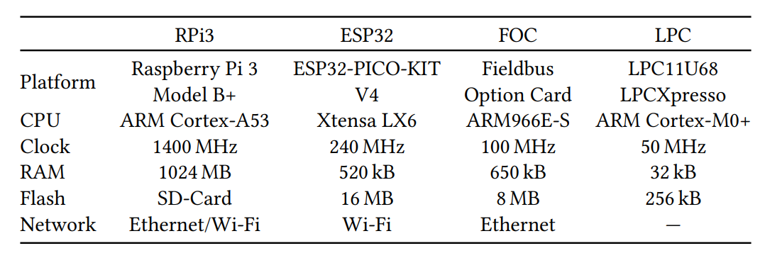
Target Platform
Processor and peripheral specifications of the evaluated platforms
1)
2)
1)
  The mbed TLS provides highly optimized assembler code for ARM platforms
  The ESP32 has hardware acceleration for RSA, ECC, AES, and SHA

Slide 12
Evaluation
A desktop PC performs the remote role of client or server depending on the use case
  The desktop PC with Windows 10 64-bit and an Intel Xeon E3-1231v3 running on 3.40 GHz with 16 GB RAM
The measurements do not include network round-trip time, response time of the remote machine, and network-stack overhead but only the time of the handshake routines and the cryptographic primitives

Slide 13
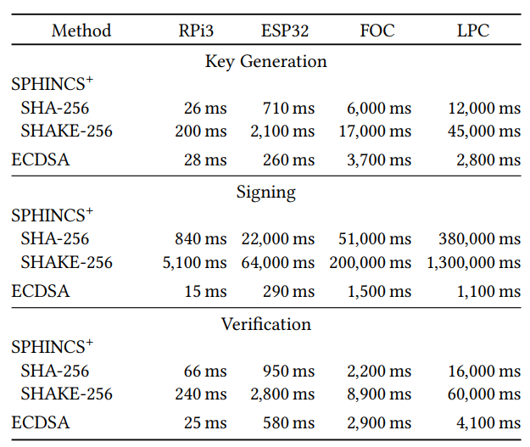
Evaluation – the Cryptographic Primitives
Runtime of SPHINCS⁺ (SPHINCS⁺ -128f) and ECDSA (SECP256R1) operations (rounded to two significant figures)
Not Include in the handshake
Typically used by the server
Typically used by the client

Slide 14
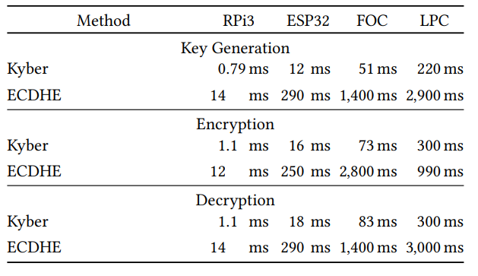
Evaluation – the Cryptographic Primitives
Runtime of Kyber (Kyber512) and ECDHE (SECP256R1) operations
Kyber performance better on every platform

Slide 15
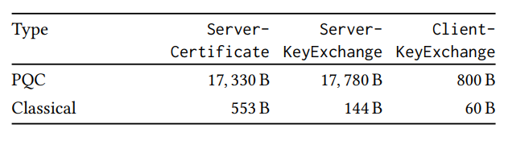
Evaluation – the TLS Handshake
Comparison of handshake message sizes between the classical and the post-quantum cipher suite
Due to large size of SPHINCS⁺ Signature and public key

Slide 16
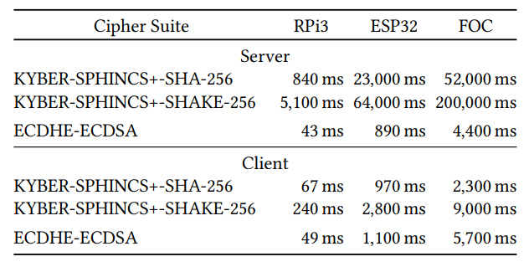
Evaluation – the TLS Handshake
Comparison of handshake runtime for different cipher suites
  Crypto only, not the network stack and network response times
the performance of the PQC-TLS client is similar for the PQC variant as for the ECC variant

Slide 17
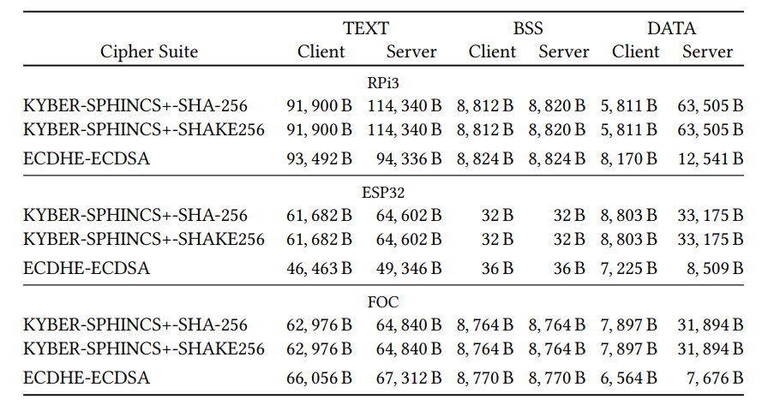
Evaluation – code size
Code sizes of client and server (include the parts of the mbed TLS library that are actually used)
the client code sizes per platform are quite equal for FOC and Raspberry Pi
the ESP32 uses its hardware accelerator for big number operations, which saves some code size for the classical handshake
TEXT: contains the executable instructions and constant values
BSS: contains uninitialized static variables
DATA: holds initialized static variables

Slide 18
Evaluation – RAM Usage
The full TLS handshake can be performed with a stack peak of only about 20kB
  Most notable allocations are the incoming and outgoing message buffers as well as a temporary buffer for the handshake fragmentation
  A single self-signed X509 certificate with a SPHINCS⁺ signature and public key is about 17kB big
  A Kyber key exchange data with a SPHINCS⁺ signature have a size of about 17.8kB
  From these values, a safe message buffer size of 20kB can be derived

Slide 19
Conclusion
The authors evaluated the performance of
  the PQC primitives on four embedded platforms, a Raspberry Pi, an ESP32, a fieldbus option card, and LPC
  a PQC-TLS variant using Kyber and SPHINCS⁺ on three embedded platforms
The authors compared the performance to
  classical TLS with corresponding ECC primitives (ECDHE, ECDSA)

Slide 20
Conclusion
Kyber performs on all platforms better than the ECDHE key exchange
SPHINCS⁺ is in general slower than ECDSA
  Especially signing takes significantly longer using SPHINCS⁺
The size of all related handshake messages increases significantly in particular if SPHINCS⁺ signatures need to be transmitted
The code and RAM size of the integration of PQC schemes on embedded devices showed that it is feasible with relatively low overhead
The cost of computing signatures with SPHINCS⁺ poses the biggest obstacle for using the selected embedded platforms as a TLS server. However, the performance of the PQC-TLS client is similar for the PQC variant as for the ECC variant

Slide 21
Conclusion
Thus, even without dedicated hardware acceleration, PQC can be used in embed TLS as of today in scenarios where the embedded device has the role of the TLS client

Slide 22
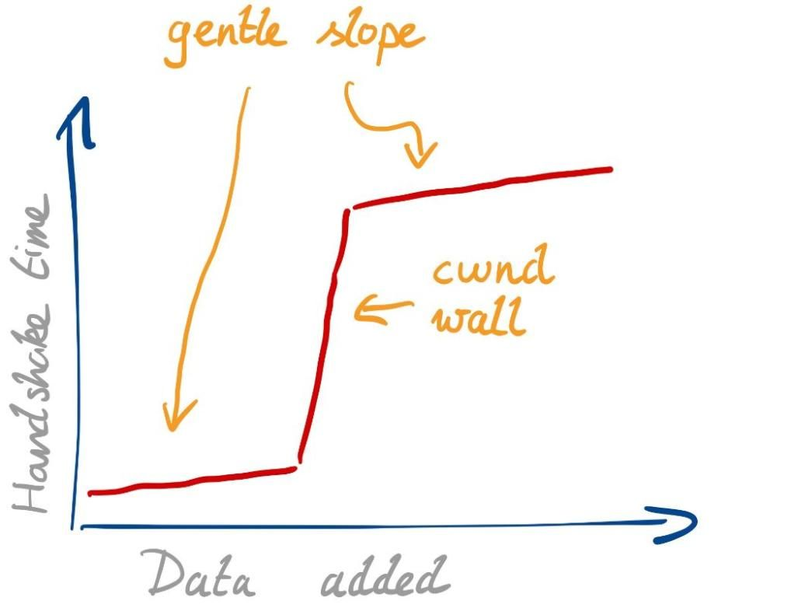
Appendix
from external articles
Because of the TCP congestion window, PQ TLS can suffer from poor handshake performance with large SERVER_HELLO
TCP initial window (initcwnd) = 10

