Slide 1
End-Users Get Maneuvered: Empirical Analysis of Redirection Hijacking in Content Delivery Networks
Shuai Hao, Yubao Zhang, Haining Wang, Angelos Stavrou
USENIX Security 2018
2020. 1. 9.
Joonhee Lee
jhlee2019@mmlab.snu.ac.kr

Slide 2
Outline
Background
Threat Model
Attack Assessment
Countermeasures
Conclusion
/ 29

Slide 3
Background

Slide 4


Content Delivery Networks (CDNs)
CDNs are delivering a large fraction of the Internet content to end-users with high availability, performance, and scalability
  Large number of edge servers (surrogates)
  Content caching
  Proximal access for end-users
User requests are served at the “edge” via request redirection
  Improving user-perceived performance
  Balancing the load across server clusters
  Protecting against distributed denial-of-service (DDoS) attacks
/ 29

Slide 5


CDN Mapping System
DNS-based Mapping
Anycast Routing
img.a.com?
a.com
Name Server
Content
Request
img.a.com?
CDN’s NS
Local
DNS
CDN
Edge Server
img.a.com?
Cached
Content
Edge’s IP
CDN
Name Server
Mapping
Algorithm
User
Edge’s IP
Far CDN
Edge Server
(Anycast IP)
BGP
Request to
Anycast IP
img.a.com?
Local
DNS
Anycast IP
User
Request
Near CDN
Edge Server
(Anycast IP)
/ 29

Slide 6
EDNS Client Subnet (ECS)
Inaccurate DNS-based Mapping
  Poor location proximity between clients and their local DNSes
  Increasing usage of public DNS services such as Google Public DNS
EDNS-Client-Subnet (ECS) extension
  The network prefix of a client’s IP address is included in a DNS query
  The DNS-based mapping system uses the direct knowledge of a client’s location rather than its LDNS
Header
Query
Answer
Authoritative
Additional Section
ENDS0 OPTRR
ECS (x.x.x.x/n)
DNS Message
/ 29

Slide 7

DNS Record Injection Attack
DNS Record Injection Attack (DNS Cache Poisoning Attack)
  Adversaries trick a resolver to accept fraudulent DNS records as legitimate responses from authoritative nameservers
Challenge-Response defenses
  A resolver can validate the legitimacy of received responses via the randomized transaction IDs within requests
  Not effective because of insufficient adoptions and deployment
  Man-In-The-Middle attacker still able to construct a forged DNS response
Resolver
DNS query + Random txID
DNS answer + txID
DNS answer + txID
Name Server
Attacker
/ 29

Slide 8
DNSSEC and Zone Enumeration Attack
DNSSEC (DNS SECurity Extensions)
  Securing the process of DNS resolution, especially against the MITM attack
  Each resource record (RR) set is signed and verified by public key cryptography
Zone Enumeration Attack
  DNSSEC Next-SECure (NSEC) record links the next lexicographic name in the zone for authenticated denial of existence
  Zone Enumeration Attack: adversaries can learn all of the subdomains
  NSEC3/5: Cryptographically hashed name rather than the real domain name
  ECDSA Live Signing: Generating on-demand signature (RRSIG) with reduced computational overhead
/ 29

Slide 9
Threat Model

Slide 10
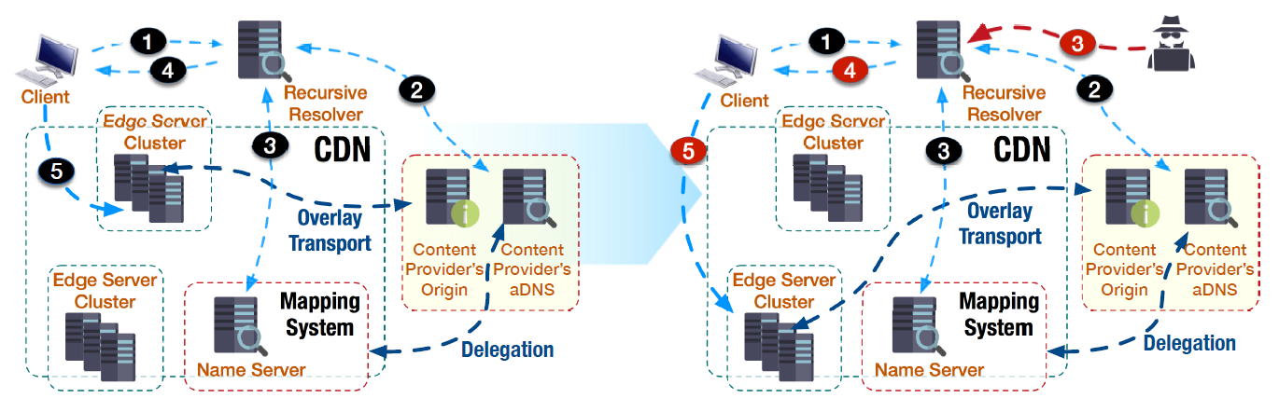
Redirection Hijacking Attack
An adversary can inject crafted but legitimate records into a recursive DNS resolver to manipulate dynamic mapping inside CDNs
/ 29

Slide 11
How to Inject a DNS Record
More than 92% of current DNS platforms are still vulnerable to record injection
  Off-path adversary: Using insufficient randomization or vulnerable implementations to bypass the challenge-response mechanism
  MITM attacker: sniffing random parameters
  Directly injecting legitimate records into DNS caches
DNSSEC is vulnerable to replay attacks
  Validity period of a DNSSEC signature should be long enough to avoid query load peaks (ECDSA-based: 2 days, RSA-based: 1 month)
  Validation of the DNSSEC signature cannot detect whether a message forwarded or replayed
/ 29

Slide 12
Detailed Attack Model
A
A’
DNS
Cache
RRSIG
RRSIG’
DNSKEY
DNSKEY’
a.com
Name Server
Near
CDN
Edge Server
img.a.com?
img.a.com?
Local
DNS
CNAME
A’
img.a.com.cdn?
User
A
RRSIG
CDN
Name Server
with DNSSEC
DNSKEY
Maneuvered
Request
A’
RRSIG’
DNSKEY’
img.a.com.cdn?
DNSKEY’
RRSIG’
Far
CDN
Edge Server
A’
DoS Attack
Attacker
/ 29

Slide 13
Attack Assessment

Slide 14
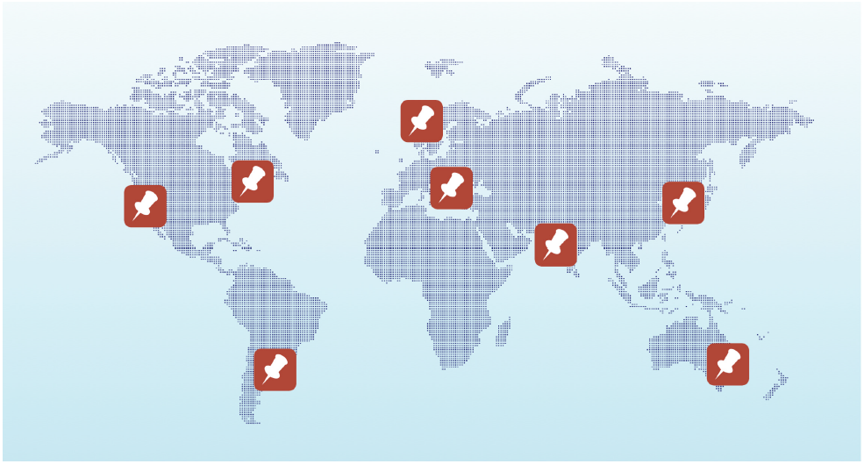
CDN Characterization Measurement
Content delivery pattern investigation
  Search official documents to learn the details of content delivery mechanisms
  Verify it by studying resolution results from distributed vantage points
  Crosscheck with publicly available passive DNS databases
Example case
  Anycast routing: Identical “A” RRset should be fetched from different locations
  DNS-based mapping: Diverse “A” RRsets are observed
/ 29

Slide 15
Two Steps of Request Routing in CDNs
Domain Delegation
  CNAME Redirection: Pointing the domain provisioned by CDN via CNAME
  NS Hosting: Designating CDN-provided nameservers in the NS records
Surrogate Selection
  DNS-based Mapping with or without ECS support
  Anycast Routing
  Hybrid Type: Leveraging both methods
/ 29

Slide 16
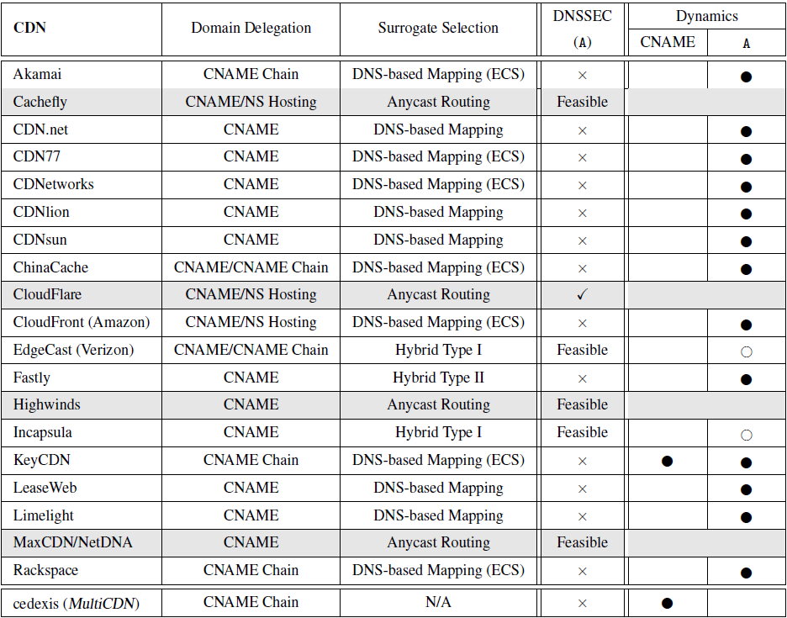
CDN Characterization Overview
  DNSSEC (A)
    √: Providing DNSSEC signing
    Feasible: Capable to secure non-dynamic records with DNSSEC
    x: Vulnerable to replay attacks
  Dynamics
    ●: Resulting serious damage
    ○: Limited forms of dynamic vulnerability
/ 29

Slide 17
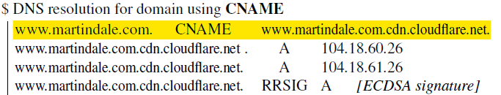
Case Studies (1/3)
End-User Mapping: Akamai
  CNAME chain and DNS-based mapping is vulnerable to record injection attack
  ECDSA-based dynamic signing can mitigate but still vulnerable
Anycast: Cloudflare
  Immune to redirection hijacking but one weak point
Record injection →
Mislead to a different domain
← Out of the CDN’s control
/ 29

Slide 18
Case Studies (2/3)
Hybrid Type I – Regional Anycast: Incapsula
  DNS-based mapping is used to preliminarily determine the geographic area
  Regional anycast address is used to serve a specific region
  An adversary can inject a legitimate anycast record from a different region
Hybrid Type II – Separate Anycast and Unicast: Fastly
  DNS-based mapping without ECS in a normal case (vulnerable)
  Anycast address are used to answer queries from public DNS resolvers
/ 29

Slide 19
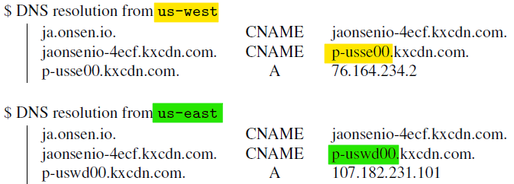
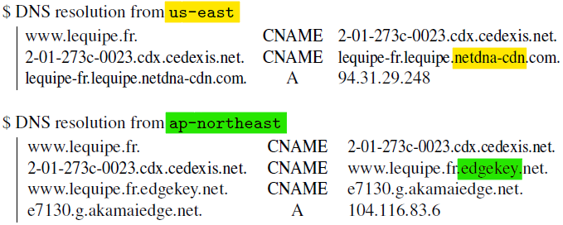
Case Studies (3/3)
Dynamic CNAME: KeyCDN
  CNAME is used to map the domain to a close region
  CNAME record injection is possible
  All legitimate “A” records are in the same region
Multiple-CDN Deployment: Cedexis
  Global Traffic Management (GTM) platform directs end-users to a selected appropriate CDN provider
  Vulnerable to the CNAME record injection
/ 29

Slide 20
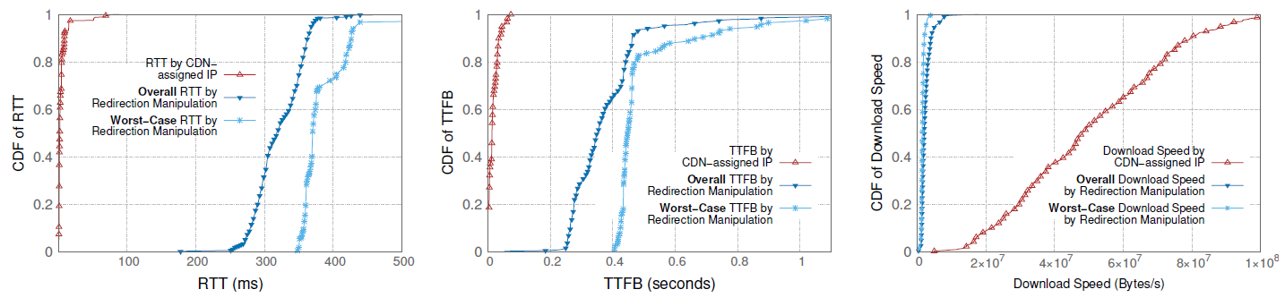
Performance Impact
CDN Performance Degradation
  Round-Trip-Tie (RTT): 20ms → 300ms
  Time-to-First-Byte (TTFB): Similar impacts compared to RTT
  Download Speed: Significant decrease in file download performance
/ 29

Slide 21
CDN Caching Impact
CDN Caching
  Caching system is an important building block of a CDN’s infrastructure
  Cache-hit ratio is a critical metric to the CDN’s performance
End-user Redirection and CDN Caching
  The popularity of requested web contents shows strong localization
  Redirected end-user groups may be highly likely to have totally different interests in web content → Frequent Cache Update
  Manipulated redirection would cause degraded performance and user experience
  Increased back-end connections will further slow down server responsiveness
/ 29

Slide 22
Security Impact
Enhanced Security Provided by CDN
  Acting as reverse proxies to inspect incoming traffic
  Performing load balancing and DoS protection by diverting users
Possible Attacks using Redirection Hijacking
  Redirecting requests from a large number of clients to a single IP address → DoS Attack
  Bypassing the mapping system of CDNs → Load balancing disabled
  Redirecting to the unresponsive edge servers → End users cannot access the content
/ 29

Slide 23
Countermeasures

Slide 24
ECS Considerations
Adversaries can use ECS as information
  Selectively poisoning a resolver’s cache to impact only a specific IP range
  Targeting a DNS query with less detailed ECS network prefix to impact more clients
Countermeasures
  Including ECS data in DNSSEC when signing RRsets
  Records can be dynamically signed on demand using ECDSA
/ 29

Slide 25
DNSSEC Considerations
Validity Period of DNSSEC Signatures
  Typically long enough to be reused by adversaries
  Signature inception/expiration could be fabricated by adversaries
Countermeasures
  Including the validity period when signing a record
  Including a new extension representing the validity period in DNS messages
/ 29

Slide 26
CNAME Flattening
CNAME Flattening for Security
  Hide the CNAME chain from resolvers
  CDN’s authoritative nameserver takes full responsibility for the CNAME resolution, generating an “A” record signed with DNSSEC
  Content Providers can secure the first CNAME delegation by enabling DNSSEC signature
/ 29

Slide 27
Request Re-Mapping
High-level Re-mapping Mechanism
  Reassigning an optimal edge server by measuring RTT at the edge server
  High latency penalty
  Only suitable for large-file transfers
  With the support of ECS, clients are rarely being assigned to a non-optimal edge server
  More fine-grained performance monitoring and more active re-mapping could mitigate severe performance degradation
  Still vulnerable when unresponsive edge servers are exploited
/ 29

Slide 28
DNS Encryption
DNSCrypt, DNSCurve, DNS-over-HTTPS
  DNSCrypt and DNS-over-HTTPS enables the DNS resolution over encrypted connection, but can only between stubs and recursive resolvers
  DNSCurve aims to authenticate the DNS packets between recursive resolver and authoritative namesevers, but only supporting by OpenDNS
DNS-over-TLS
  Channels between stubs and recursive resolvers, and optionally between recursive resolvers and authoritative servers
  Adoption is limited due to the high performance impact and expensive costs of deployments
/ 29

Slide 29
Conclusion
A new vulnerability of CDNs: Redirection Hijacking
  Adversaries can easily maneuver CDN’s mapping between end-users and edge servers by injecting crafted but legitimate DNS records
  DNSSEC is ineffective, even with the new ECDSA-based signatures
  Mainly due to the reusability of signed legitimate records
Vulnerability Assessment
  Characterizing the operations of the request routing for popular CDN vendors
  Analyzing the threats via multiple case studies
  Quantifying the practical impacts of redirection hijacking
  Countermeasures against redirection hijacking from different aspects
/ 29

