Slide 1
SmrtFridge: IoT-based, User Interaction-Driven
Food Item & Quantity Sensing
Amit Sharma, Archan Mistra, Vengateswaran Subramaniam, Youngki Lee
Sensys ‘2019
Chorom Hamm
MMLAB-SNU
crhamm@mmlab.snu.ac.kr
Aug 25, 2020

Slide 2
Outline
Motivation and Introduction
System Design and details
Evaluation
Conclusion

Slide 3
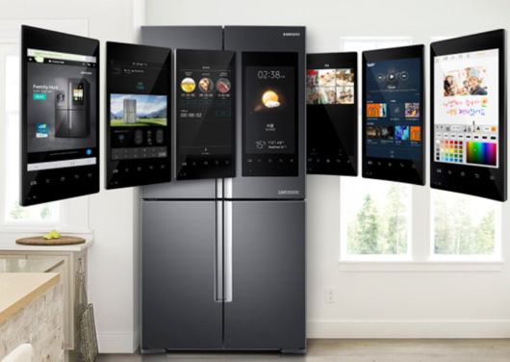
Motivation - Smart Refrigerator
Automatically track the identity and
quantity of items
Allow a consumer to ascertain items
that need to be replenished or
purchased
Show alert if the refrigerator is not
normal
Need barcode or RFID scanning

Slide 4
Related Works
Smart fridge prototypes
  Use RFID tags or interior-mounted camera to classify food items and process voice command by a voice recognition system
Analysis of food and other content
  Infer various attributes of container-based food items using CNN or RFID tags with transparent bottles or glasses
Visual analysis of food items
  Identify food items using close-up photos captured by smartphone camera or smartwatch-embedded camera

Slide 5
Introduction
Functionality of SmrtFridge
  Identify the individual food items that users place in or remove from a fridge
  Estimate the residual quantity of food items inside a refrigerated container
Assumption
  Perform unobtrusively without any explicit user action or tagging of food objects
How it works
  Use an interaction-driven, multi-modal sensing pipeline using infrared (IR) and RGB video sensing and process to identify food item by the DNN classifier
  Estimate the residual food quantity by exploiting slight thermal differences, between the empty and filled portions of the container.
#Food item identification #quantity estimation #non-intrusive

Slide 6
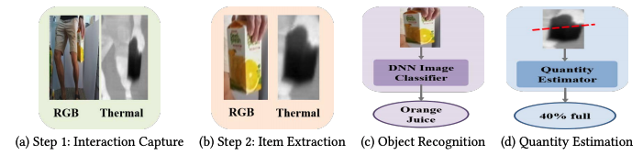
Key Challenges
Juice Product X, with approximate 40% content remaining, has been in your fridge for the past two weeks
How to extract a food item
How to overcome varying levels of object occlusion
How to estimate the content of a container

Slide 7
System Overview

Slide 8
System Workflow
Episode Segmentation. Identify the start and end of a single interaction episode by the door contact sensor
Item Image Extraction. Find the item using difference of temperature by IR camera and overlap the segment on the RGB photos
Image-based Food Item Recognition. Execute food item classification using a CNN-based recognizer
Residual Food Quantity Estimation. Recognize two spatially contiguous clusters of a container (empty or filled parts)

Slide 9
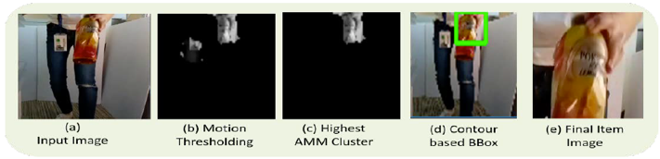
Image Segmentation
Fusion of IR and visual images. Use temperature difference
  Calculate a bounding box using a pixel intensity-based segmentation approach
RGB-based approach. Use motion vector
  Identify motion vector (direction and displacement) using optical flow estimation
  Remove static background portions using background subtraction techniques
  Employ the K-Means
  clustering and pick the
  cluster with the highest
  average motion
  magnitude (AMM) value

Slide 10
Item Recognition Process
Train a multiclass CNN classifier that outputs K+1 labels: each of the K food items + a null class for ‘non-food’ classification
Generate a probability/confidence value for each of the K+1 labels
Discard the frame if the highest likelihood class is K+1 ‘non-food’
Cumulative likelihood of K food item classes using FREQCONF method: compute frequency of identification and sum of confidence values within the episode
Choose most-frequent class that has highest frequency probability/likelihood
Select the food item label based on the highest cumulative likelihood value

Slide 11
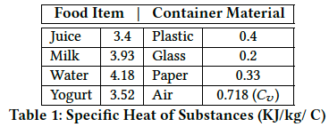
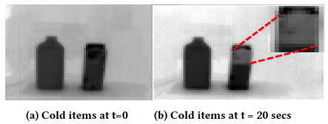
IR-based Quantity Estimation
Estimate quantity as a fraction of the
container volume (coarse granularity)
Robust to different ambient lighting
conditions and the opaqueness of the
food container
Use differential specific heat properties
of a container and the item
Show two regions of different pixel
intensities: less dark pixels for empty
part and darker pixels for filled region

Slide 12
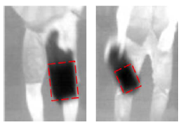

Process Pipeline
Eliminate partial captured images to obtain a clearer view
Use clustering and contour detection to remove noise
Use an interpolation strategy for occlusion removal
Apply clustering on the pixel values of the extended
container contour
  Use Silhouette Coefficient method to resolve between two alternatives

Slide 13
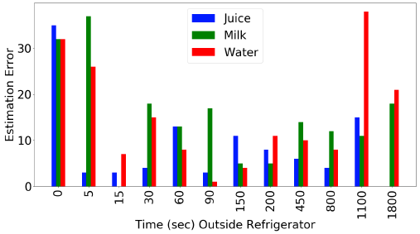
Feasibility of Quantity Estimation
How does estimation accuracy vary with different food items?
  Experiment with 3 distinct liquids {juice, milk, water}
How long does a container need to be placed outside for the thermal differentiation to be discernible?
  Apply varied between {0,5,15,30,60,90,150,
  200,450,800,1100,1800} sec. as a duration
Provide good coarse-grained quantity
discrimination between 5 sec. to 15 minutes

Slide 14
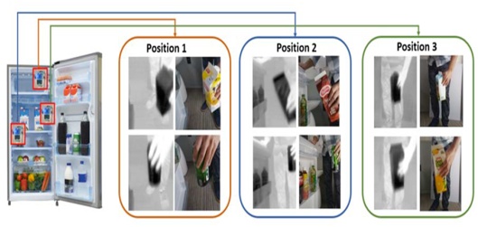
SmrtFridge Prototype
Build a prototype which is costing less than USD 300
  Visible Light Camera sensor: Raspberry Pi camera module V2
  IR/Thermal Camera sensor: Thermal imaging bricklet (80 by 60 pixels)
  Door Contact sensor: magnetic reed switch
Place sensors to maximize the chances
of correct food item classification
  Maximize gesture coverage
  Minimize occlusion
  Maximize visible frames

Slide 15
Object Recognition DNN
Utilize ResNetv2 Model (152 layers) with pre-trained ImageNet weights
Train classifier using TensorFlow (19(objects) + 1(background) class, 2000 images/class)
Use a camera to record videos of the food items under different conditions
Download corresponding Web images using Google’s Custom Search engine
Utilize 80% for training, 10% for validation and 10% testing, achieving a test accuracy of 97.6%

Slide 16
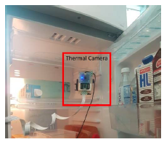
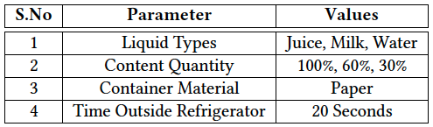
Experimental Setup
Perform natural fridge-based interactions with 15 food
items including milk, juice, etc. by 12 different users
  Insert and remove such items from the fridge multiple
  times without restrictions
Collect data with 4 fruit and vegetable items by 7 users
Execute quasi-controlled micro
study under specific conditions
in terms of items and durations
by 7 users

Slide 17

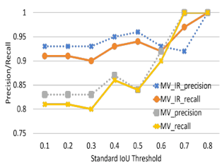
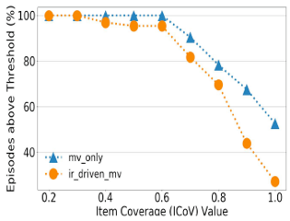
Metrics for Item Extraction
Intersection Over Union (IoU),
Item Coverage (Icov),

Slide 18
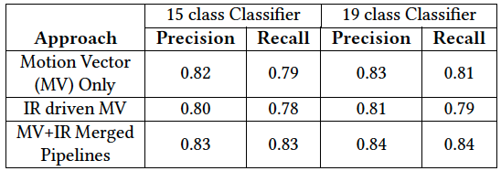
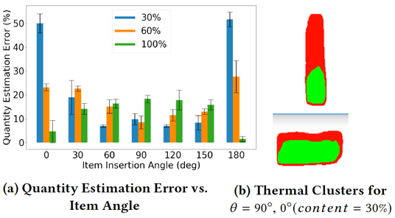
Item Identification and Quantity Estimation
Achieve a classification precision and
recall of 84% with 19 classes
  Need more training data to get better
  classification accuracy

Slide 19
Conclusion
Demonstrate the SmrtFridge prototype using infra-red (IR) and visual (RGB) camera sensors
Provide two capabilities: food item identification and residual quantity estimation
Apply a DNN-based classifier to obtain better accuracy over 84%
Future works
  Check product expiration
  Recognize unlabeled food items
  Estimate quantity precisely

Slide 20
Thank you

