Slide 1
Vulnerabilities of smart contracts and mitigation schemes: A Comprehensive Survey
Published in: Cornell University Library, arXiv.org 2024.4.8
Summarized by
Sangwon Lim (sangwonlim@snu.ac.kr)
2025-5-13
Notes:
.

Slide 2
Contents
Introduction
Vulnerabilities of smart contracts and mitigation schemes
Vulnerability detection tools
Conclusion

Slide 3
Introduction
Blockchain technology has exploded in popularity over the years due to its immutability, security, and transparency in a permissionless and decentralized environment
The Ethereum blockchain is the foundation for numerous financial projects
Given that vulnerabilities in smart contracts can lead to substantial financial losses, various tools have been developed to detect vulnerabilities in Solidity smart contracts

Slide 4
Introduction
The authors present
  the most common vulnerabilities in Solidity smart contracts, along with corresponding mitigation schemes
  an overview and comparison of the most popular tools used to detect smart contract vulnerabilities
  a set of guidelines for auditing smart contracts

Slide 5
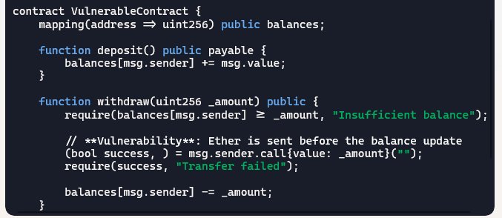
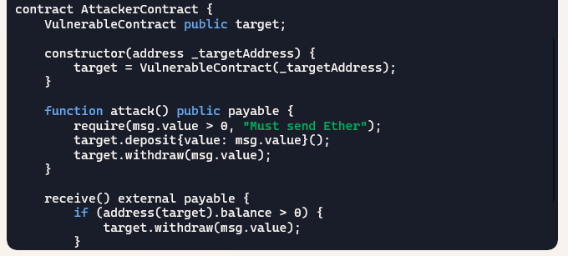
Vulnerabilities – Reentrancy
Description
  also known as a recursive call attack
  similar to the TOC-TOU (Time-of-Check to Time-of-Use) vulnerability

Slide 6
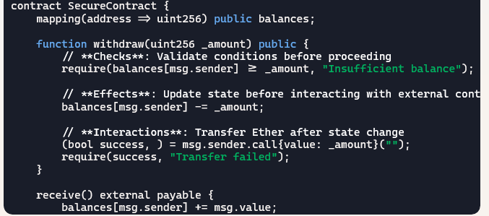
Vulnerabilities – Reentrancy
Protection Measures
  checks-effects-interactions pattern

Slide 7
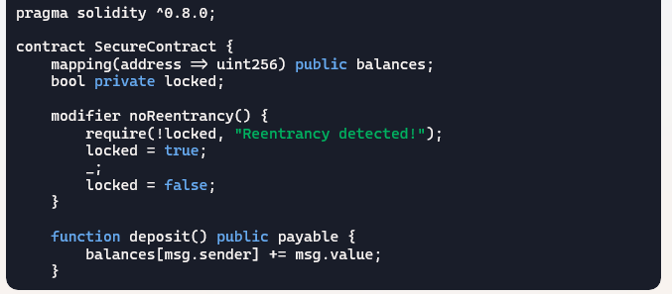
Vulnerabilities – Reentrancy
Protection Measures
  use of mutex

Slide 8
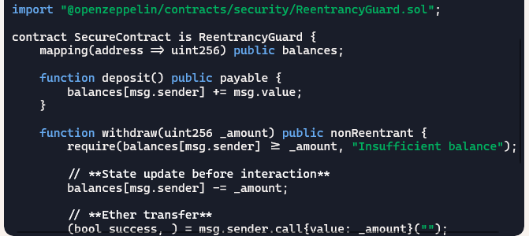
Vulnerabilities – Reentrancy
Protection Measures
  use OpenZeppelin’s ReentrancyGuard

Slide 9
Vulnerabilities – Front Running
Description
  front-running, also known as transaction ordering dependency, occurs when the execution logic depends on the order of the submitted transactions
  the transaction is visible to the network before being executed. The participants can exploit this visibility by sending transactions with a higher gas price to be included first

Slide 10
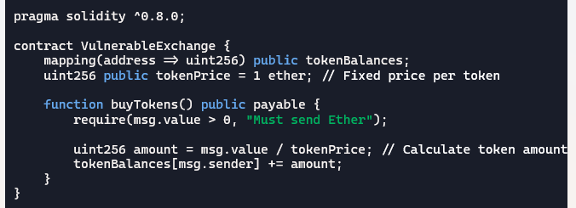
Vulnerabilities – Front Running
Description

Slide 11
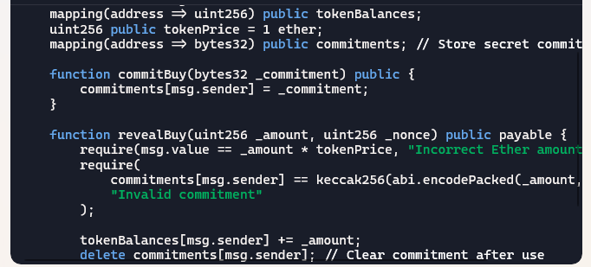
Vulnerabilities – Front Running
Protection Measures
  commit-reveal scheme

Slide 12
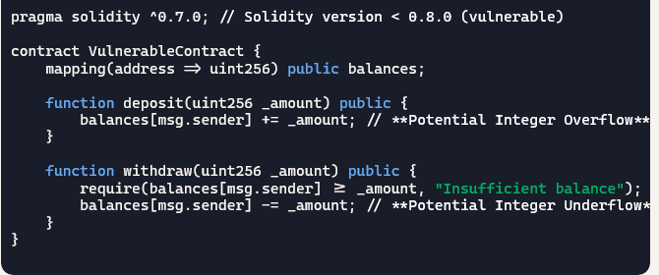
Vulnerabilities – Arithmetic
Description
  arithmetic operations that result in values outside these permissible ranges lead to integer overflow (exceeding the maximum value) or underflow (dropping below zero)

Slide 13
Vulnerabilities – Arithmetic
Protection Measures
  since Solidity 0.8.0, SafeMath functionality is built-in, making arithmetic operations safe by default
  using OpenZeppelin's SafeMath (for older versions)

Slide 14
Vulnerabilities – Mishandled Exceptions
Description
  direct contract calls automatically revert on failure
  low-level calls (call(), delegatecall(), callcode()) return a boolean instead of reverting, requiring explicit error handling
  failure to adequately check the result of a low-level call can lead to unintended execution continuation, potentially compromising contract logic and security

Slide 15
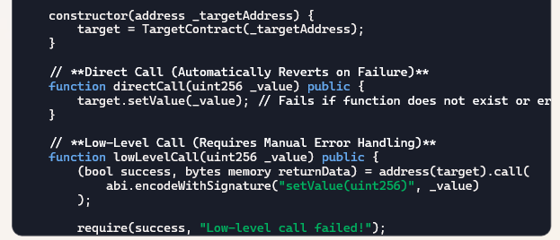
Vulnerabilities – Mishandled Exceptions
Protection Measures
  checks of low-level call’s return value to ensure the intended execution

Slide 16
Vulnerabilities – Code Injection via delegatecall
Description
  the DELEGATECALL opcode is similar to a conventional message call, except that the code performed at the target address is executed in the context of the calling contract
  this can allow malicious contracts to execute arbitrary code in the context of the calling contract, modifying its state unexpectedly

Slide 17
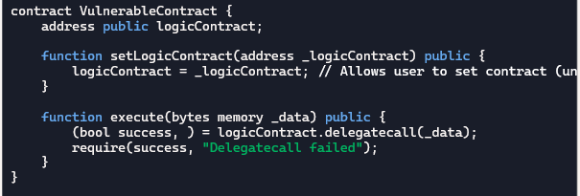
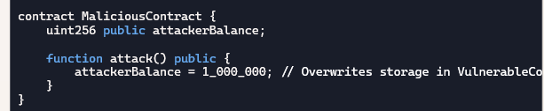
Vulnerabilities – Code Injection via delegatecall
Description (example)
  a contract that blindly uses delegatecall to execute functions from another contract (left)
  a malicious contract with harmful functionality (right)

Slide 18
Vulnerabilities – Code Injection via delegatecall
Protection Measures
  restrict logicContract assignments (only allow trusted contracts)
  use immutable contracts for logic execution
  perform access control checks before executing delegatecall
  validate input data to prevent arbitrary function execution

Slide 19
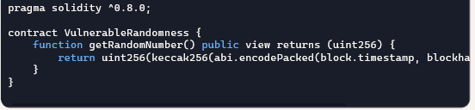
Vulnerabilities – Randomness Using Block Information
Description
  using block information (such as block timestamps or hashes) to generate randomness in Solidity can be highly insecure, as miners can manipulate these values to influence outcomes

Slide 20
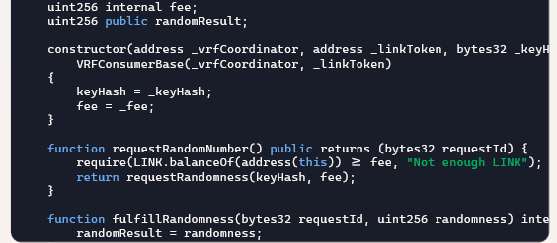
Vulnerabilities – Randomness Using Block Information
Protection Measures
  to implement true randomness, developers should use Chainlink VRF (Verifiable Random Function)

Slide 21
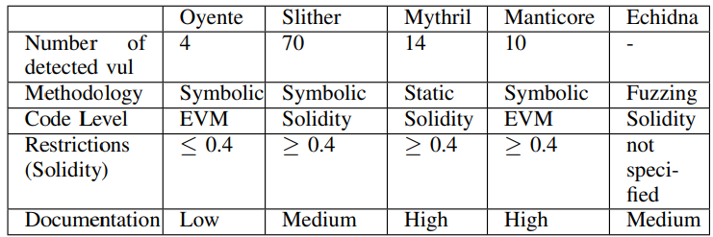
Vulnerability Detection Tools
Various tools that can be used to test smart contracts and identify a wide range of vulnerabilities

Slide 22
Conclusion
The authors presented detailed common vulnerabilities in Ethereum smart contracts and mitigation solutions based on patterns and standards
They provided community-recommended vulnerability detection tools, an execution sample, and detailed feedback for each

