Slide 1
An End-to-End, Large-Scale Measurement of DNS-over-Encryption: How Far Have We Come?
Chaoyi Lu, Baojun Liu, Zhou Li, Shuang Hao, Haixin Duan,
Mingming Zhang, Chunying Leng, Ying Liu, Zaifeng Zhang, Jianping Wu
(Tsinghua Univ. / University of California / University of Texas at Dallas /
Qi An Xin Techgnology Research Institute / 360 Netlab)
IMC 2019
2020. 04. 29
Hyeonmin Lee
Network Convergence and Security Laboratory
hmlee@mmlab.snu.ac.kr

Slide 2
Outline
Introduction
Background
DNS-over-Encryption (DoE) protocols
Measurement study
How many DoE servers are there?
How are the reachability and performance of DoE servers?
What does the real-world usage of DoE look like?
Conclusion

Slide 3






Introduction
…
DNS precedes almost all Internet activities
But DNS packets are sent in clear-text by its initial design
Thus, DNS communications are vulnerable to
Passive attacks (eavesdropper) or active attacks (rogue DNS server)
Ex) NSA has been monitoring and hijacking DNS traffic
To address this problem, several approaches were suggested
Guarantee the integrity of DNS records: DNSSEC
Encrypt DNS packets btw. a client and a recursive resolver: DNS-over-TLS, DNS-over-HTTPS, ...
Client
Recursive
Resolver
Authoritative Servers
※ We’ll term 2nd approaches as DNS-over-Encryption (DoE)

Slide 4
Introduction
Focus
…
Little has been done to understand the operational status of these solutions from the “bottom-up” view
Despite the “top-down” effort made by the industry
This paper aims to give an end-to-end review of DNS-over-Encryption (DoE) approaches
How many providers are offering DoE services?
What does their performance look like for users distributed globally?
What does the real-world usage of DoE look like?
For this purpose
Launch Internet-wide scanning to discover DoE service providers
Assess the accessibility and performance of DoE services
Client
DNS-over-TLS
DNS-over-HTTPS
Recursive
Resolver
Authoritative Servers

Slide 5
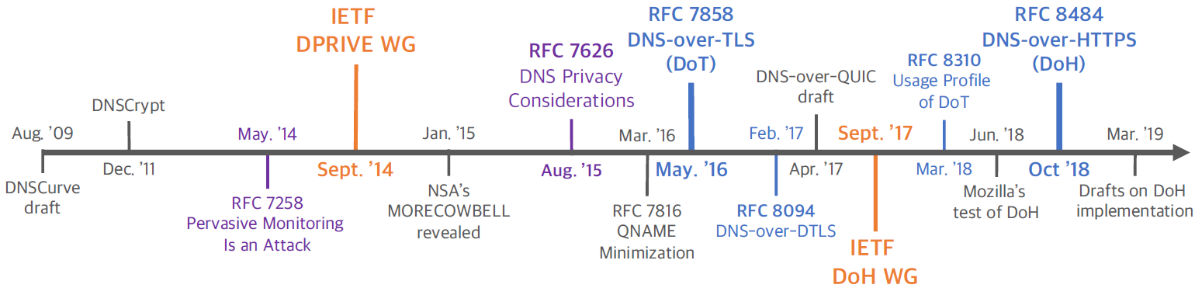
Backgrounds: DNS-over-Encryption Protocols
Since 2009, the Internet community has been made efforts to mitigate DNS privacy issues
Two IETF WGs have been established
Several DoE protocols have been proposed
DNSCrypt, DNS-over-TLS, DNS-over-DTLS, DNS-over-HTTPS, …
Some OS & DNS software support DoE
Linux, Android / Unbound, Knot resolver, …
Large public DNS providers support DoE
Google, Cloudflare, Quad9, …

Slide 6
Backgrounds: DNS-over-Encryption Protocols
This study focus on DoT & DoH
Standardized by IETF
Extensively implemented by various DNS software and public resolvers
DNS-over-TLS (DoT)
Negotiate TLS session before DNS lookups and use it to wrap DNS messages
Use dedicated port 853 for communication
DNS-over-HTTPS (DoH)
Embed DNS messages into HTTPS messages
Share port 443 with HTTPS traffic
※ DoH Example
DoH Resolver
Query
https://dns.google.com/resolve?name=example.com&type=A
Response
{“Status”: 0, “RA”: true ,… “Answer”:[ {“name”: “example.com”, “type”:1,
“TTL”: 19159, “data”: “93.184.216.34”}]}

Slide 7
Research Questions
How many DoE servers are there?
How are the reachability and performance of DoE servers?
What does the real-world usage of DoE look like?
Internet-wide scanning of DoT & DoH
Large-scale client-side measurement using proxy network
Traffic analysis using Chinese ISP/DNSDB/PassvieDNS datasets

Slide 8
How Many DoE Servers Are There?

Slide 9
Q1-1. How Many DoT Servers Are There?
Public resolver lists are provided but they are not complete
Data
DoT runs over dedicated port 853
Internet-wide scanning using port 853 as input
Repeat process every 10 days from Feb 1, 2019 to May 1, 2019
Methodology
Discover all IPv4 addr. with port 853 open
Send DoT queries to scanned addr.
Check responses for DoT queries

Slide 10
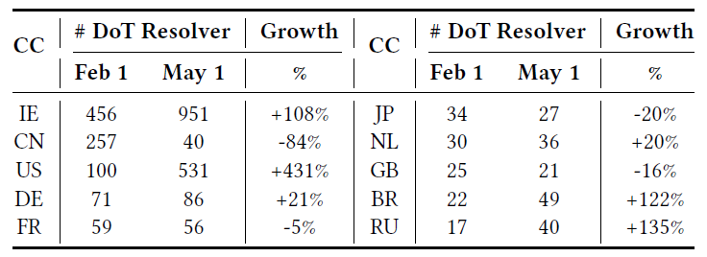
Q1-1. How Many DoT Servers Are There?
DoT resolvers have increased in
Ireland, Brazil and Russia (doubled) / USA (four times)
Significant drop in China (-84%)
Belong to a cloud hosting platform (the paper does not have analysis about this result)
< Top 10 countries of open DoT resolvers >

Slide 11
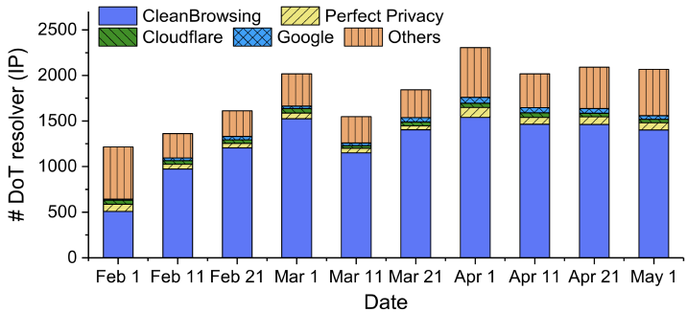
Q1-1. How Many DoT Servers Are There?
Over 1.5K open DoT resolvers are discovered
Several large providers account for more than 75% resolvers
< Open DoT resolvers identified by each scan >

Slide 12
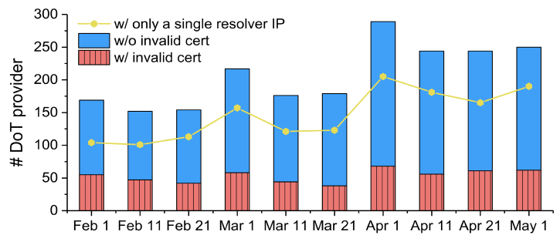
Q1-1. How Many DoT Servers Are There?
Small DoT providers account for the long tail
70% of providers only operate one single resolver (yellow line)
25% of DoT providers have invalid SSL certificates
On at least one of their resolvers
< Providers of open DoT resolvers >

Slide 13
Q1-2. How Many DoH Servers Are There?
Data
DoH runs over port 443 (shared with HTTPS traffic)
Cannot distinguish it just using port number
Instead, inspect a large-scale URL dataset provided by industrial partner (include billions of URLs)
Methodology
Specify common URI patterns of DoH query (/dns-query, /resolve)
Scan whole URL dataset using these patterns
Results
Find 17 public DoH resolvers (15 is known, find 2 new resolvers)
Find no invalid certificates for DoH resolvers
Ex) https://dns.google.com/resolve?name=example.com&type=A

Slide 14
How Are the Reachability & Performance of DoE Servers?

Slide 15
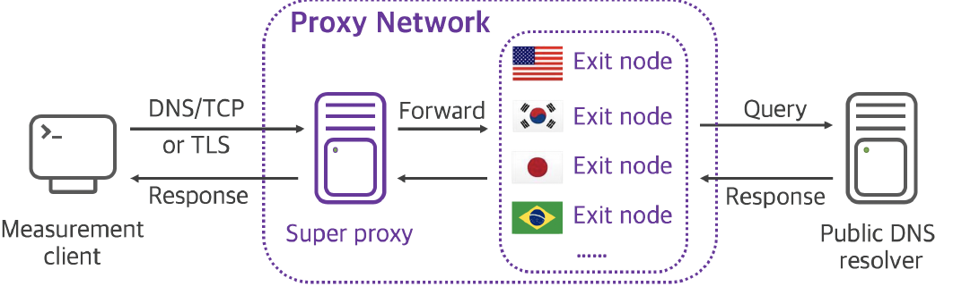
Q2-1. How Is the Reachability?
Challenge
Vantage point should be able to send DoT & DoH queries directly to public resolvers, instead of their local DNS resolver
Solution? Proxy networks!
What is a proxy network?
The proxy network accepts traffic generated by a client, and forwards it to various proxy nodes

Slide 16
Q2-1. How Is the Reachability?
Use two residential proxy networks
Collected vantage points statistics
Platform | Characteristics | Description
ProxyRack | More than 600K endpoints in over 150 countries | Gain a global view
Zhima | Endpoints are all located in two Chinese ISPs | Gain a usability in censored networks
Platform | # of
 | IP | Country | AS
ProxyRack | 29,622 | 166 | 2,597
Zhima | 85,122 | 1 (China) | 5

Slide 17
Q2-1. How Is the Reachability?
Test the reachability of popular DoE resolvers
Methodology
Perform DNS lookups on each proxy client
Check the response
If lookup fails, try to find the reason
Target protocols | Target resolvers
DNS/TCP DoT DoH | Cloudflare Google Quad9

Slide 18
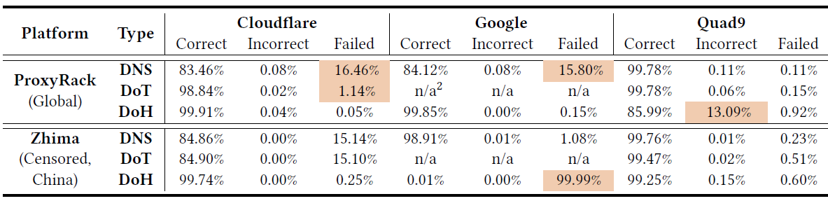
Q2-1. How Is the Reachability?
*Google DoT was not announced at the time of experiment
Overall, about 99% of global users can access DoE servers
Failure rate of DNS is higher than DoT or DoH
Suppose that filtering on the regular DNS port (e.g. 53) is common than DoE port
※ Failed: no DNS response / Incorrect: received a response but SERVFAIL

Slide 19
Q2-1. How Is the Reachability?
*Google DoT was not announced at the time of experiment
Failure rate of Cloudflare DoT is higher
Address 1.1.1.1 conflicted by residential network devices
※ Failed: no DNS response / Incorrect: received a response but SERVFAIL

Slide 20
Q2-1. How Is the Reachability?
*Google DoT was not announced at the time of experiment
Failure rate of Cloudflare DoT is higher
Address 1.1.1.1 conflicted by residential network devices
Censorship blocks users in China from Google DoH
Address of DoH server (216.58.192.*) is blocked
※ Failed: no DNS response / Incorrect: received a response but SERVFAIL

Slide 21
Q2-1. How Is the Reachability?
*Google DoT was not announced at the time of experiment
Failure rate of Cloudflare DoT is higher
Address 1.1.1.1 conflicted by residential network devices
Censorship blocks users in China from Google DoH
Address of DoH server (216.58.192.*) is blocked
Quad9 has a configuration issues with timeout
※ Failed: no DNS response / Incorrect: received a response but SERVFAIL

Slide 22
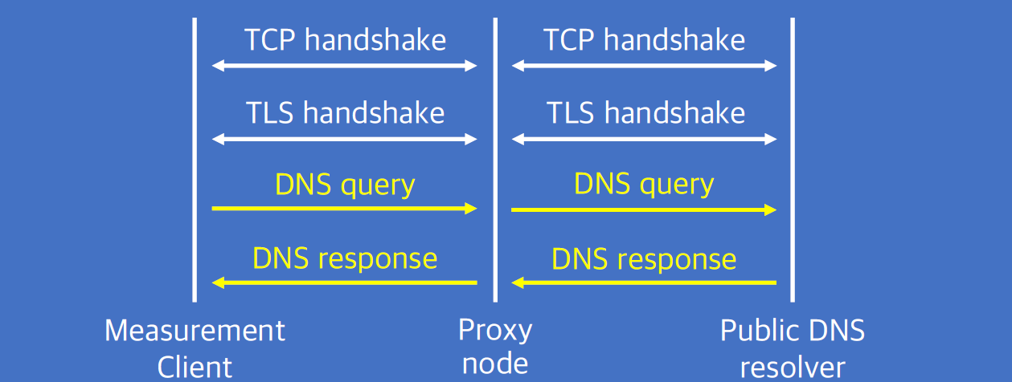
Q2-2. How Is the Performance?
Extra delay can be introduced by TLS session setup and encryption
Connection reuse
Clients and servers should reuse connections by DoE specification
Consider that connection reuse is the major scenario of DoE
Challenge
We cannot directly measure the latency between a proxy node and a public resolver
But we want to measure the overhead of DoE compared to traditional DNS
Connection
Reuse

Slide 23
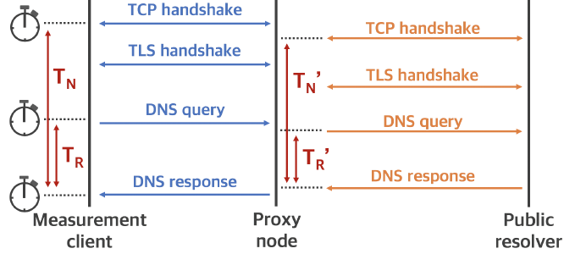



Q2-2. How Is the Performance?
We can only measure and
We cannot know or
We Just use (connection reuse case) to see the relative overhead of DoE
Connection
Reuse

Slide 24
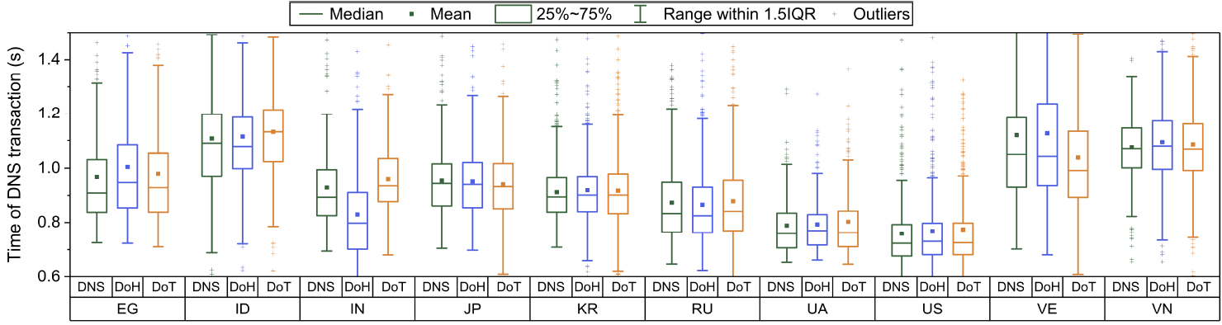
Q2-2. How Is the Performance?
On average, query latency of DoE with reused connection is several milliseconds longer than traditional DNS
< Query performance per country >

Slide 25
Q2-2. How Is the Performance?
Surprisingly, DoH is faster than DNS in Indonesia
Hypothesis 1: DoH has better service consistency and uses modern features of HTTP like congestion control
Hypothesis 2: resolvers in different regions have different latency to nameservers
< Query performance per country >

Slide 26
What Does the Real-World Usage of DoE Look Like?

Slide 27
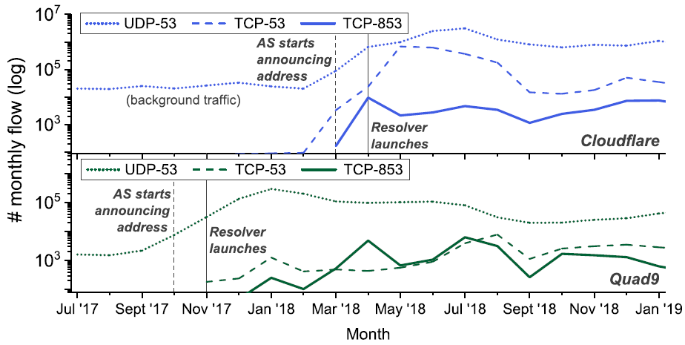
Q3. What Does the Real-World DoE Traffic Look Like?
Dataset
DoT: Collected by backbone routers in large Chinese ISP (18 months)
DoH: DNSDB, 360 PassiveDNS (passive DNS dataset)
DoT traffic
DoE traffic is still small
- 2~3 orders of magnitude less than traditional DNS
But growing!
< # of query to 2 popular DoT resolvers >
Notes:
TCP is used when the response data size exceeds 512 bytes

Slide 28
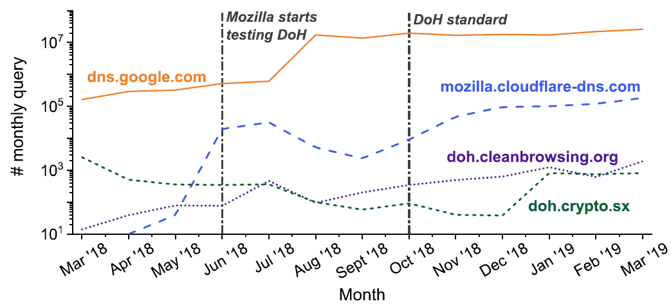
Q3. What Does the Real-World DoE Traffic Look Like?
DoH traffic
Among 17 public DoH resolvers, only 4 domains have more than 10K queries
Large providers dominate and their usage is growing
< # of query for 4 popular DoH resolvers >

Slide 29
Conclusion
Various protocols are proposed to encrypt and secure DNS transactions
DNS-over-TLS, DNS-over-HTTPS, and etc.
This paper performs the first large-scale measurement study on the ecosystem of DNS-over-Encryption
Internet-wide scanning of DoT and DoH
Measurement results show that
DoE supporting resolvers have good reachability and tolerable performance overhead
DoE traffic is much less than traditional DNS, but growing

Slide 30
Q & A
Thank you.

