Slide 1
Behind Closed Doors:
A Network Tale of Spoofing, Intrusion, and False DNS Security
IMC 2020
Casey Deccio, Alden Hilton, Michael Briggs, Trevin Avery, Robert Richardson
Brigham Young University
2021. 07. 15
Hyeonmin Lee
hmlee@mmlab.snu.ac.kr
Network Convergence and Security Lab

Slide 2
Outline
Introduction & Background
  Source Spoofing
  Source Address Validation (SAV)
Measuring (D)SAV using DNS
  Experiment Setup
  Experiment Results
Case Studies: Vulnerabilities Behind Closed Doors
  Source Port Randomization
  OS Identification
Conclusion

Slide 3






Access Control
Bob trusts Alice but not Mallory
Alice
From: Alice
To: Bob
Bob
Mallory
From: Mallory
To: Bob

Slide 4
Source Spoofing – (1) From Outside
Alice is not in the same network as Bob.
Mallory can spoof its source to Alice
Alice
From: Alice
To: Bob
Bob
Mallory
From: Alice
To: Bob
Vulnerable to
Reflection or Intrusion attack

Slide 5
Source Spoofing – (2) From Inside
Alice and Bob are on the same network
Mallory can spoof its source to Alice
Alice
Bob
Mallory
From: Alice
To: Bob

Slide 6
Source Spoofing – Countermeasures
Origin-side Source Address Validation (OSAV)
  Protect others: from the attacker-side networks
Alice
Bob
From: Alice
To: Bob
Mallory
OSAV
→ Alice is not in my network
Notes:
*OSAV requires the participation of third party networks—those hosting the attackers, not the victims.

Slide 7
Source Spoofing – Countermeasures
Destination-side Source Address Validation (DSAV)
  Protect self: from the victim-side networks
Alice
Bob
Mallory
DSAV
→ Alice is in my network
From: Alice
To: Bob

Slide 8

Research Question
Prevalent of DSAV?
Impact of the unauthorized access?
  How it can be exploited to
  compromise internal systems?
Alice
DSAV
Bob
Mallory
Alice is in
my network
From: Alice
To: Bob

Slide 9
How Prevalent is DSAV? – Experiment
Methodology
  The client sends DNS queries with spoofed-source IPs to recursive DNS servers world-wide
  The authoritative nameserver checks whether they got DNS queries from target recursive resolvers
Experiment Infrastructure (No OSAV)
Target Network
unique-name*: contain information about target resolvers
Client
From: spoofed IP
To: 1.2.3.4
DNS Query:
<unique-name*>.dns-lab.org
1.2.3.4
Authoritative Nameserver
(dns-lab.org)
Got response?
No DSAV
From: 1.2.3.4
To: IP of dns-lab.org
DNS Query:
<unique-name>.dns-lab.org
Recursive
Resolver

Slide 10
How Prevalent is DSAV? – Experiment Setup
Selecting target DNS servers
  Exploit DITL 2019 dataset – 48 hours of DNS queries destined for the DNS root servers
  Extract source IPs (of DNS resolvers) from DNS queries in the dataset
  Consist of 11,204,889 IPv4 (in 53,992 ASes) and 784,777 IPv6 (in 7,904 ASes)
Selecting spoofed sources
  Issued up to 101 DNS queries using spoofed sources for a target IP
Same prefix | 1 address from same /24 (IPv4) or /64 (IPv6) prefix containing a target IP (e.g., target resolver: 192.0.2.1 → spoofed source: 192.0.2.21)
Other prefix | Up to 97 addresses from /24 or /64 prefixes announced by the same AS but not containing a target IP
Private | 192.168.0.10 or fc00:10
Destination-as-Source | The target IP itself
Loopback | 127.0.0.1 or ::1

Slide 11
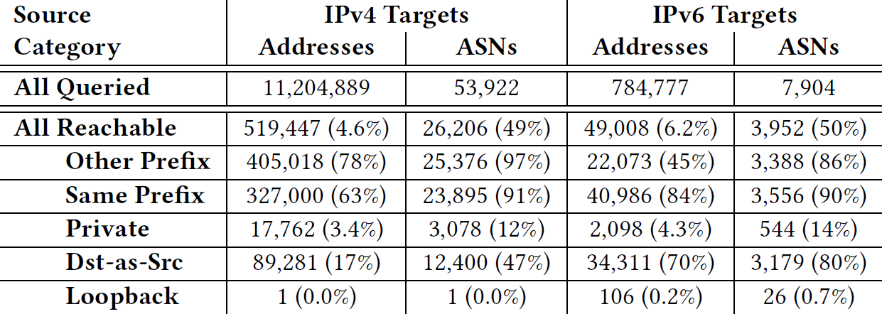
How Prevalent is DSAV? – Experiment Results
The queries were issued between Nov 6 ~ Dec 27, 2019
Overall results
Target Reachability
4.6% of IPv4 addr and 6.2% of IPv6 addr received query
49% of IPv4 ASes and 50% of IPv6 ASes received query
No DSAV,
Vulnerable to spoofing attacks!

Slide 12
How Prevalent is DSAV? – Experiment Results
The queries were issued between Nov 6 ~ Dec 27, 2019
Overall results
Spoofing Effectiveness
Using other or same prefix show high infiltration rate
Dst-as-Src shows high ratio for IPv6 targets
  Linux kernel drops IPv4 packets that use Dst-as-Src, but not for IPv6

Slide 13
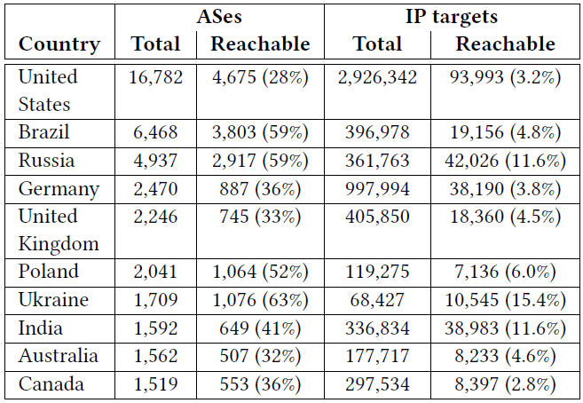
How Prevalent is DSAV? – Experiment Results
10 countries that show the high percentage of ASes accepting spoofed-source packets

Slide 14
DSAV Case Studies
Attackers can easily get the knowledge that a network lacks DSAV
How this can be used to survey or exploit vulnerabilities of internal systems?
  Closed resolvers
  Source port randomization
  OS identification

Slide 15
DSAV Case Studies – Closed Resolvers
For DNS resolvers that are reachable with spoofed-source queries, we send a non-spoofed query (normal query) to check whether they offer service to external networks
  Open: resolvers can be reached with the normal query
  Closed: resolvers cannot be reached with the normal query
Results
  Open: 40% (of 519,447 reachable resolvers)
  Closed: 60%
  What’s the matter?
Closed resolvers in a network that lacks DSAV have little advantage over open resolvers
Closed resolvers are thought, “falsely”, to be limiting their query access to only trusted clients
Notes:
DNS RFC - Nameservers should not offer recursive service to external networks

Slide 16
DSAV Case Studies – Source Port Randomization
Investigate one of the most prominent DNS resolver vulnerabilities → Lack of source port randomization
Send 10 follow-up queries to reachable destinations and check port ranges of DNS queries that contacted our authoritative nameserver
Experiment Infrastructure (No OSAV)
Target Network
Client
…
Port range of A?
5050~10800!
< DNS query >
Port: 5050
Authoritative Nameserver
…
Recursive
Resolver (A)
< DNS query >
Port: 10800

Slide 17
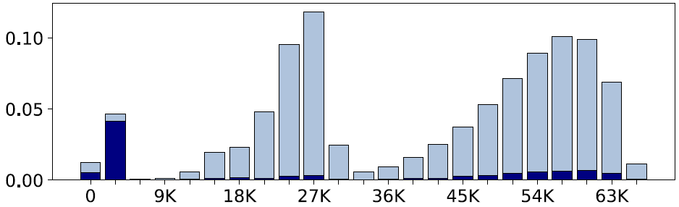

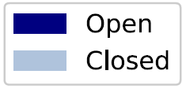
DSAV Case Studies – Source Port Randomization
The below plot shows the frequency distribution of source port ranges used by resolvers
  Ranges between 0 and 65,535
Zero source port randomization → More than 0.01% of resolvers (6% of all ASes)
More vulnerable to attacks such as DNS cache poisoning
Reasons? old software and improper configuration (most common ports: 53)

Slide 18
DSAV Case Studies – OS Identification
How internal systems might be surveyed to identify OS?
Apply 2 methods
  The p0f software → fingerprinting tool; but only categorize 10% of resolvers
  Investigating observed source port range → Port pools used by DNS resolver software are specific to OS
Can we specify the OS of resolvers
using the range of 10 randomly-selected ports?

Slide 19
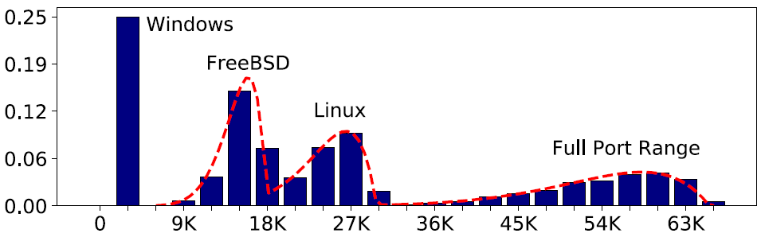

DSAV Case Studies – OS Identification
Can we specify the OS of resolvers using the range of 10 randomly-selected ports?
Lab experiment
  The probability distribution of range for a given pool size can be modeled → Beta distribution (how likely it is that a given observed range comes from a pool of a given size)
  Issued 1,000 sets of 10 queries to (FreeBSD & Linux – BIND / Windows Server – Windows DNS)
Tight fit between the histogram and the theoretical Beta curve!

Slide 20
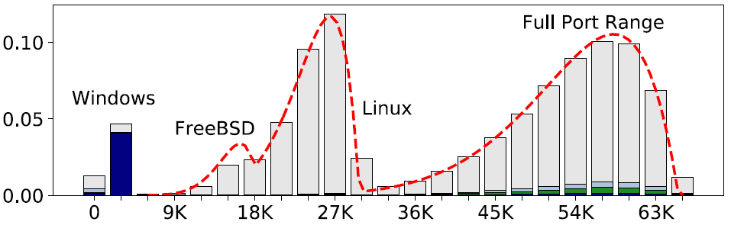
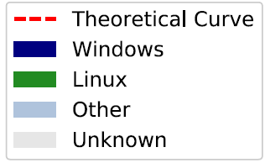
DSAV Case Studies – OS Identification
Now, apply to the target resolver data
Cross-validation with p0f tools
  89% of resolvers identified as Windows are validated by p0f
  But p0f do not cover FreeBSD or Linux very much

Slide 21
Conclusion
Investigate the lack of DSAV in networks and systems
Present a methodology for effectively identifying networks and systems vulnerable to spoofed-source infiltration
  About 5% of IPv4 and 6% of IPv6 resolvers are vulnerable
Identify vulnerable systems by analyzing the source port allocation strategies employed by reachable systems
  Nearly 4,000 resolvers exhibit zero source port randomization
Identify the OS of many of the systems behind closed doors
  Based on observed port ranges

Slide 22
Thank you!

