Slide 1
Poison over Troubled Forwarders: A Cache Poisoning Attack Targeting DNS Forwarding Devices
Xiaofeng Zheng, Chaoyi Lu, Jian Peng, Qiushi Yang, Dongjie Zhou, Baojun Liu,
Keyu Man, Shuang Hao, Haixin Duan, and Zhiyun Qian
Tsinghua University / Qi An Xin Technology Research Institute /
State Key Laboratory of Mathematical Engineering and Advanced Computing /
University of California, Riverside / University of Texas at Dallas
USENIX Security 2020
2020. 09. 16
Hyeonmin Lee
Network Convergence and Security Laboratory
hmlee@mmlab.snu.ac.kr

Slide 2
Outline
Introduction
Background
DNS Cache Poisoning Attacks
DNS Forwarder
Defragmentation Attack Targeting DNS Forwarders
Threat Model
Attack Details
Experiment
Vulnerable DNS Forwarder Software
A Nationwide Measurement of Client
Conclusion

Slide 3



Introduction
Traditional DNS ecosystem
Stub resolver
(DNS client)
Recursive
Resolver
Authoritative servers

Slide 4
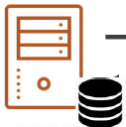
Introduction
The DNS ecosystem has evolved dramatically
The system now consists of multiple layers of servers
DNS Forwarder
Devices standing in between DNS clients (stub resolvers) and recursive resolvers
Simply forwards queries/replies to upstream/downstream resolvers
Stub resolver
(DNS client)
Recursive
Resolver
DNS forwarder
Authoritative servers

Slide 5
Introduction
What is the problem?
DNS forwarders do not perform recursive queries
They rely on the integrity of its upstream recursive resolver (do not verify responses)
They have caching abilities
Vulnerable to cache poisoning attacks
Stub resolver
(DNS client)
DNS forwarder
Recursive
Resolver
Authoritative servers

Slide 6
Background: DNS Forwarder
Recursive resolver vs. DNS forwarder
Recursive resolver | DNS Forwarder
Recursively access other servers to find final answer of DNS queries Perform integrity checks and validate DNSSEC of responses Can cache responses | Just forward queries to upstream resolver or downstream resolvers Rely on the integrity of its upstream recursive resolver Can cache responses
(Resolve CNAME chains and aggregate the resource records into one final answer)
(Do not recursively resolve queries)

Slide 7
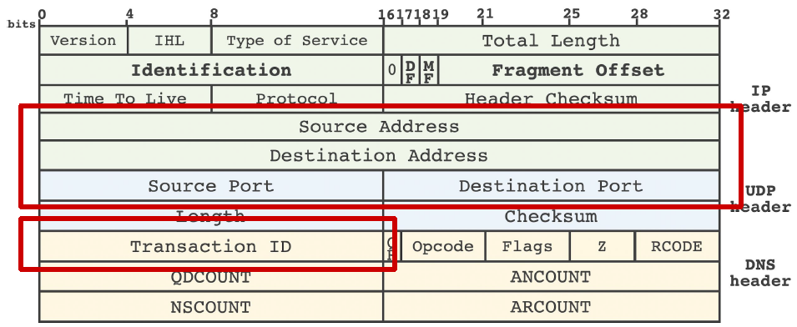
Background: Cache Poisoning Attacks
Forging attack
Craft a rogue DNS response and trick a resolver into accepting it
Attackers forge a DNS response with the correct metadata before the authenticated response arrives
Correct metadata? Question section, DNS transaction ID, source/destination IP, source/destination port number

Slide 8
Background: Cache Poisoning Attacks
Forging attack
Craft a rogue DNS response and trick a resolver into accepting it
Attackers forge a DNS response with the correct metadata before the authenticated response arrives
Correct metadata? Question section, DNS transaction ID, source/destination IP, port number
Mitigation
Increase the randomness of DNS query packets
ex) randomized port number or DNS transaction ID

Slide 9
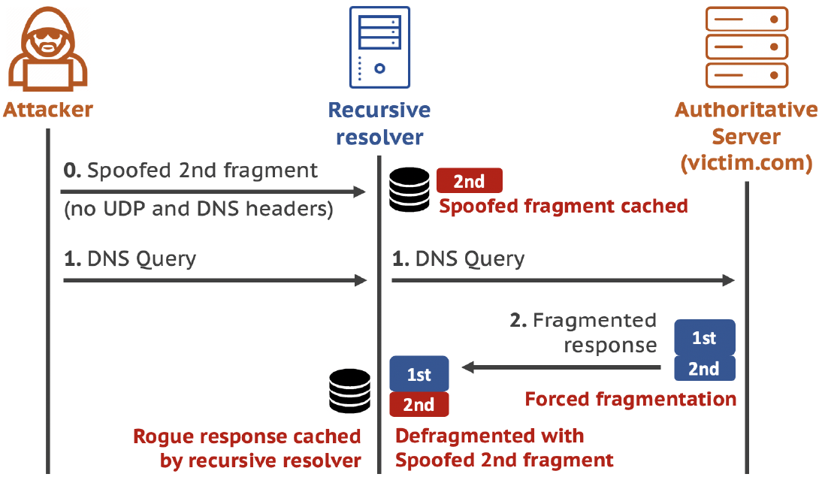
Background: Cache Poisoning Attacks
Defragmentation attack
Exploits the fact that the 2nd fragment of a fragmented DNS response packet does not contain DNS or UDP headers or question section → Bypass randomization based defenses

Slide 10
Background: Cache Poisoning Attacks
IP header
Defragmentation attack
UDP header
DNS header
> Ethernet MTU
victim.com A 1.1.1.1

Slide 11
Background: Cache Poisoning Attacks
IP header
IP header
Defragmentation attack
UDP header
victim.com A 1.1.1.1
DNS header
victim.com DNSSEC ..
2nd Frag
1st Frag

Slide 12
Background: Cache Poisoning Attacks
IP header
IP header
Defragmentation attack
UDP header
victim.com A 1.1.1.1
DNS header
2nd Frag (forged)
victim.com DNSSEC ..
2nd Frag
IP header
victim.com A 2.2.2.2
1st Frag

Slide 13
Background: Cache Poisoning Attacks
Defragmentation attack
Exploits the fact that the 2nd fragment of a fragmented DNS response packet does not contain DNS or UDP headers or question section → Bypass randomization based defenses
Limitation
Hard to force DNS response fragmentation
DNS responses are typically small
Including DNSSEC records can increase DNS response size but DNSSEC deployment is too low (less than 1.85% in 2017)
Require recursive resolvers that do not validate DNSSEC records

Slide 14
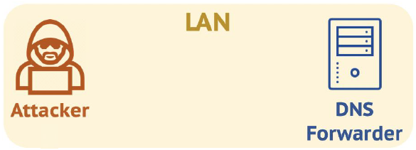

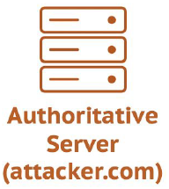
Defragmentation Attack Targeting DNS Forwarders
Threat model
DNS forwarder: residential network devices (ex. home router)
Attacker: in the same LAN as the DNS forwarder and can issue DNS queries (ex. Open Wi-Fi network like coffee shops)
Authoritative server: run by the attacker
Rely on recursive resolver
Check integrity of responses

Slide 15
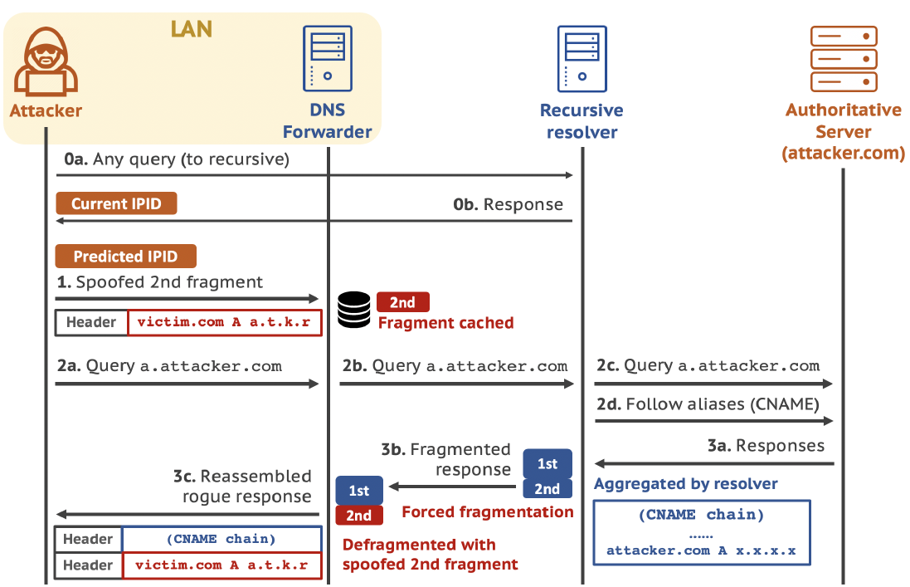
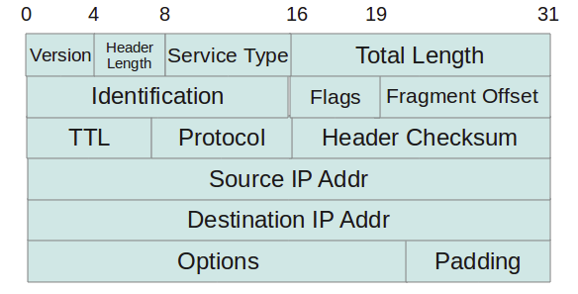
Defragmentation Attack Targeting DNS Forwarders :Workflow
IP Identification

Slide 16
Defragmentation Attack Targeting DNS Forwarders :Workflow

Slide 17
Defragmentation Attack Targeting DNS Forwarders :Workflow

Slide 18
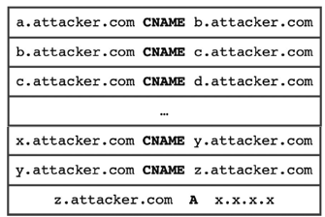
Defragmentation Attack Targeting DNS Forwarders :Workflow
Increasing response size

Slide 19
Defragmentation Attack Targeting DNS Forwarders :Workflow

Slide 20
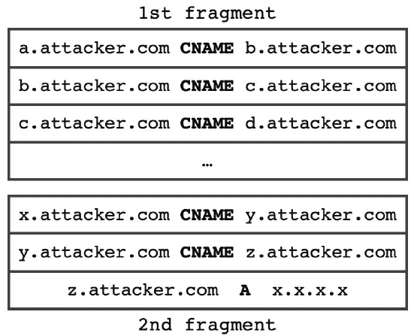
Defragmentation Attack Targeting DNS Forwarders :Workflow

Slide 21
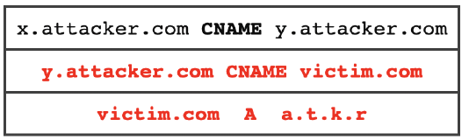
Defragmentation Attack Targeting DNS Forwarders :Workflow

Slide 22
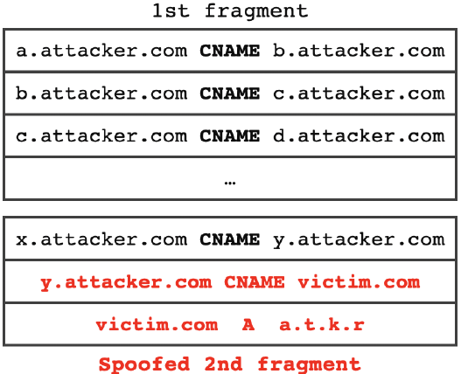
Defragmentation Attack Targeting DNS Forwarders :Workflow
Lack
Security Checks
Will be cached in the DNS forwarder!

Slide 23
Defragmentation Attack Targeting DNS Forwarders : Challenges
i) How can we predict IPID?
ii) How can we force fragmentation?

Slide 24
Crafting Spoofed Fragments
Only the 1st fragment contains DNS and UDP headers
The spoofed 2nd fragment does not need to predict port number & DNS transaction ID
But have to predict IP identification (IPID) in the IP header
For defragmentation, the IPID of each fragment must be the same
< 3 major IPID assignment algorithm >
Global IPID counter | Increase by one for every sent packet
Hash-based IPID counter | Use a hash function to map an outgoing packet to one in an array of IPID counter (Generate hash using source/destination IP of packet) Increase the selected counter by a random amount btw. [1 ~ the last packet sent time]
Random IPID counter | Increase the counter by a random amount

Slide 25
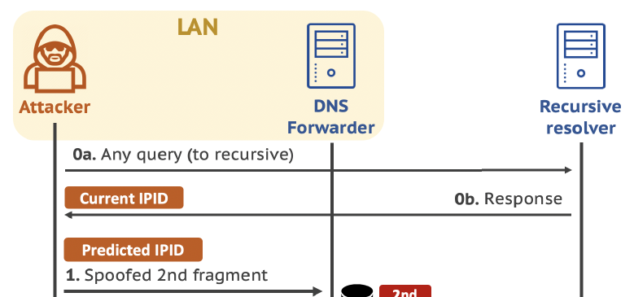
Crafting Spoofed Fragments
IPID prediction
Global IPID counter | Just incrementally increase
Hash-based IPID counter | If a proving query is sent close enough in time with the target query, IPID increments are predictable
Random IPID counter | Hard to predict
Attacker is behind the
DNS forwarder (router)
→ Same public IP

Slide 26
Crafting Spoofed Fragments
IPID prediction
Global IPID counter | Just incrementally increase
Hash-based IPID counter | If a proving query is sent close enough in time with the target query, IPID increments are predictable
Random IPID counter | Hard to predict
Linux, Windows (after Window 8) use hash-based IPID counter
5 public DNS services use hash-based IPID counter
85% of open DNS resolver use Global IPID counter

Slide 27
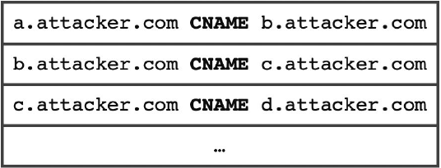
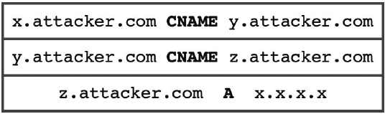
Forcing DNS Response Fragmentation
Use CNAME chain
Use a chain of dummy CNAME records to enlarge DNS response

Slide 28
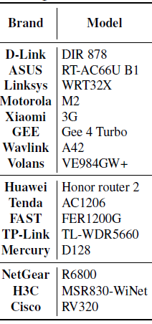
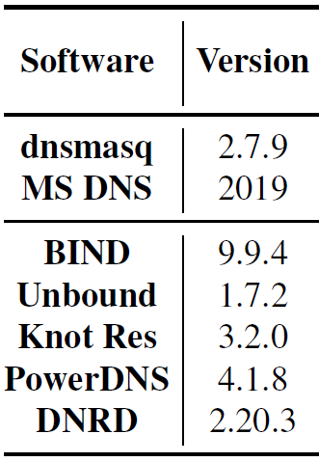
Vulnerable DNS Forwarder Software
Measure the vulnerability of home routers and DNS software
Check attack conditions and launch real attacks
Report the issue to the affected vendors
Home routers
16 models are tested, 8 models are vulnerable
D-LINK, ASUS, Linksys, Motorola, Xiaomi, …
DNS software
7 software are tested, 2 popular DNS software are vulnerable
dnsmasq 2.7.9, MS DNS 2019

Slide 29
A Nationwide Measurement of Client
How many real-world clients are vulnerable to the attack?
Collecting vantage points
Collaborate with industrial partner who develops network diagnosis software for mobile client
Implement vulnerability checking methods in the diagnosis software
Checking vulnerability
The method performs several checks on the attack conditions and reports the collected data
Note: do not actually launch the attack; just check whether the client is vulnerable

Slide 30
A Nationwide Measurement of Client
Vulnerable conditions
The client’s network have to use DNS forwarder → check whether the client is connected through home router
Extension mechanism for DNS (EDNS(0)) must be supported for large DNS responses → check EDNS option in DNS records
…
We cannot know whether the client
is actually vulnerable
Find clients that are potentially vulnerable

Slide 31
A Nationwide Measurement of Client
Vulnerable conditions
The client’s network have to use DNS forwarder → check whether the client is connected through home router
Extension mechanism for DNS (EDNS(0)) must be supported for large DNS responses → check EDNS option in DNS records
…
Results
Collect 20,113 mobile clients (mostly located in mainland China)
6.6% meet vulnerable conditions
→ Potentially vulnerable to the defragmentation attack

Slide 32
Conclusion
Reveal that DNS forwarders can be a soft spot
Vulnerable to cache poisoning attacks
Devise an attack targeting DNS forwarders
Exploit DNS response fragmentation
Enlarge DNS responses using CNAME chain
Conduct experiments to assess the effect of the attack
16 router models and 2 popular DNS software
A nationwide measurement study show that 6.6% of clients are potentially vulnerable

Slide 33
Q & A
Thank you.

Slide 34
Mitigation
Response verification of DNS forwarder
DNS forwarder can re-query all names and perform response verification
But cause significant performance overhead and contradicts with the purpose of DNS forwarders
Randomizing IPID values
Make IPID hard to guess
Make clear guidelines of DNS forwarders
There is no clear definition of “DNS forwarder”
Need clear answer to “What role should they play?” and “What features should be supported?”

Slide 35
Conditions of Successful Attacks
DNS forwarders should satisfy following conditions to be successfully attacked
EDNS(0) support
Extension mechanism for DNS (EDNS(0)) allows large DNS packets over UDP
Otherwise, DNS packets larger than 512 bytes are sent over TCP
No truncation of DNS response
Entire oversized response should be transferred
No verification of DNS response
DNS caching by record

