Slide 1
End-to-End Measurements of
Email Spoofing Attacks
Hang Hu, Gang Wang
Virginia Tech
USENIX Security 2018
2021. 01. 19
Hyeonmin Lee
Network Convergence and Security Laboratory
hmlee@mmlab.snu.ac.kr

Slide 2
Outline
Introduction & Background
  Email spoofing / countermeasures
  Adoption of anti-spoofing protocols
End-to-End Spoofing Experiments
  Research questions
  Experiment setup & parameters
  Experiment Results
User study: Effectiveness of Security Indicators
Discussion
Conclusion

Slide 3
Introduction
Spear phishing is a big threat
  Spear phishing: targeted phishing attack, often attackers impersonates a trusted entity
Email spoofing is a critical step in phishing
  Email spoofing is widely in spear phishing attacks to target employees of various businesses (Anti-Phishing Working Group)
  About thousand of reported security breaches in recent 2 years, leakage of billions of user records
  Unfortunately, today’s email transmission protocol has no built-in mechanism to prevent spoofing

Slide 4
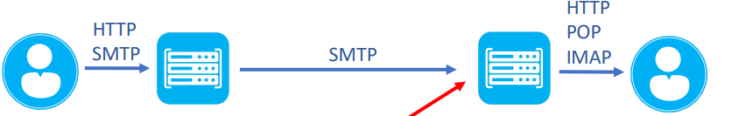
What is Email Spoofing?
Email transmission process
  Sender sends a message to the sender’s mail server through SMTP/HTTP
Alex
Mail Server
a.com
Mail Server
b.com
Bob

Slide 5
What is Email Spoofing?
Email transmission process
  Sender sends a message to the sender’s mail server through SMTP/HTTP
  Sender’s mail server sends the message to the receiver’s mail server
MAIL FROM: alex@a.com
RCPT TO: bob@b.com
Alex
Mail Server
a.com
Mail Server
b.com
Bob

Slide 6
What is Email Spoofing?
Email transmission process
  Sender sends a message to the sender’s mail server through SMTP/HTTP
  Sender’s mail server sends the message to the receiver’s mail server
  The message is delivered to the receiving user through IMAP/POP/HTTP
Mail from Alex!
MAIL FROM: alex@a.com
RCPT TO: bob@b.com
Alex
Mail Server
a.com
Mail Server
b.com
Bob

Slide 7
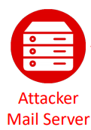
What is Email Spoofing?
How spoofing can be done?
  SMTP has no built-in authentication mechanism
  Attackers can spoof anyone by modifying MAIL FROM field in SMTP
Alex
Mail Server
a.com
Mail Server
b.com
Bob

Slide 8

What is Email Spoofing?
How spoofing can be done?
  SMTP has no built-in authentication mechanism
  Attackers can spoof anyone by modifying MAIL FROM field in SMTP
SMTP
MAIL FROM: alex@a.com
RCPT TO: bob@b.com
Mail from Alex!
Alex
Mail Server
a.com
Mail Server
b.com
Bob

Slide 9


Anti-Spoofing Countermeasures
Sender Policy Framework (SPF)
  Allow email service to publish a list of IPs that are authorized to send emails for its domain
  Receiving email services can check this record to match the sender’s IP
SPF record
1.2.3.4
DNS
a.com
MAIL FROM: alex@a.com
IP: 1.2.3.4
Alex
Mail Server
a.com
Mail Server
b.com
Bob

Slide 10
Anti-Spoofing Countermeasures
DomainKeys Identified Mail (DKIM)
  Sender’s email service put a digital signature in the email header signed by the private key of sender’s domain
  The receiving service retrieves the sender’s public key from DNS to check the signature
DKIM record
key=MIGZ…
DNS
a.com
MAIL FROM: alex@a.com
DKIM-Signature: MtId..
Alex
Mail Server
a.com
Mail Server
b.com
Bob

Slide 11
Anti-Spoofing Countermeasures
Domain-based Message Authentication, Reporting and Conformance (DMARC)
  Built on top of SPF and DKIM (not a standalone protocol)
  Allow the domain administrator to publish a policy to specify what actions the receiver should take when the incoming mail fails the SPF/DKIM check
SPF correct? Do A
incorrect? Do B
DKIM correct? Do C
incorrect? Do D
DMARC record
DNS
a.com
MAIL FROM: alex@a.com
Alex
Mail Server
a.com
Mail Server
b.com
Bob

Slide 12
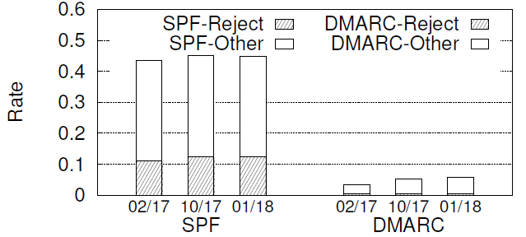
Adoption of Anti-Spoofing Protocols
Scan SPF and DMARC record for Alexa Top 1 million
  DKIM is excluded due to the difficulty of scanning
Reject (policy): strictly reject failed emails
Other (policy): leave the decision to the receiver / no policy is specified / just process the email with caution, …

Slide 13
Adoption of Anti-Spoofing Protocols
Scan SPF and DMARC record for Alexa Top 1 million
  DKIM is excluded due to the difficulty of scanning
Adoption rates are low..
But increasing slowly
Reject (policy): strictly reject failed emails
Other (policy): leave the decision to the receiver / no policy is specified / just process the email with caution, …

Slide 14
In This Study,
Research Question
  How do email providers detect and handle spoofing emails?
  Under what conditions can spoofing emails penetrate the defense
  Once spoofing emails get in, how do email providers warn users?
  How effective is the warning mechanism?
Method
  Measurement: 35 popular email providers’ reaction to spoofing emails
  User study: Examine 488 users’ reaction to warnings

Slide 15
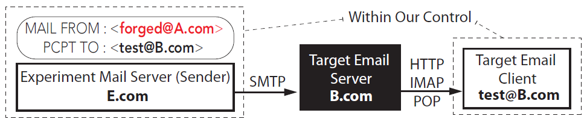
End-to-End Spoofing Experiments
Goal: understanding how email providers reaction to spoofing emails
How?
  Set up an experimental server E.com to send forged emails
  Set up a user account under B.com (popular mail service)
  Send a forged email to the target email service B.com by spoofing A.com
RCPT TO

Slide 16
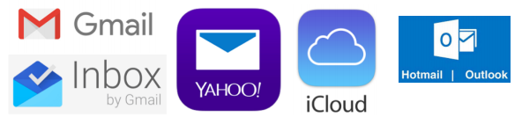




Target Email Providers
35 email providers
  Refer Adobe’s leaked user database (9.3 million unique email domains) → get top 29 email domains
  Added 6 more service after searching on Google
…
…
Cover 99.8 million email addresses (65.7%) in the Adobe database

Slide 17
Experiment Parameters
How different factors affect the outcome of email spoofing?
Policy of Spoofed Sender Address
Strict: SPF/DKIM with a strict “reject” policy
Relaxed: SPF/DKIM with a “none” policy (no policy is specified)
None: no SPF/DKIM/DMARC record

Slide 18
Experiment Parameters
How different factors affect the outcome of email spoofing?
Email content
Blank
Blank w/ benign URL
Blank w/ benign attachment
Benign
Phishing
Policy of Spoofed Sender Address
Strict: SPF/DKIM with a strict “reject” policy
Relaxed: SPF/DKIM with a “none” policy (no policy is specified)
None: no SPF/DKIM/DMARC record

Slide 19
Experiment Parameters
How different factors affect the outcome of email spoofing?
Email content
Blank
Blank w/ benign URL
Blank w/ benign attachment
Benign
Phishing
Policy of Spoofed Sender Address
Strict: SPF/DKIM with a strict “reject” policy
Relaxed: SPF/DKIM with a “none” policy (no policy is specified)
None: no SPF/DKIM/DMARC record
Sender IP
Static IP
Dynamic IP
* Send email for all possible combinations
* Repeat 5 times for each email providers

Slide 20



Target Email Providers: Authentication
35 email providers
  Full authentication check (16): perform all 3 authentication checks (SPF, DKIM, DMARC)
  SPF/DKIM but no DMARC check (15): check either SPF/DKIM but do not check DMARC policy
  No authentication (4): do not perform any of the 3 authentication
…
…
…

Slide 21
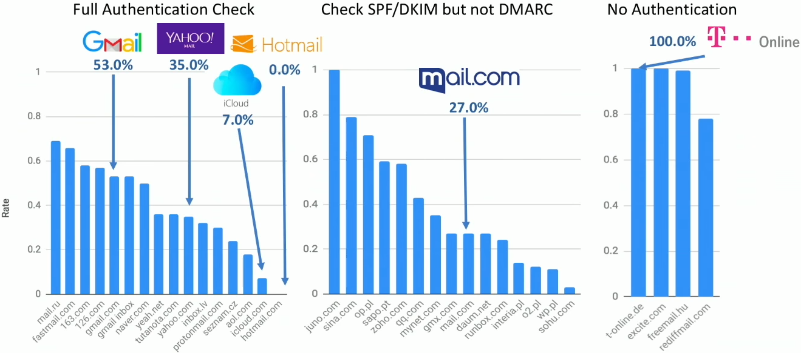
Penetration Rate
*penetration rate? ratio of spoofed mails that are delivered to the users
Impact of receiver’s authentication

Slide 22
Penetration Rate
Impact of receiver’s authentication
Even though email providers conduct authentication check,
Vast majority of spoofing emails still be delivered

Slide 23
Penetration Rate with Impacting Factors
* Strict: SPF/DKIM with a strict “reject” policy
Relaxed: SPF/DKIM with a “none” policy
None: no SPF/DKIM/DMARC record
 |  | Spoofed Sender Address
 |  | Strict | Relaxed | None
Receiver Authentication | Full Authentication | 0.13 | 045 | 0.6
 | SPF/DKIM but no DMARC | 0.28 | 0.37 | 0.5
 | No Authentication | 0.94 | 0.95 | 0.94
Content
Blank | 0.467
Blank w/ benign URL | 0.428
Blank w/ benign attachment | 0.427
Benign w/ actual content | 0.495
Phishing | 0.457
Sender IP
Static IP | 0.6
Dynamic IP | 0.34

Slide 24
Penetration Rate with Impacting Factors
* Strict: SPF/DKIM with a strict “reject” policy
Relaxed: SPF/DKIM with a “none” policy
None: no SPF/DKIM/DMARC record
 |  | Spoofed Sender Address
 |  | Strict | Relaxed | None
Receiver Authentication | Full Authentication | 0.13 | 045 | 0.6
 | SPF/DKIM but no DMARC | 0.28 | 0.37 | 0.5
 | No Authentication | 0.94 | 0.95 | 0.94
Both senders and receivers need to configure correctly
Content
Blank | 0.467
Blank w/ benign URL | 0.428
Blank w/ benign attachment | 0.427
Benign w/ actual content | 0.495
Phishing | 0.457

Slide 25
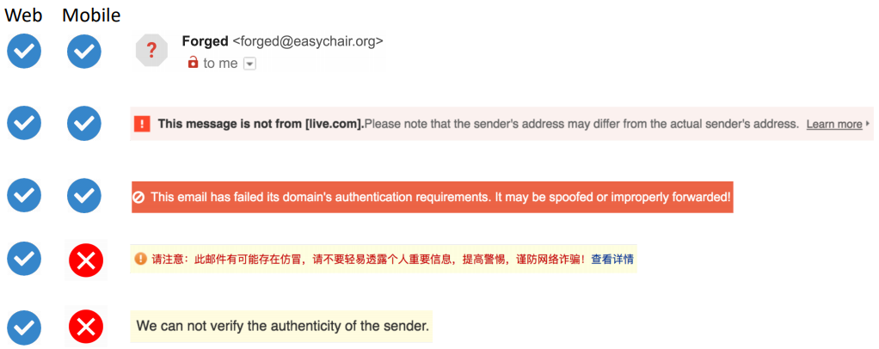
Email Clients and Security Indicators
  Once spoofing emails get in, how do email providers warn users?
    Only 6/35 web clients and 3/28 mobile clients give warnings
Gmail
(* Also, google inbox for mobile)
Naver
Protonmail
163.com
126.com
Mail.ru

Slide 26
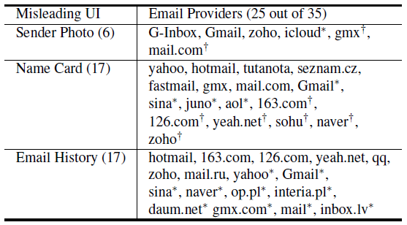
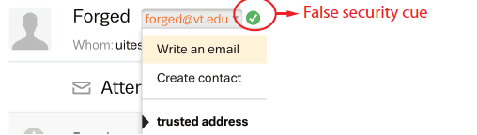
Misleading UI Elements
Find that attackers can trigger misleading UI elements to make the forged emails look realistic
Spoofing existing contacts or same-domain emails
  Profile photo / name card, email history of the spoofed sender is automatically loaded
* Misleading UI Example

Slide 27
User Study: Effectiveness of Security Indicators
Goal: understanding how effective security indicators are in detecting spoofed phishing emails
Challenge
  How to capture the realistic user reactions?
  Participants should examine the phishing email without knowing that they are in an experiment
Method
  (Phase 1) Setup deception
  (Phase 2) Sending actual spoofing emails

Slide 28
Phase 1: Set Up Deception
Frame the study as a survey to understand email using habits
Procedures
  Ask for users’ email address
  Send an email that contains tracking pixel to check if the email has been opened
  Ask a few distraction questions about email using habits
  Pay users and make them believe the survey is over
Purpose
  To make sure the participants actually own the email address
  To set up the deception

Slide 29
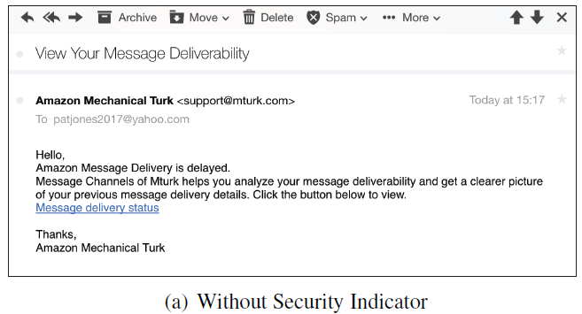
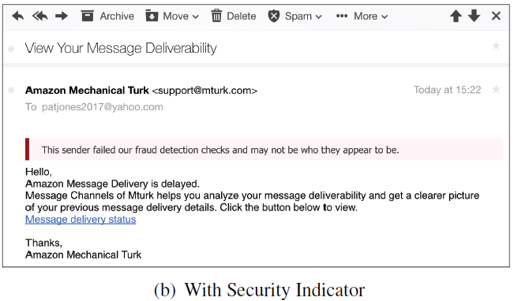
Phase 2: Sending Spoofing Emails
Wait for 10 days and send the phishing email
  Impersonate the tech-support of Amazon Mechanical Turk
  The email contains a benign URL pointing to authors server to measure whether an URL is clicked
Test 2 security indicator settings
  With security indicator (text-based)
  Without security indicator
Wait for another 20 days to monitor user clicks
  After then, send debriefing emails
✓

Slide 30
User Study: Results
Participants
  488 users from Amazon Mechanical Turk
  243 in “without indicator” group / 245 in “with indicator” group
Results
 | Users | w/o Indicator | w/ Indicator
Phase 1 | All participants | 243 | 245
 | Not block tracking pixel | 176 | 179
Phase 2 | Opened email | 94 | 86
 | Clicked URL | 46 | 32
Click Rate | Clicked URL / Opened Email | 0.49 | 0.37

Slide 31
Discussion
Email availability vs. Security
  Difficult trade-off between security and email availability
  Most email providers let spoofing emails reach inbox even when the email fails the authentication
  Blocking all the unverified emails can block legitimate emails
Countermeasures
  Email providers should adopt SPF, DKIM, DMARC
  Research is needed to ease the deployment process
  Place a security indicator to warn users
  Misleading UI elements should be disabled

Slide 32
Conclusion
End-to-end measurement provides new insights into how email providers handle forged emails
  Reveal trade-off between email availability and security
Empirically analyze the usage of security indicators on spoofed emails
  Show that most email providers lack the security indicators and also have misleading UIs
Conduct a real-world phishing test to evaluate the effectiveness of the security indicator
  Demonstrate the positive impact of the security indicator

Slide 33
Q & A
Thank you.

