Slide 1
Quack: Scalable Remote Measurement of Application-Layer Censorship
Benjamin VanderSloot, Allison McDonald, Will Scot,
J. Alex Halderman, Roya Ensafi
(University of Michigan)
USENIX Security 2018
2020. 02. 13
Hyeonmin Lee
Network Convergence and Security Laboratory
hmlee@mmlab.snu.ac.kr

Slide 2
Outline
Introduction
System Design
  Echo Protocol
Experiment
  Setup & Data
Evaluation
Calculation

Slide 3
Introduction
Global censorship measurement is a challenging problem
  The most common way for censorship measuring uses in-country volunteers to host network probes
But this kinds of research have some problems
  Hard to scale
  Volunteers have substantial risks about cooperating
To address these problems recent works focus on remote measurement of
  DNS poisoning: manipulate DNS response
  TCP/IP connectivity disruptions: intentional packet drops
  Application-layer censorship

Slide 4
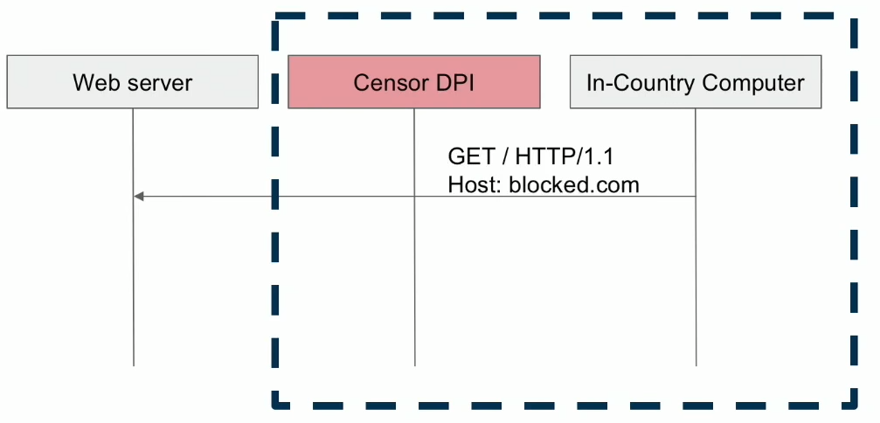
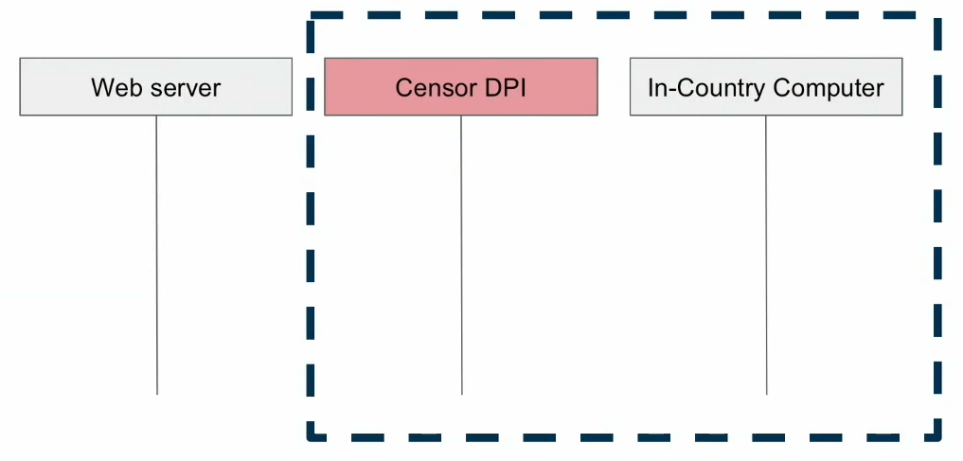
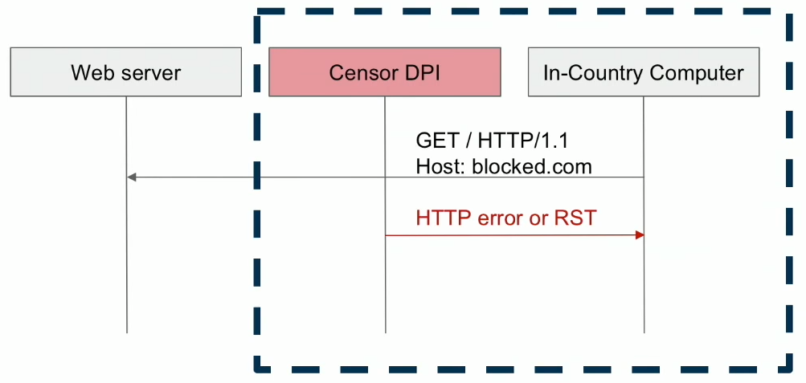
Background: Application-Layer Censorship
With the increasing popularity of CDN, application-layer censorship has become important
  DNS or IP based censorship cannot look into the content of requests
Adversary
Adversary
Adversary
Adversary
※ RST: Field in TCP header, immediately kill TCP connection

Slide 5
System Design: Quack
Quack: The first remote censorship measurement technique that efficiently detects application-layer blocking
Goal
  Detection: if keywords are blocked
  Safety: minimize risk to end-users in censored countries
  Robustness: distinguish unrelated network activity (e.g. packet loss)
  Scalability: accurately measure the phenomenon of keyword blocking on a global scale

Slide 6
System Design: Echo Protocol
Quack relies on Echo protocol
Echo protocol (RFC 862)
  If a client sends a data, a server sends back the data it receives
  Public IPv4 addr. space contains more than 50,000 echo servers across 196 countries
Why use Echo?
  Send arbitrary binary data → Can test any application-layer protocol (ex. HTTP)
  Send back original data → Can learn directionality of blocking
(Details in later)

Slide 7
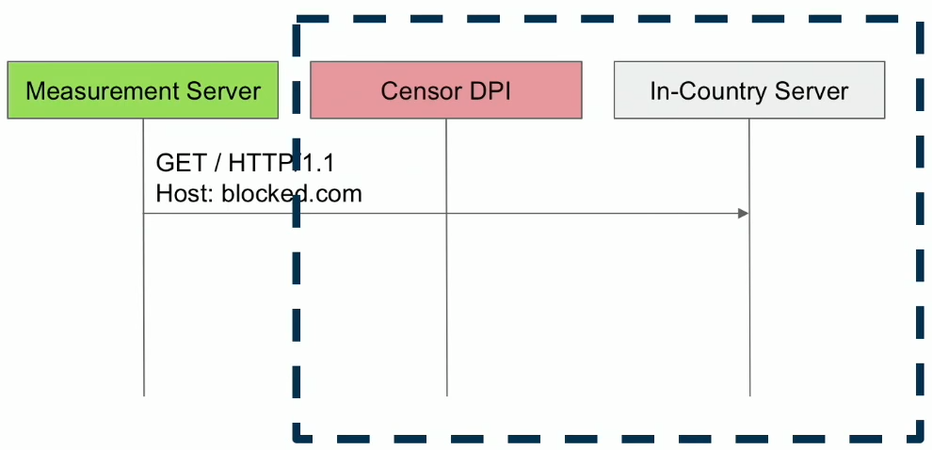
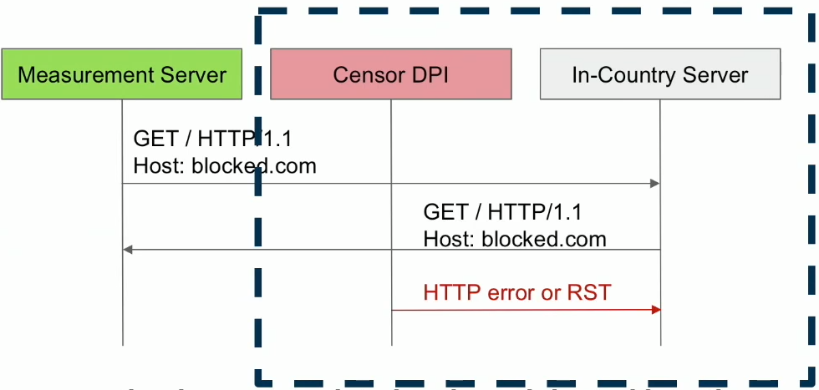
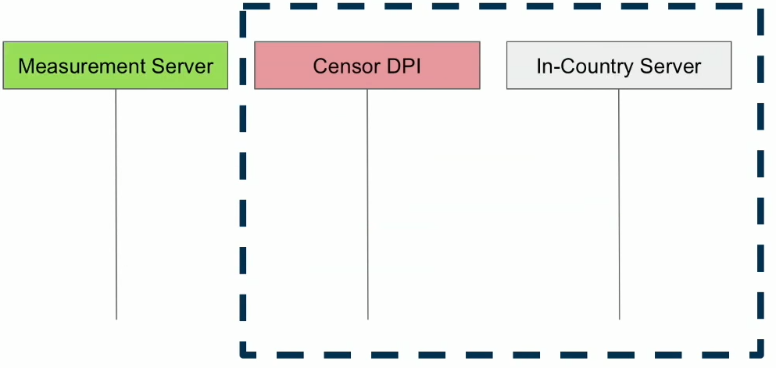
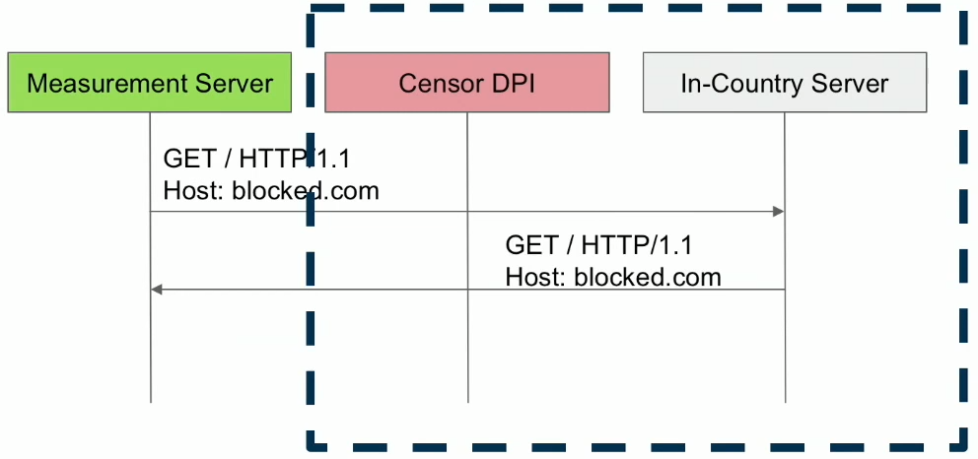
System Design: Echo Protocol
Censorship measurement with Echo protocol
Adversary
Echo Server
Adversary
Echo Server
Adversary
Echo Server
Adversary
Echo Server
No response??
Request is Blocked!!

Slide 8
Coverage of Echo Server
Discovery
  Perform Internet-wide scans on the IPv4 addr. space
  Find more than 50,000 echo servers (for 2 months daily scans)
Coverage
  Associate IPs with ASs
  On average, find echo servers in 177 countries
  39 countries with more than 100 echo servers
  82 countries with more than 15 echo servers

Slide 9
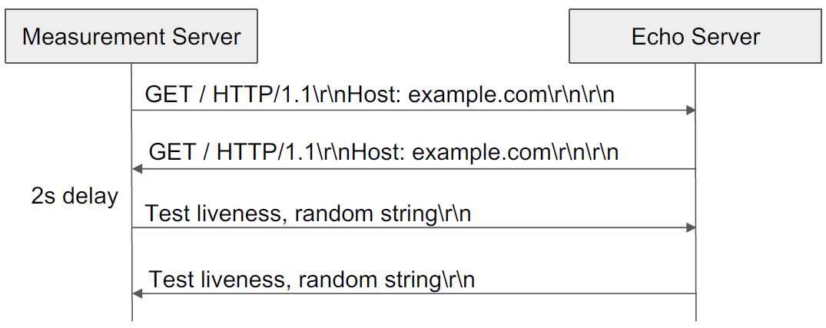
System Design: Details
Single trial
  An individual transaction with a remote echo server
  Conducted with an application protocol containing a single keyword
*keyword
Response1
Response2
※ Response1 is blocked? Blocked immediately
Response2 is blocked? Connected but RST packet is injected

Slide 10
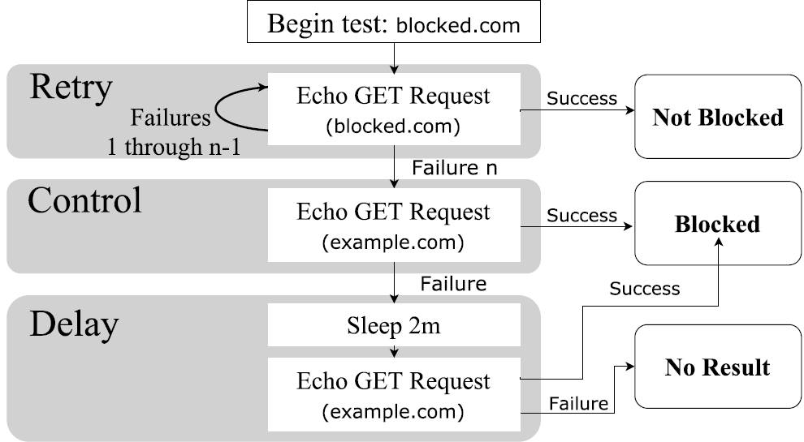
System Design: Details
Single test
  The repeated single trial of a particular Echo server & keyword
  To distinguish noise from network interference through multiple retries (noise? e.g. sporadic packet loss)
*keyword

Slide 11
System Design: Details
Single test
  Consist of 3 phases
Retry phase
  Run a trial with a target keyword
  (e.g. blocked.com)
  Retry if it fails
*keyword
*noise: sporadic packet loss, server error, etc.
  Get expected answer: Target keyword is not blocked for this server
  Cannot get any answer: Why.. Is it blocked? or some *noise?
  Need to ensure it

Slide 12
System Design: Details
Single test
  Consist of 3 phases
Control phase
  Run a trial with an innocuous keyword (e.g. example.com)
*keyword
  Get expected answer: Target keyword is blocked
  Cannot get the answer: Is it noise..? or *stateful disruption?
*Stateful disruption? Once a request is blocked,
successive requests are also blocked

Slide 13
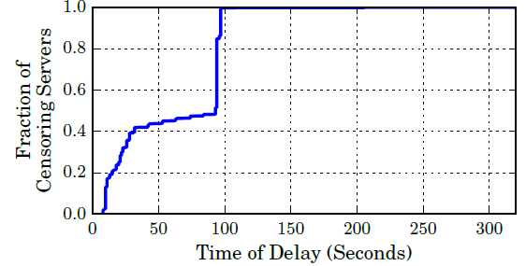
System Design: Details
Single test
  Consist of 3 phases
Delayed phase
  Run a trial again with an innocuous keyword
  To inspect stateful disruption, use 2 min delay
*keyword
Why 2 min?
After 100 sec, 99.9% responded correctly
< CDF of the length of time interference occurs after a censorship event >
  Get expected answer? Target keyword is blocked
  Cannot get the answer? No Result! echo server is not responsive

Slide 14
Experiment Setup
Examine URLs as the source of content that can be disrupted
  Send the domain name (keyword) in a valid HTTP/1.1 GET request
  ex)
Citizen Lab Block List
  A set of URLs for researchers to use for censorship research (e.g. pornographic websites)
  Contains 1109 URLs (July 2017)
  Send 1109 URLs to each target echo servers

Slide 15
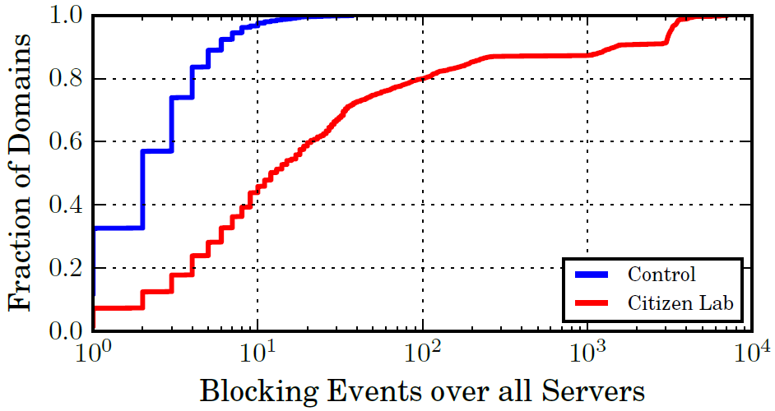
Experiment Setup
Citizen Lab Block List vs. Control (Innocuous URLs)
  Control: 99% of echo servers show less than 10 blocking events
  Citizen Lab: 20% of servers show more than 100 blocking events
Blocking Detection works well !

Slide 16
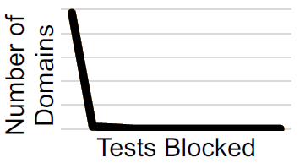
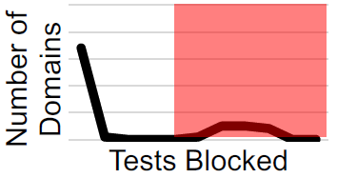
Evaluation: Classifying Interference
Differentiate interference that is occurring at a local level (e.g. firewall) from that a national level
  Consider distribution of blocked domains for each country
  If the distribution is not monotonic, a country is marked as conducting national-wide interference
ex) Due to firewall
Country A
# of Domains
Monotonic
# of Blocked Test
Some domains are blocked many times!
Evidence of
national-wide
censorship
Country B
# of Domains
Not Monotonic
# of Blocked Test

Slide 17
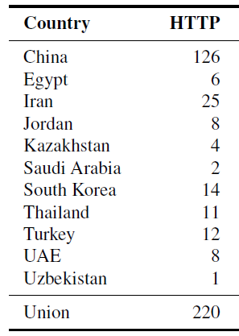
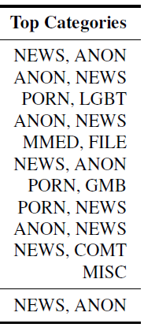
Evaluation: Detecting Interference
Test Citizen Lab Global List against echo servers around the world
Censorship observed in 12 countries
  With unique 220 domains (among 1109 domains)
  Only consider countries who have at least 15 echo servers
Country Blocked Domains Category

Slide 18
Evaluation: Detecting Interference
Censorship observed in 12 countries
  With unique 220 domains (among 1109 domains)
  Only consider countries who have at least 15 echo servers
Country Blocked Domains Category
NEWS: news outlets
ANON: tools used for anonymization
PORN: pornography
LGBT: gay-lesbian-bisexual-transgender queer issues
MMED: video, photo sharing platform
FILE: tools used to share files
GMB: online gambling site
COMT: communication tools

Slide 19
Evaluation: Detecting Interference
Censorship observed in 12 countries
  With unique 220 domains (among 1109 domains)
  Only consider countries who have at least 15 echo servers
Country Blocked Domains Category
NEWS: news outlets
ANON: tools used for anonymization
PORN: pornography
LGBT: gay-lesbian-bisexual-transgender queer issues
MMED: video, photo sharing platform
FILE: tools used to share files
GMB: online gambling site
COMT: communication tools

Slide 20
Evaluation: Detecting Interference
Censorship observed in 12 countries
  With unique 220 domains (among 1109 domains)
  Only consider countries who have at least 15 echo servers
Country Blocked Domains Category
NEWS: news outlets
ANON: tools used for anonymization
PORN: pornography
LGBT: gay-lesbian-bisexual-transgender queer issues
MMED: video, photo sharing platform
FILE: tools used to share files
GMB: online gambling site
COMT: communication tools

Slide 21
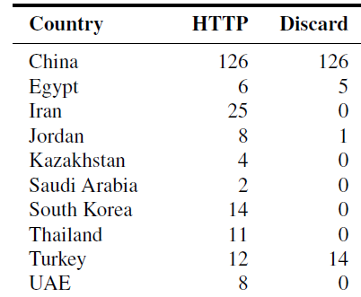
Evaluation: Directionality
Does the direction of a request matters? (Inbound or Outbound)
  Use Discard Protocol: similar to Echo protocol but the server only send an ACK (not echoing)
Test the subset of echo servers that are also serving Discard protocol
  Only blocking outbound data: 6 countries (among 10 countries)
Country Echo Discard
Echo Protocol | Discard Protocol | Directionality
Blocked | Blocked | Inbound + (Outbound cannot know)
 | Not blocked | Only Outbound
< # of blocked domains >

Slide 22
Evaluation: Alexa Top 100,000
Test across 40 countries for the Alex 100,000 top domains
  Only consider countries who have at least 100 echo server
  Provide insight into what is being blocked in each country without introducing the biases of a manually curated list
Observe censorship in 7 countries
  Most of blocked domains are from pornography category

Slide 23
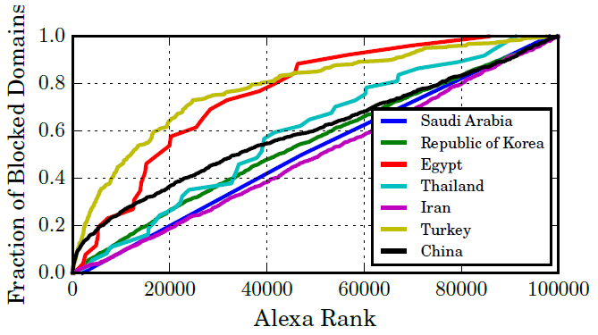
Evaluation: Alexa Top 100,000
Test across 40 countries for the Alex 100,000 top domains
  Only consider countries who have at least 100 echo server
  Provide insight into what is being blocked in each country without introducing the biases of a manually curated list
How each country's blocking changes with the popularity of a site?
  Some countries block popular domains with greater frequency
  Why? Maybe domains are blocked when they are detected to be visited with high frequency (reactive blocking)

Slide 24
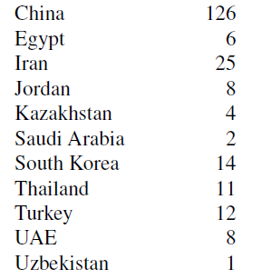

Additional Test: HTTP vs. HTTPS
Send request as valid TLS ClientHello messages with Server Name Indication (SNI) Extension
  SNI? a client indicates which hostname it is attempting to connect to in a ClientHello message
  SNI places the domain name in clear-test → Used for censorship..
Country HTTP HTTPS
※ South Korea also uses SNI filtering to block illegal/harmful websites since Feb 2019
< # of blocked domains >

Slide 25
Conclusion
Introduce Quack, a new system for remotely detecting application-layer interference at global scale
  Exploit Echo servers which are already deployed
Show that Quack can effectively detect application-layer blocking
  Test using Citizen Lab Block List and Alexa 100,000 domains
  Detect censorship in 12 countries
Analyze the results to provide insight into application-layer blocking ecosystem
  Most consistently blocked services are related to news, circumvention tools or pornography

Slide 26
Q & A
Thank you.

