Slide 1
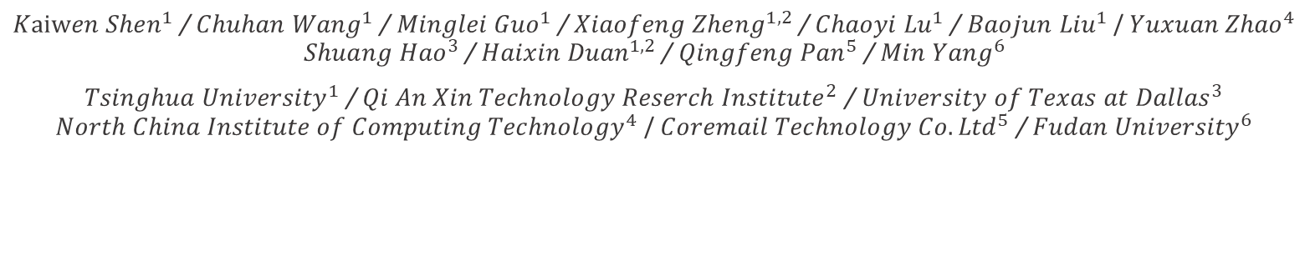
Weak Links in Authentication Chains:
A large-scale Analysis of
Email Sender Spoofing Attacks
USENIX Security 2021 (Prepublication)
${Kaiwen Shen}^{1}$ / ${Chuhan Wang}^{1}$ / ${Minglei Guo}^{1}$ / ${Xiaofeng Zheng}^{1, 2}$ / ${Chaoyi Lu}^{1}$ / ${Baojun Liu}^{1}$ / ${Yuxuan Zhao}^{4}$ ${Shuang Hao}^{3}$ / ${Haixin Duan}^{1, 2}$ / ${Qingfeng Pan}^{5}$ / ${Min Yang}^{6}$
${Tsinghua University}^{1}$ / ${Qi An Xin Technology Reserch Institute}^{2}$ / ${University of Texas at Dallas}^{3}$ ${North China Institute of Computing Technology}^{4}$ / ${Coremail Technology Co. Ltd}^{5}$ / ${Fudan University}^{6}$
2021. 04. 01
Hyeonmin Lee
hmlee@mmlab.snu.ac.kr
Network Convergence and Security Lab

Slide 2
Outline
Introduction & Background
  Email delivery process
  Email spoofing protections
Attack Model
Email Spoofing Attack Experiment
  Email sending authentication
  Email receiving verification
  Email forwarding verification
  Email UI rendering
Conclusion

Slide 3





Introduction
Email is playing an important role in both individual and corporate communications
Email delivery process
* If an email forwarding
service is used
* MUA: Mail User Agent
MTA: Mail Transfer Agent
SMTP
SMTP
Forwarding Server
SMTP
HTTP
IMAP
HTTP
…
SMTP
Sender’s MUA
Sender’s MTA
Receiver’s MTA
Receiver’s MUA

Slide 4



Introduction
No security features in the initial design of the mail delivery
  Key target of cyber attacks
SMTP
SMTP
Forwarding Server
SMTP
HTTP
IMAP
HTTP
…
SMTP
Sender’s MUA
Sender’s MTA
Receiver’s MTA
Receiver’s MUA

Slide 5

Introduction
No security features in the initial design of the mail delivery
  Key target of cyber attacks
Several security extensions have been proposed
  SPF, DKIM, and DMARC … (will see in later)
SPF
DKIM
DMARC
Forwarding Server
SPF
DKIM
DMARC
Sender’s MUA
Sender’s MTA
Receiver’s MTA
Receiver’s MUA

Slide 6
What’s the Problem?
Authentication of an email involves 4 different roles
  Senders / Receivers / Forwarders / UI renderers
Security mechanisms have a number of inconsistencies in implementation among different services (ex. dealing with ambiguous headers)
  Attackers can exploit these inconsistencies
Forwarding Server
SPF (ver. A)
SPF (ver. B)
Sender’s MUA
Sender’s MTA
Receiver’s MTA
Receiver’s MUA
(Include UI renderer)

Slide 7
What’s the Problem?
The authenticity of an email depends on the weakest link
in the authentication chain
If any role or service fails to provide a proper security defense, an email’s authenticity can be broken
I support
SPF
Forwarding Server
I do not support
SPF
Sender’s MUA
Sender’s MTA
Receiver’s MTA
Receiver’s MUA
(Include UI renderer)

Slide 8
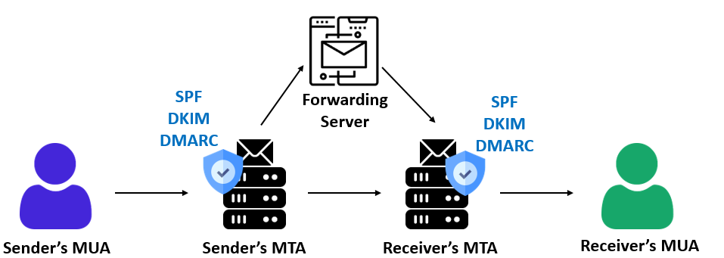

In This Work..
Systematically analyze authentication chains in the email delivery process
  Conduct a large-scale experiment on 30 popular email services with billion of users
Identify a series of new attacks capable of bypassing security extensions
  By combining different attacks, a spoofing email can completely pass all email security protocols
  All popular email services are vulnerable to certain types of attacks

Slide 9


Background – Email Security Extensions
Sender Policy Framework (SPF)
  Allow email service to publish a list of IPs that are authorized to send emails for its domain
  Receiving email services can check this record to match the sender’s IP
SPF record
1.2.3.4
DNS
(a.com)
IP: 1.2.3.4
MAIL FROM: alex@a.com
IP: 1.2.3.4
Sender
MTA
(a.com)
MTA
(b.com)
Receiver

Slide 10
Background – Email Security Extensions
DomainKeys Identified Mail (DKIM)
  Sender’s email service put a digital signature in the email header signed by the private key of sender’s domain
  The receiving service retrieves the sending service’s public key from DNS to check the signature
DKIM record
Key=MIgwD…
DNS
(a.com)
MAIL FROM: alex@a.com
DKIM-Signature: Mtld..
Sender
MTA
(a.com)
MTA
(b.com)
Receiver

Slide 11
Background – Email Security Extensions
Domain-based Message Authentication, Reporting and Conformance (DMARC)
  Built on top of SPF & DKIM (not a standalone protocol)
  Allow the domain administrator to publish a policy to specify what actions the receiver should take when the incoming mail fails SPF/DKIM check
SPF record
SPF correct? Pass
incorrect? Reject mail
DKIM correct? Pass
incorrect? Pass w/ caution
DMARC record
DKIM record
DNS
(a.com)
MAIL FROM: alex@a.com
DKIM-Signature: Mtld..
Sender
MTA
(a.com)
MTA
(b.com)
Receiver

Slide 12
Background – Sender’s Identity
Sender’s identity information in the SMTP
  Auth username: Used to authenticate the user
  Mail From: Used for identity verification during the mail delivery process
  From: Displayed address that the email client shows to the user
Auth login: <Alice@a.com>, password
Mail From: <Alice@a.com>
From: <Alice@a.com>
To: <Bob@b.com>
Subject: Mail from Alice.
* SPF checks a domain in Mail From
DKIM, DMARC check a domain in From
Bob’s view
The inconsistency of these fields provides the basis
for email spoofing attacks

Slide 13
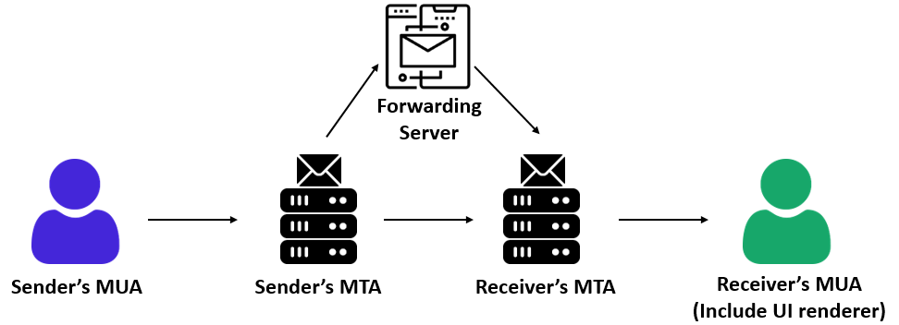
Background – Stages of Authentication
4 critical stages of authentication in the email transmission
Email Sending Authentication | Sender’s MTA must verify the user’s identity (also, the consistency of Mail From field and Auth username field)
Email Receiving Verification | Receiver’s MTA must validate the sender’s authenticity through SPF, DKIM, DMARC protocols
Email Forwarding Verification | Email forwarder must verify the sender’s address
Email UI Rendering | Email client’s UI must present the authenticity check result to users
If any stages fail to authentication,
an email can be spoofed

Slide 14
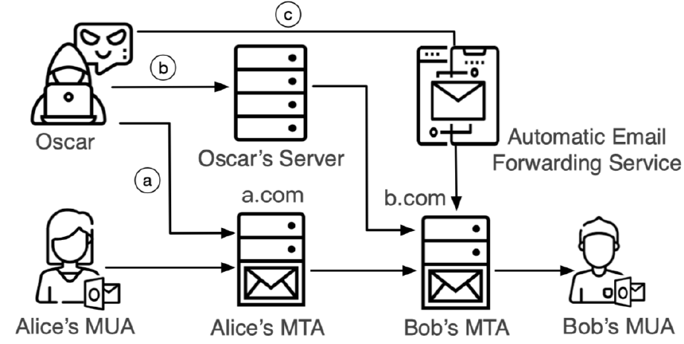
Attack Model
Shared MTA attack
  An attacker sends spoofing emails through the reputable MTA by modifying the Mail From, From, Auth username headers
  Spoofing emails can bypass the SPF/DKIM/DMARC through reputable MTA
a
Auth login: <Oscar@a.com>
Mail From: <Oscar@a.com>
From: <Alice@a.com>
To: <Bob@b.com>
Subject: I’m Alice. Click the below link.
Have an email account under a.com
(Oscar@a.com)
SPF check
Bob’s view
(Alice@a.com)
(Bob@b.com)

Slide 15
Attack Model
Direct MTA attack
  An attacker sends spoofing mail through his own server
  The attacker can spoof arbitrary sender by modifying the Mail From, From headers
  Especially work well if the receiver’s MTA does not have an authentication mechanism
b
Mail From: <Oscar@attack.com>
From: <Alice@a.com>
To: <Bob@b.com>
Subject: I’m Alice. Click the below link.
Bob’s view
(Alice@a.com)
(Bob@b.com)

Slide 16
Attack Model
Forward MTA attack
  Abuse the email forwarding service to automatically forward spoofing email to the victim
  Bypass the receiver’s security check through the legitimate MTA of forwarding services
c
SPF check
Mail From: <>
From: <Alice@a.com>
To: <Bob@b.com>
Subject: I’m Alice.
Click the below link.
Mail From: <Oscar@c.com>
From: <Alice@a.com>
To: <Bob@b.com>
Subject: I’m Alice.
Click the below link.
c.com
Bob’s view
(Alice@a.com)
(Bob@b.com)

Slide 17
Experiment
Aim to cover all possible verification issues throughout the email delivery process
  Analyze 30 email services including popular public email services & enterprise-level email services
Focus on modifying SMTP header values related to authentication to spoof emails
  Headers: Mail From, From, …
  Set email content as legal and harmless to minimize the effect of spam detection
An email spoofing attack is successful if the email is delivered to the victim’s inbox (not a spam box)
  Repeat each attack 3 times
  Only attacks that work all 3 times are considered as successful

Slide 18
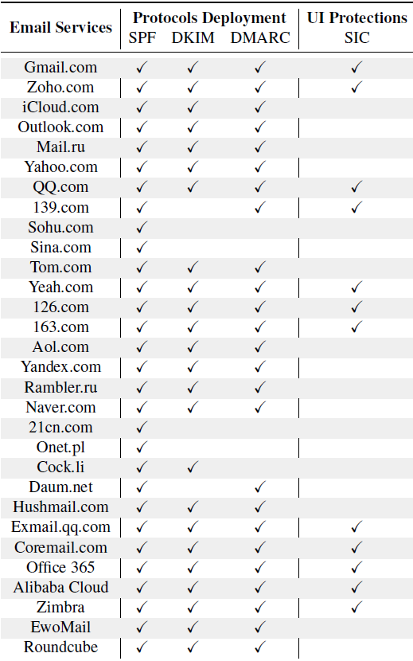
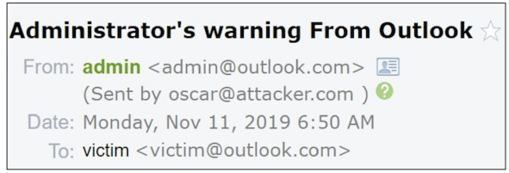
Results – Deployment of Email Protections
Security protocols
  All email providers support SPF
  23 providers deploy all of the 3 protocols
Sender inconsistency checks (SIC)
  Only 12 providers perform SIC
  Security indicator alerts the receiver that the actual sender may not be the displayed one

Slide 19
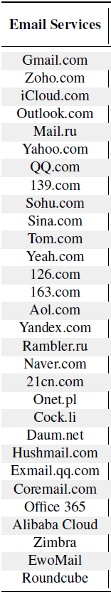
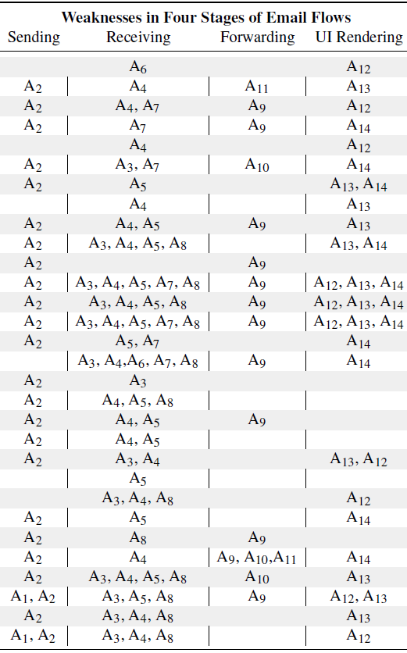
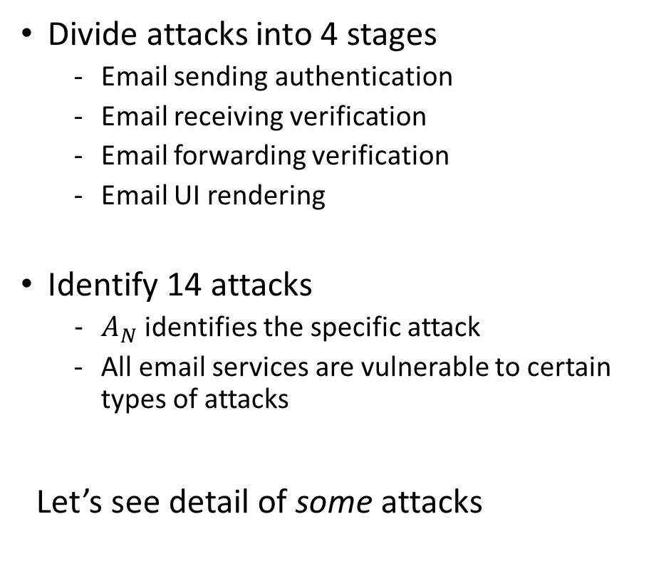
Results – Email Sender Spoofing Attacks
Divide attacks into 4 stages
  Email sending authentication
  Email receiving verification
  Email forwarding verification
  Email UI rendering
Identify 14 attacks
  $A_{N}$ identifies the specific attack
  All email services are vulnerable to certain types of attacks
Let’s see detail of some attacks

Slide 20
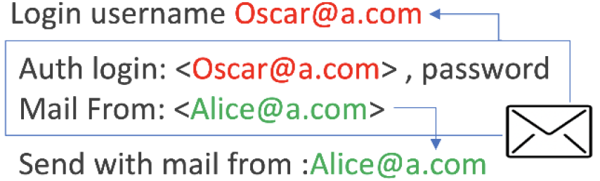
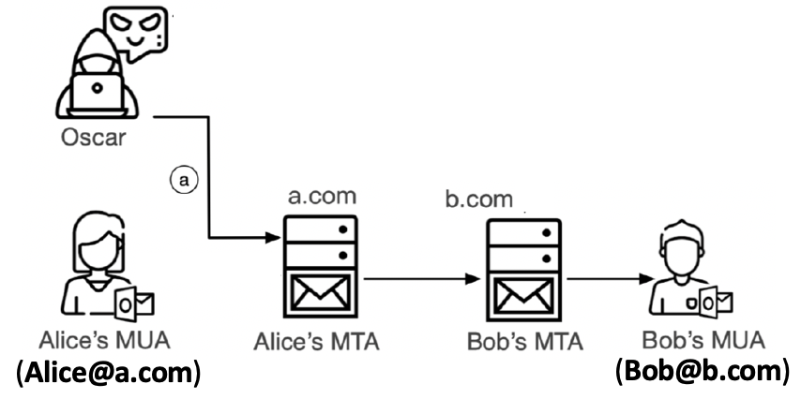
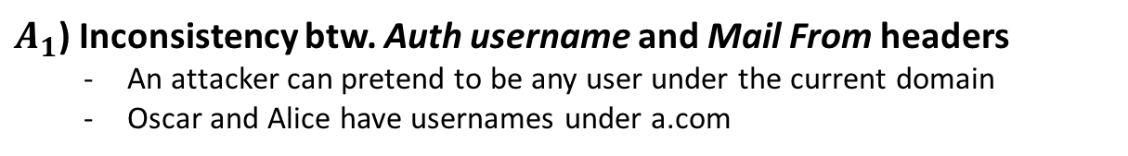
1) Attacks in Email Sending Authentication
Abuse the reputation of well-known email services
  Mainly used in the shared attack model
$A_{1}$) Inconsistency btw. Auth username and Mail From headers
  An attacker can pretend to be any user under the current domain
  Oscar and Alice have usernames under a.com
Most email services prohibit this inconsistency
But 2 services are vulnerable
(Zimbra, Roundcube)

Slide 21
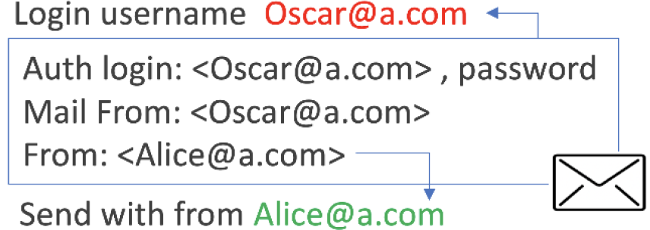
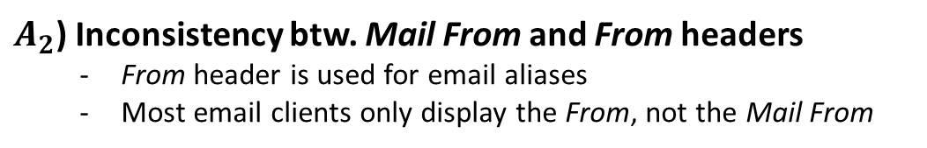
1) Attacks in Email Sending Authentication
Abuse the reputation of well-known email services
  Mainly used in the shared attack model
$A_{2}$) Inconsistency btw. Mail From and From headers
  From header is used for email aliases
  Most email clients only display the From, not the Mail From
24 email services are vulnerable
(Outlook, Yahoo, Naver, …)

Slide 22
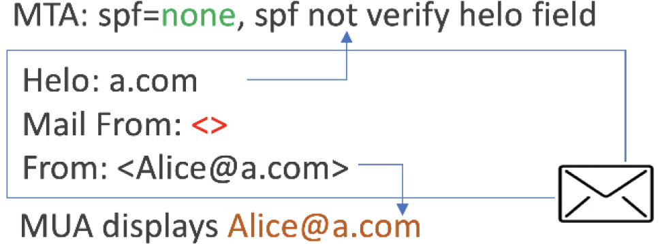
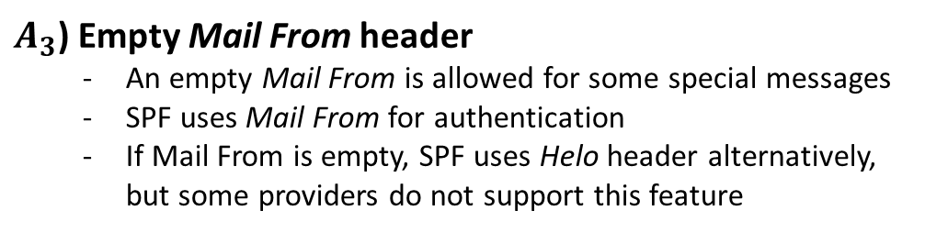
2) Attacks in Email Receiving Verification
* SPF checks a domain in Mail From
DKIM, DMARC check a domain in From
Try to bypass SPF/DKIM/DMARC verification
  An attack is successful if the receiver’s MTA gets a ‘none or pass’ verification result
$A_{3}$) Empty Mail From header
  An empty Mail From is allowed for some special messages
  SPF uses Mail From for authentication
  If Mail From is empty, SPF uses Helo header alternatively, but some providers do not support this feature
13 email services are vulnerable
(Sina, Alibaba Cloud, …)

Slide 23
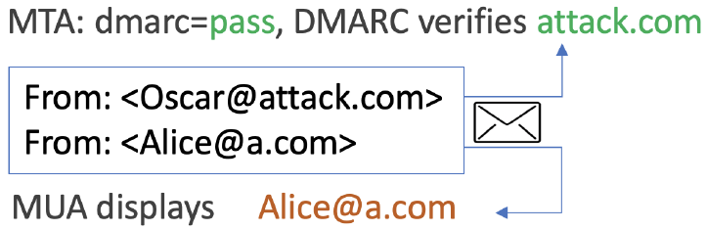
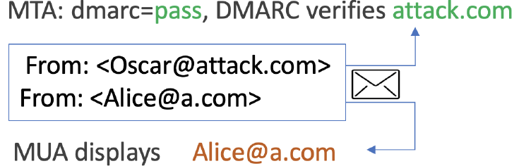
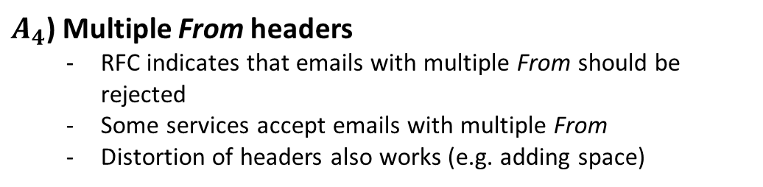
2) Attacks in Email Receiving Verification
* SPF checks a domain in Mail From
DKIM, DMARC check a domain in From
Try to bypass SPF/DKIM/DMARC verification
  An attack is successful if the receiver’s MTA gets a ‘none or pass’ verification result
$A_{4}$) Multiple From headers
  RFC indicates that emails with multiple From should be rejected
  Some services accept emails with multiple From
  Distortion of headers also works (e.g. adding space)
< Ordinary multiple From attack >
19 email services are vulnerable
(iCloud, Naver, …)
< Multiple From attack with spaces >

Slide 24
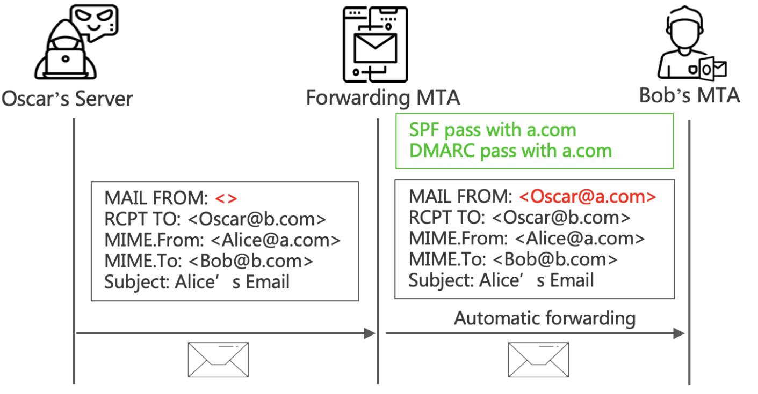

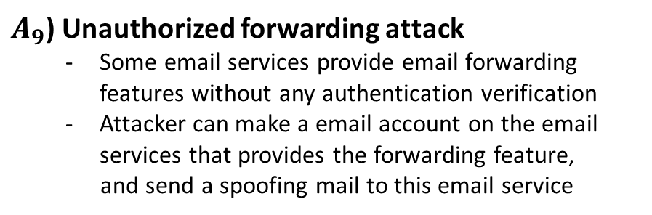
3) Attacks in Email Forwarding Verification
* SPF checks a domain in Mail From
DKIM, DMARC check a domain in From
Abuse the email forwarding service
  Also, forwarding service can give an email a higher security endorsement (ex. DKIM signature)
a.com
b.com
$A_{9}$) Unauthorized forwarding attack
  Some email services provide email forwarding features without any authentication verification
  Attacker can make a email account on the email services that provides the forwarding feature,
  and send a spoofing mail to this email service
< iCloud forwarding feature without any authentication >
12 email services are vulnerable
(iCloud, Outlook, …)

Slide 25
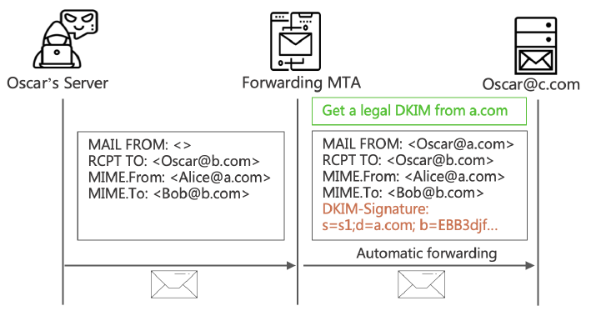
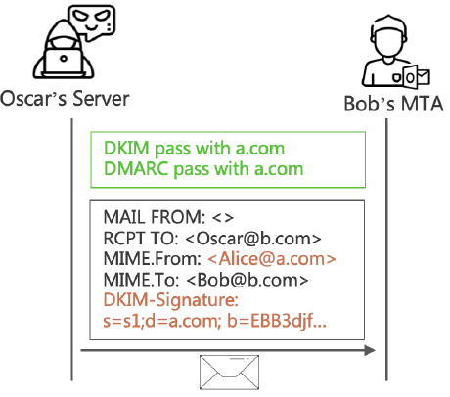
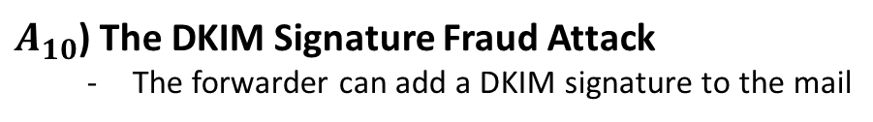
3) Attacks in Email Forwarding Verification
* SPF checks a domain in Mail From
DKIM, DMARC check a domain in From
Abuse the email forwarding service
  Also, forwarding service can give an email a higher security endorsement (ex. DKIM signature)
$A_{10}$) The DKIM Signature Fraud Attack
  The forwarder can add a DKIM signature to the mail
3 email services are vulnerable
(Yahoo, Office 365, Alibaba Cloud)
a.com
Included in the DKIM signature
1. The attacker can obtain a DKIM signature signed by a.com
2. The attacker can spoof with the legal DKIM signature
Notes:
Mail From – DKIM hash 포함 안돼도 됨 (rfc 6376 5.4.1)

Slide 26
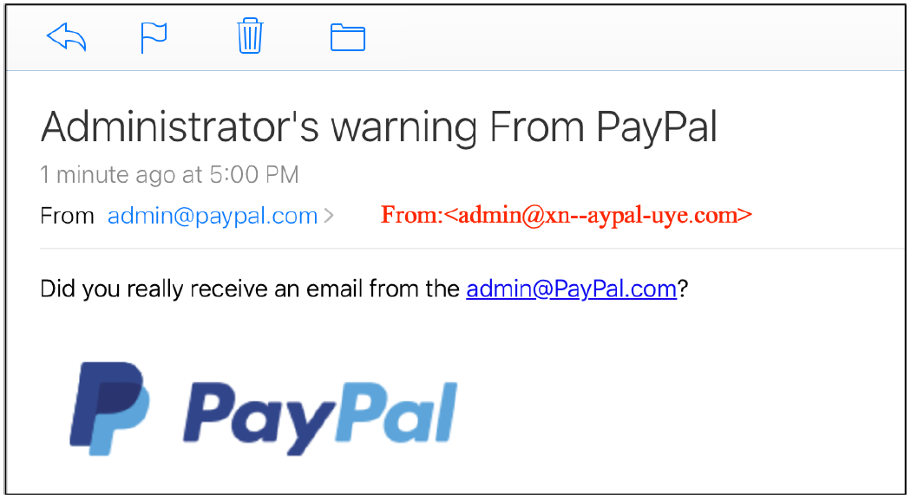
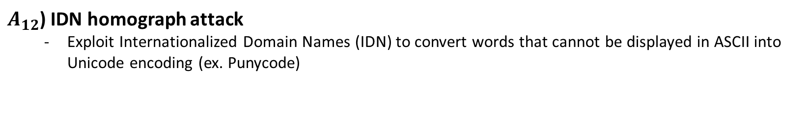
4) Attacks in Email UI Rendering
Try to bypass the sender inconsistency checks and spoof the email address shown for users (rather than bypass email security protocols)
$A_{12}$) IDN homograph attack
  Exploit Internationalized Domain Names (IDN) to convert words that cannot be displayed in ASCII into Unicode encoding (ex. Punycode)
Displayed address
(ex. Cyrillic alphabets)
Actual address
IDN | ASCII domain name
안녕.com | xn-bm41afbe.com
أهلا.com | xn-ik41-w3dm.com
10 email services
are vulnerable
< IDN example >

Slide 27

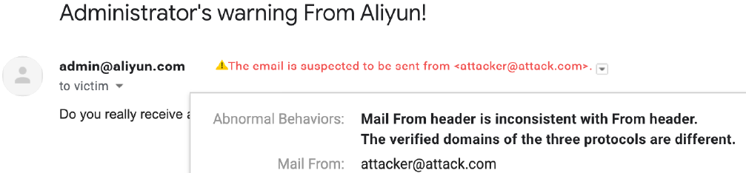
Mitigation and Disclosure
Mitigation
  Need more accurate email protocol descriptions to eliminate inconsistencies in the practice
  ex) Email forwarders should not add DKIM signature to all emails
  Need a user-friendly UI notification and alerts for spoofing emails
Disclosure to email vendors
  Reported the vulnerabilities to all 30 relevant email services
  Got responses from Alibaba Cloud / Gmail / iCloud / Yahoo / QQ Mail / Outlook …

Slide 28
Conclusion
Explore the vulnerabilities of the chain-based authentication structure in the email ecosystem
  The authenticity of an email depends on the weakest link in the email authentication chain
Conduct large-scale analysis with 30 popular email services
  Find a series of new attacks that can bypass SPF/DKIM/DAMRC and user-interface protections
  All popular services are vulnerable to the some new attacks
Suggest key mitigating measures to defend against email spoofing attacks
  Also report the revealed problems to each email service providers

Slide 29
Thank you!

