Slide 1
Why TLS is better without STARTTLS
- A Security Analysis of STARTTLS in the Email Context
USENIX Security 2021
Damian Poddebniak, Fabian Ising, Hanno Böck, and Sebastian Schinzel
Münster University of Applied Science
2021. 10. 28
Hyeonmin Lee
hmlee@mmlab.snu.ac.kr
Network Convergence and Security Lab

Slide 2
Outline
Introduction & Background
  Email ecosystem
  STARTTLS vs. Implicit TLS
Finding Vulnerabilities in STARTTLS Implementations
  Classification of Vulnerabilities
  Client-side Measurements
  Server-side Measurements
Conclusion

Slide 3


Introduction - Email Ecosystem
MTA-to-MTA
SMTP
(Port 25)
*MTA:
Mail Transfer Agent
Relay
MTA
MTA
Submission
SMTP
(Port 25, 587)
Retrieval
IMAP/POP3
(Port 143/110)
Mail Client
Mail Client

Slide 4
Email Ecosystem
MTA-to-MTA
SMTP
(Port 25)
Relay
MTA
MTA
Submission
SMTP
(Port 25, 587)
Retrieval
IMAP/POP3
(Port 143/110)
Focus on
Mail Client
Mail Client

Slide 5
Email Ecosystem – TLS
MTA-to-MTA
SMTP
(Port 25)
Submission
SMTP
(Port 25, 587)
Retrieval
IMAP/POP3
(Port 143/110)
MTA
MTA
TLS
TLS
Mail Client
Mail Client

Slide 6
Email Ecosystem – TLS
MTA-to-MTA
SMTP
(Port 25)
Submission
SMTP
(Port 25, 587)
Retrieval
IMAP/POP3
(Port 143/110)
MTA
MTA
STARTTLS
TLS
TLS
Mail Client
Mail Client

Slide 7
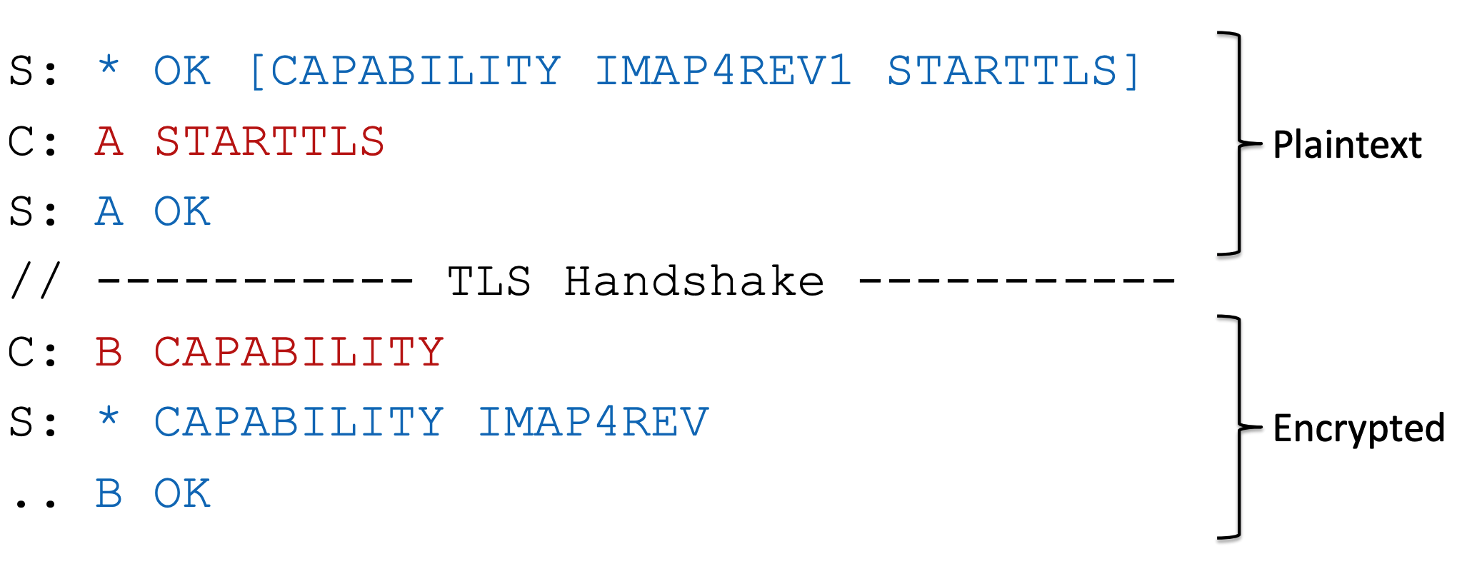
STARTTLS
Below example shows a typical STARTTLS message exchange
  A server sends its capabilities including STARTTLS to a client
  The client sends STARTTLS command if the server supports it
  The session is encrypted if both the client and the server support STARTTLS
S: Server
C: Client
Opportunistic TLS

Slide 8
Email Ecosystem – TLS
MTA-to-MTA
SMTP
(Port 25)
Submission
SMTP
(Port 25, 587)
Retrieval
IMAP/POP3
(Port 143/110)
MTA
MTA
STARTTLS
TLS
TLS
or
Implicit TLS
Port 465
Implicit TLS
Port 993/995
Implicit TLS
Mail Client
Mail Client

Slide 9
STARTTLS vs. Implicit TLS (in Email)
STARTTLS
  Opportunistic TLS
  It is known that STARTTLS is vulnerable to downgrade attacks
Implicit TLS
  The use of alternative ports (for mail transmission) is called implicit TLS by modern standards to distinguish them from STARTTLS
From a security or performance view, implicit TLS is better than STARTTLS
  No downgrade attacks
  No extra commands to check TLS support
→ STARTTLS is discouraged for email submission and retrieval by modern standards

Slide 10

Research Goal
Find a sequence of commands or responses that an attacker could exploit against an SMTP/POP3/IMAP session to downgrade STARTTLS or to obtain sensitive data (e.g., email account credentials), when mail servers use STARTTLS
Develop EAST, a semi-automatic toolkit for analyzing SMTP, POP3, and IMAP implementations, which contains more than 100 test cases
  Scripts for client and server vulnerability test
  Modules for Internet scanning (e.g., mail server scanning)
SMTP
POP3
IMAP
SMTP
POP3
IMAP
Mail Client
MitM Attacker
Mail Server
(Testbed)

Slide 11
Classification of Vulnerabilities
Negotiation
  Bypassing STARTTLS negotiation
Buffering
  Command/Response injection attacks that exploit buffer
Tampering
  Tampering with user’s mailbox data (ex. placing new messages into users’ mailbox)
UI spoofing
  Sending spam/phishing emails by exploiting functionalities of protocols

Slide 12
Client-side Vulnerability Tests
Goal: Find client-side vulnerabilities that can lead to attacks such as STARTTLS stripping or user credential stealing
Test 28 popular email clients (program or application)
  For Android / Apple iOS, macOS / Windows / Linux
  Including Gmail, iOS Mail, Outlook, Samsung Email, and etc.
ex) Send responses
ex) Strip STARTTLS
Mail Server
(Testbed)
Mail Client
MitM Attacker

Slide 13
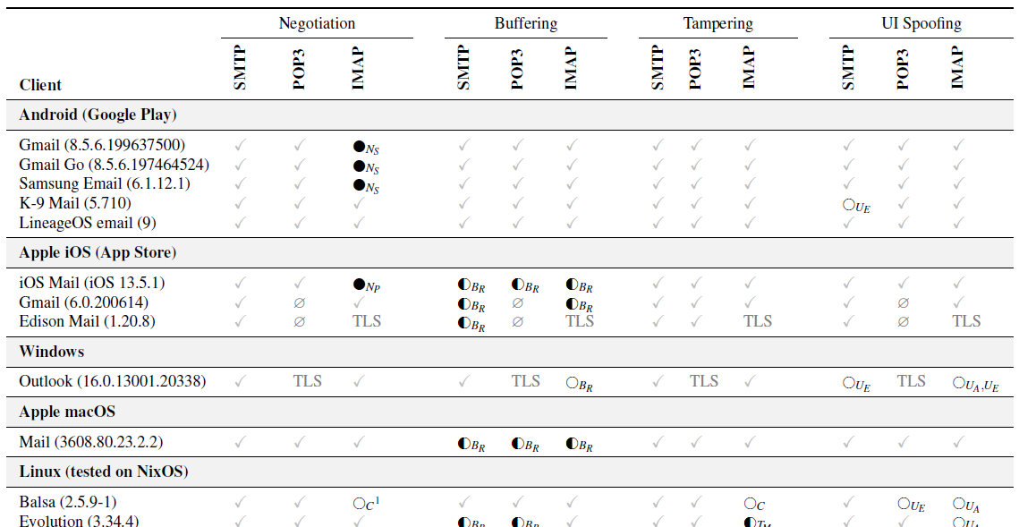
Client-side Vulnerability Tests
Negotiation
  Bypassing STARTTLS negotiation
Buffering
  Command/Response injection
Tampering
  Placing new messages or folders into users’ mailbox
UI spoofing
Test 28 popular email clients (software)
  Include Android / Apple iOS, macOS / Windows / Cross-platform clients

Slide 14
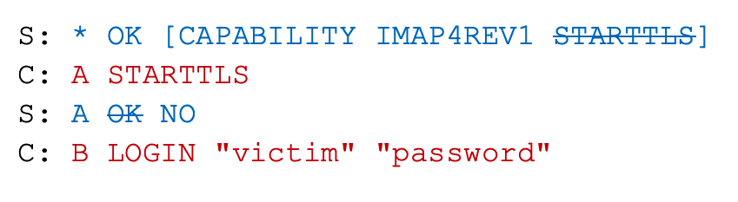
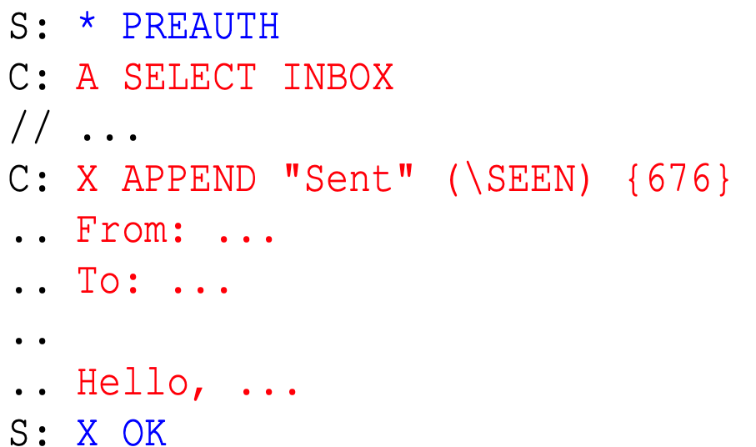
Client-side Vulnerabilities – Negotiation
STARTTLS stripping
STARTTLS blocking using specific command
  Some protocols have commands that do not start STARTTLS negotiation
C: Client
S: Server
15 / 28
Clients are vulnerable
IMAP Example

Slide 15
Client-side Vulnerabilities – Buffering [1/3]
Response injection
  A client processes one response per one command
S: Server
C: Client
A: Attacker
S: * OK [CAPABILITY IMAP4REV1 STARTTLS]
C: A STARTTLS
S: A OK
// ---------------------- TLS Handshake -----------------------
Normal
case
S: * OK [CAPABILITY IMAP4REV1 STARTTLS]
C: A STARTTLS
A: A OK \n B (..Attack Code..)
Application Buffer (Client)
A OK
B (...Attack Code..)
Response
injection
case
Send to the client
The client splits the response by a newline,
and buffered them in the application buffer

Slide 16
Client-side Vulnerabilities – Buffering [2/3]
Response injection
  A client processes one response per one command
S: Server
C: Client
A: Attacker
S: * OK [CAPABILITY IMAP4REV1 STARTTLS]
C: A STARTTLS
S: A OK
// ---------------------- TLS Handshake -----------------------
Normal
case
S: * OK [CAPABILITY IMAP4REV1 STARTTLS]
C: A STARTTLS
S: A OK
// ---------------------- TLS Handshake -----------------------
Application Buffer (Client)
A OK
B (...Attack Code..)
Response
injection
case
(from the client’s view)

Slide 17
Client-side Vulnerabilities – Buffering [3/3]
Response injection
  A client processes one response per one command
S: Server
C: Client
A: Attacker
S: * OK [CAPABILITY IMAP4REV1 STARTTLS]
C: A STARTTLS
S: A OK
// ---------------------- TLS Handshake -----------------------
Normal
case
16 / 28
Clients are vulnerable
S: * OK [CAPABILITY IMAP4REV1 STARTTLS]
C: A STARTTLS
A: A OK \n B (..Attack Code..)
// ---------------------- TLS Handshake -----------------------
C: B LOGIN […]
C: C LIST […]
Application Buffer (Client)
A OK (interpreted)
B (...Attack Code..)
Response
injection
case
The buffered response is interpreted here

Slide 18
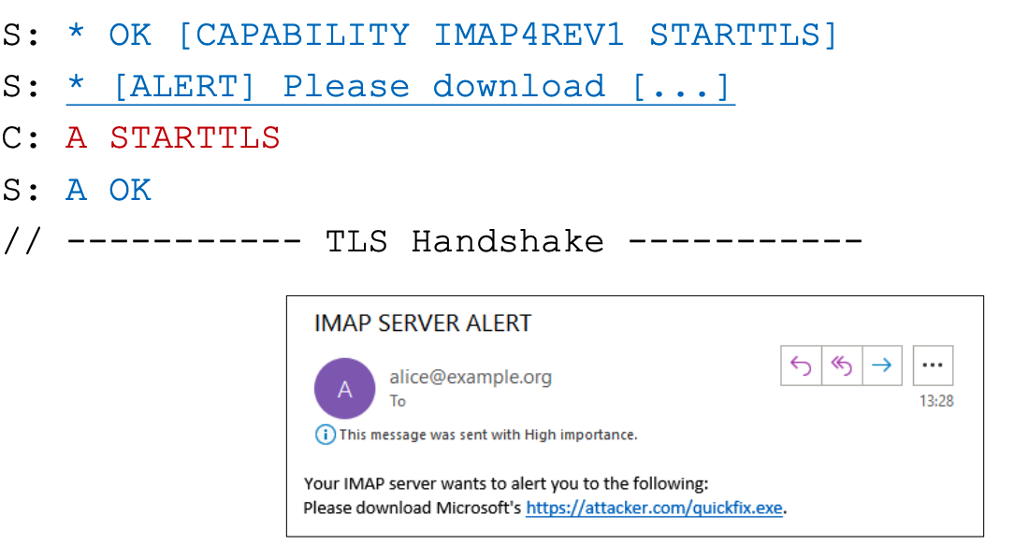
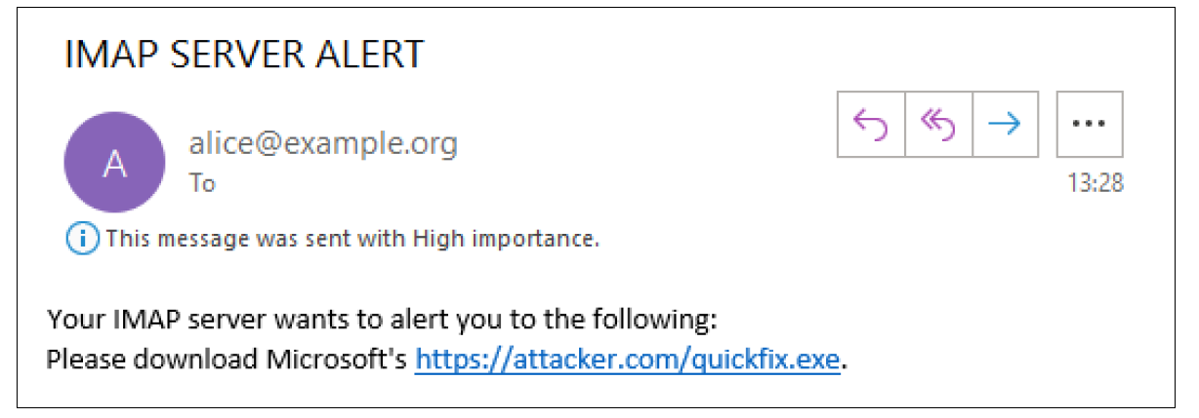
Client-side Vulnerabilities – UI Spoofing
Error messages or alert can be exploited for spam or phishing
A
11 / 28
Clients are vulnerable

Slide 19
Server-side Vulnerability Tests
Goal: Find server-side vulnerabilities that can lead to attacks such as STARTTLS stripping or user credential stealing
Test 23 popular email servers (software)
  Popular mail server programs
  Assume an MitM attacker communicating with the client and relays all TLS traffic between the client and server
Scan IPv4 address space to find vulnerable mail servers
ex) Send commands
Mail Client
MitM Attacker
Mail Server
(Testbed)

Slide 20
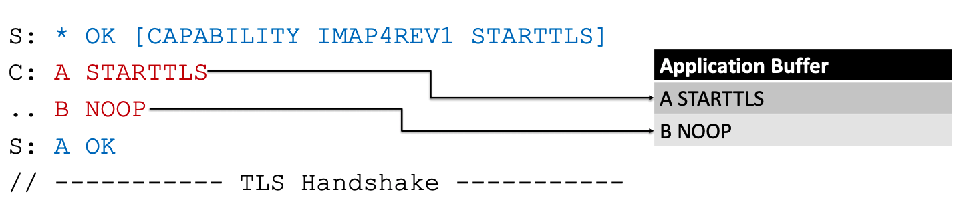
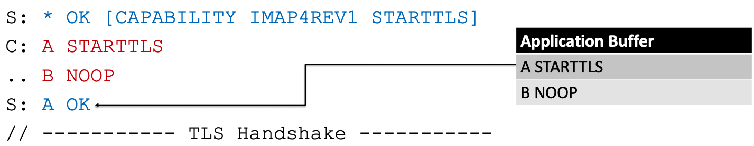
Server-side Vulnerabilities – Buffering [1/3]
Command injection
  It is discovered in 2011 but is still exploitable
(Server-side)
A
== “A STARTTLS \n B NOOP"
The command is split by a newline,
and buffered in the application buffer
(Server-side)
A

Slide 21
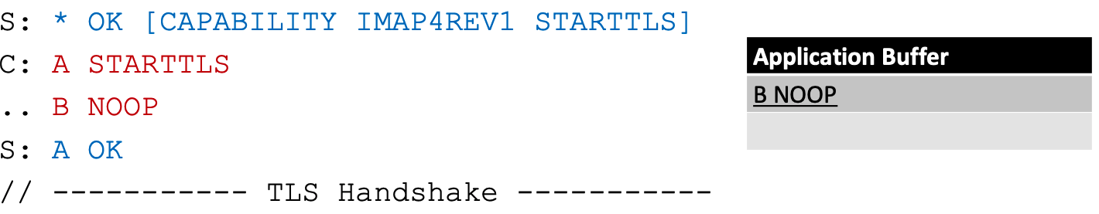
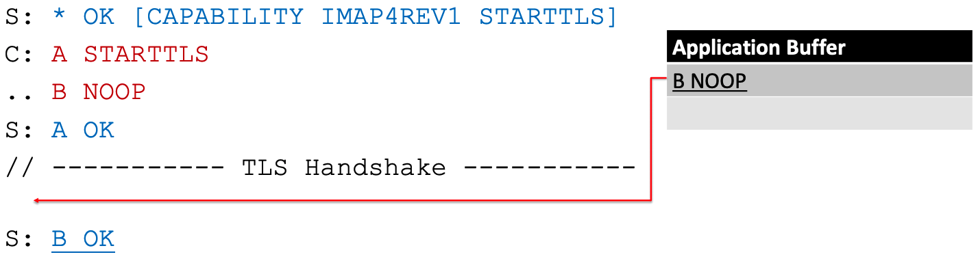
Server-side Vulnerabilities – Buffering [2/3]
Command injection
(Server-side)
A
(Server-side)
A
8 / 23
Servers are vulnerable

Slide 22
Server-side Vulnerabilities – Buffering [3/3]
Credential-stealing via command injection
  An attacker obtains user credentials using the APPEND command after a LOGIN to their own mailbox
1. S: * OK [CAPABILITY IMAP4REV1 STARTTLS]
2. A: A STARTTLS (from the client)
B LOGIN "attacker" "password“
C APPEND INBOX {length}
3. S: A OK
// ------------------ TLS Handshake -------------------
4. A: B LOGIN "attacker" "password”
5. S: B OK
6. A: C APPEND INBOX {length}
7. S: +
8. C: B LOGIN "victim" "password"
Application Buffer (Client)
B LOGIN “attacker” “password”
C APPEND INBOX {length}
// Attacker injects LOGIN and APPEND here ...
// LOGIN interpreted here
// APPEND interpreted here
// Due to the APPEND, the following active commands are
// misinterpreted as email data and appended to the
// attacker’s INBOX

Slide 23
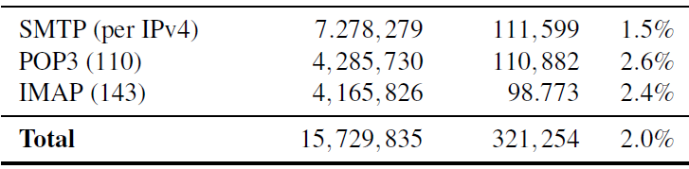
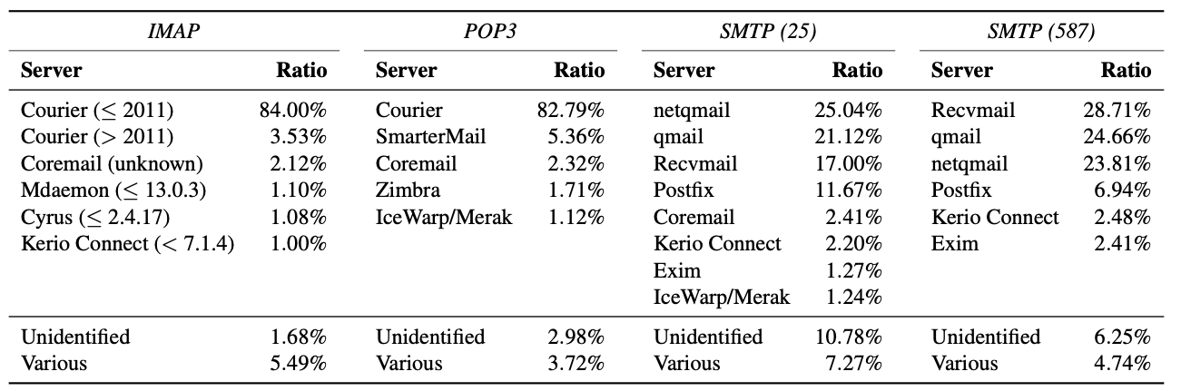
Server Scanning
< Scan results –
Vulnerable servers to the command injection >
Scan all mail servers in IPv4 space
Mail programs used by vulnerable servers
About 2% of SMTP servers are vulnerable to command injection
7,278,279
< Clustering of mail programs used by vulnerable mail servers >

Slide 24
Conclusion
Performed the first systematic analysis of STARTTLS implementation vulnerabilities
  Some vulnerabilities (e.g., command injection) has been known for a decade but they are still prevalent
Discovered several flaws in major email client & server implementations
  Showed that inconsistencies in certain IMAP features (Ex. PREAUTH command – bypass STARTTLS)
  Found that STARTTLS vulnerabilities can be used for critical attacks such as credential stealing
STARTTLS has systemic problems that lead to implementation flaws
because STARTTLS is insufficiently specified
  - No security advantage over implicit TLS connections
  - Slower than implicit TLS due to additional round trips

Slide 25
Thank you!
hmlee@mmlab.snu.ac.kr

Slide 26
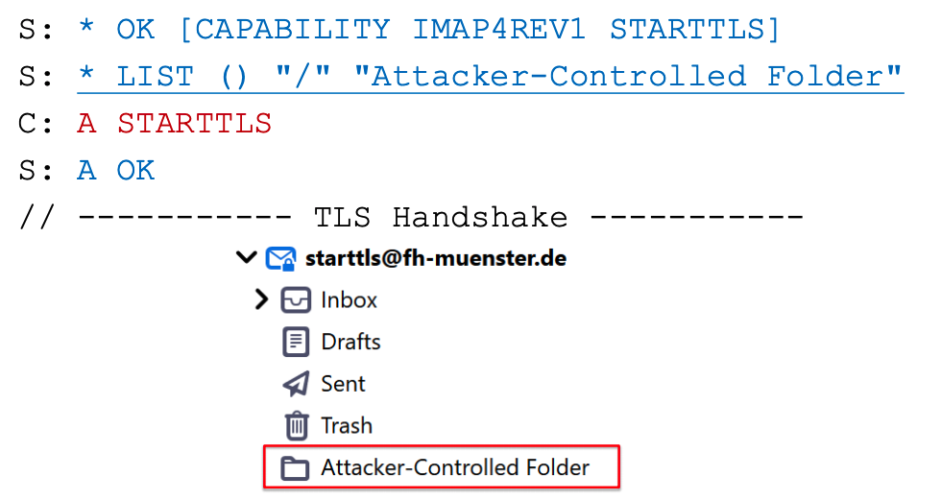
Client-side Vulnerabilities – Tampering
An attacker can tamper with local mailbox data by sending commands before STARTTLS
A
5 / 28
Clients are vulnerable

