Slide 1
A Flushing Attack on the DNS Cache
[2024.10.15] Main Seminar
USENIX Security 24’ Fall
Yehuda Afek*, Anat Bremler-Barr*, Shani Stajnrod
Tel-Aviv University*, Reichman University
Jungbum Lee
jblee@mmlab.ac.kr

Slide 2
Contents
Current trends in DNS amplification attack
Background DNS resolving in depth
Cache flushing attack and limitations
Conclusion

Slide 3
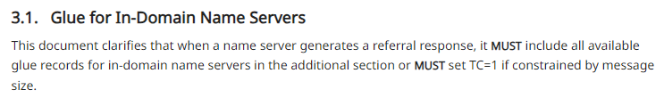
Current Trends in DNS Amplification Attacks
Problem within
standard
Problem within
implementation
Deplete
machine power
Deplete
cache
RFC 9471

Slide 4


Current Trends in DNS Amplification Attacks (cont.)
x10+
x500+
iDNS
OARC 15’
tsuNAME
IMC 20’
DNS and TTL
ArXiv
x1600
x5600*
12MB/s*
NXNS
Security 20’
NRDelegation
Security 23’
FlushingAttack
Security 24’
Problem with BIND, UNBOUND, etc.
Afek, Y

Slide 5



DNS Basic
DNS is a distributed database that stores some values (such as IP address) that map domain names to the values
Ask .test zone
example.test A?
example.test A?
Ask example.test zone
NO CACHE
10.98.9.9

Slide 6
Delegation and Referral in DNS
To answer the resolver’s query, an authoritative nameserver can choose whether to answer the question directly or delegate the answer to another nameserver
The delegation is mostly driven by performance gains and enables integration with third-party services
Referral response is a multiple delegation response
Motivated by fault-tolerance and managing latency
Delegation has been a vulnerable attack vector in DNS

Slide 7
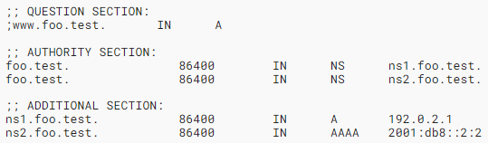
Glue records (after RFC 9471)
DNS uses glue records to allow iterative clients to find the addresses of name servers that are contained within a delegated zone
Glue records are added to the parent zone as part of the delegation process and returned in referral response
Name server MUST include all available glue records for in-domain name servers

Slide 8
DNS Resolver Cache
DNS resolver cache many answers including DNS RR types, domain names, IP addresses, etc.
There are two type of caches, benign cache and negative cache
  Benign cache saves successful resolution
  Negative cache saves failed resolution, such as NXDOMAIN, NODATA, time-out, etc.
Cache is dynamically distributed, means the storage where benign cache uses, and negative cache uses are integrated
  Benign cache has higher priority
Benign cache
Negative cache
Garbage values
8 MB ~ 4GB

Slide 9
SLIST
SLIST is a scratch pad memory for name servers and zone which the resolver is currently trying to query
SLIST keeps track of the resolver’s best guess about what to query next
Query? google.com. A
a.gtld-servers.net
google.com. A 142.251.42.142
. NS e.root-servers.net.
com. NS c.gtld-servers.net.
google.com. NS ns3.google.com.
e.root-servers.net. A x.x.x.x
c.gtld-server.net. A x.x.x.x
ns3.google.com. A x.x.x.x
a.root-servers.net
b.gtld-servers.net
b.root-servers.net
c.gtld-servers.net
.
c.root-servers.net
...
...
m.gtld-servers.net
m.root-servers.net

Slide 10


SLIST (cont.)
SLIST is a scratch pad memory for name servers and zone which the resolver is currently trying to query
SLIST keeps track of the resolver’s best guess about what to query next
Query? google.com. A
SLIST
google.com. A 142.251.42.142
. NS e.root-servers.net.
com. NS c.gtld-servers.net.
google.com. NS ns3.google.com.
e.root-servers.net. A x.x.x.x
c.gtld-server.net. A x.x.x.x
ns3.google.com. A x.x.x.x
google.com.
com.
.
a.root-servers.net
~
m.root-servers.net
a.gtld-servers.net
~
m.gtld-servers.net

Slide 11

Why we need SLIST?
To prevent redundancy and infinite looping
Benign Cache
B.falso.mi
fake.com NS A.false.me
A.false.me.
A.false.me NS B.falso.mi
B.falso.mi NS A.false.me
A.false.me A 1.2.3.4
B.falso.mi A 5.6.7.8
Q. fake.com. A
Resolver

Slide 12
Why we need SLIST? (cont.)
To prevent redundancy and infinite looping
Benign Cache
B.falso.mi
fake.com NS A.false.me
A.false.me.
A.false.me NS B.falso.mi
B.falso.mi NS A.false.me
A.false.me A 1.2.3.4
B.falso.mi A 5.6.7.8
Q. fake.com. A
SLIST
Resolver
fake.com
A.false.me
B.falso.mi

Slide 13
SLIST and Cache
The resolver fetches all name server information from the target server and checks the connectivity to each server in parallel, storing the results in the cache based on whether the servers are reachable
Therefore, the resolver with SLIST relies heavily on cache
Without cache, resolver should query all nameservers they met from root for each query
;; AUTHORITY SECTION:
com. NS a.gtld-servers.net.
com. NS b.gtld-servers.net.
com. NS c.gtld-servers.net.
This is NOT resolved by glue record
;; ADDITIONAL SECTION:
a.gtld-servers.net. A 192.5.6.30
b.gtld-servers.net. A 192.33.14.30
c.gtld-servers.net. A 192.26.92.30
Resolver traverse all this IPs in parallel
and check its reachability

Slide 14
Two Issues with Cache Management in Resolver
There are no limits of the NS record number in a single domain to benign cache
When the hard limit is reached, the resolver usually drops all requests
google.com NS ns2.google.com
google.com NS ns1.google.com
google.com NS ns4.google.com
google.com NS ns3.google.com
A google.com
NS c1483.del.c
e1.attack.com NS c0001.del.c
e1.attack.com NS c0002.del.c
e1.attack.com NS c0003.del.c
...
e1.attack.com NS c1499.del.c
e1.attack.com NS c1500.del.c
NS c1482.del.c
NS c1481.del.c
NS c1480.del.c

Slide 15

NSCacheFlush Attack
Authoritative NS
Resolver
1.2.3.4
e1.attack.com A
e1.attack.com A
+60KB
SERVFAIL
+60KB
Zonefile
e2.attack.com
+60KB
e3.attack.com
e4.attack.com
Benign Cache
Zonefile
e1.attack.com NS c0001.del.c
e1.attack.com NS c0002.del.c
e1.attack.com NS c0003.del.c
...
e1.attack.com NS c1500.del.c
e2.attack.com NS c1501.del.c
...
e2.attack.com NS c3000.del.c
usenix.org A 23.185.0.4
e1.attack.com NS c0001.del.c
e1.attack.com NS c0002.del.c
e1.attack.com NS c0003.del.c
...
e1.attack.com NS c1500.del.c
e2.attack.com NS c1501.del.c
e2.attack.com NS c1502.del.c
...
...
40 bytes each
40 bytes * (1500 + 20) $≈$ 60KB

Slide 16
CNAMECacheFlush Attack
Resolver
Authoritative NS
e1.attack.com A
e1.attack.com A
SERVFAIL
Zonefile
Benign Cache
Zonefile
e1.attack.com CNAME e2.attack.com
e2.attack.com CNAME e3.attack.com
e3.attack.com CNAME e4.attack.com
e4.attack.com CNAME e5.attack.com
...
e98.attack.com CNAME e99.attack.com
...
e1.attack.com CNAME e2.attack.com
e2.attack.com CNAME e3.attack.com
e3.attack.com CNAME e4.attack.com
e5.attack.com CNAME e6.attack.com
...
e98.attack.com CNAME e99.attack.com
...
usenix.org A 23.185.0.4

Slide 17
Computational Load of Authoritative Name Server
Computational load is relatively low
Resolver
Authoritative NS
e1.attack.com A
e1.attack.com A
SERVFAIL
Zonefile
Intel(R) Xeon(R) CPU E5-2673
2.30GHz 2vCPUs
8GiB RAM

Slide 18
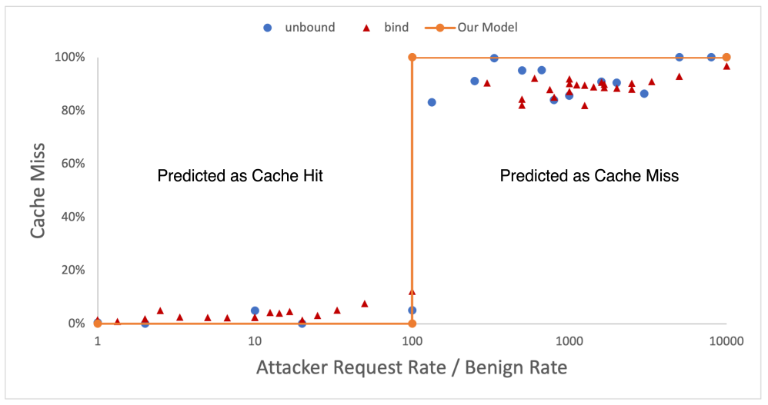
Result
After a certain request rate builds up, the cache miss ratio suddenly increases
Cache size: 10MB

Slide 19
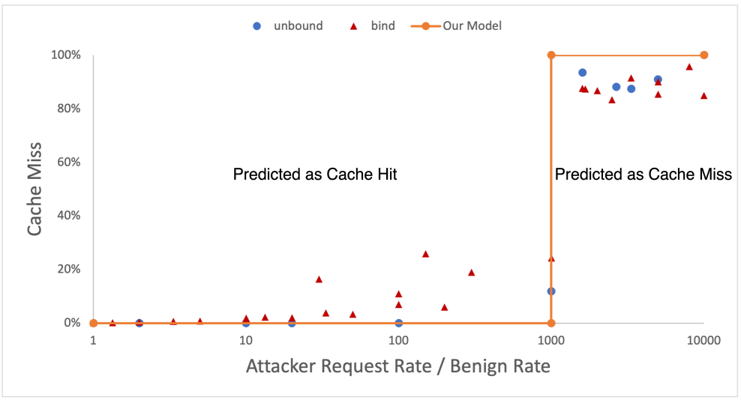
Result (cont.)
The request rate required for the attack to succeed increases proportionally to the cache size
Cache size: 10MB
Cache size: 100MB

Slide 20
CacheFlush Mitigation – Create a hard limit!
Bounding NS referral list
Bounding the length of CNAME chains
Benign Cache
Benign Cache
e1.attack.com NS c0001.del.c
e1.attack.com NS c0002.del.c
e1.attack.com NS c0003.del.c
...
e1.attack.com NS c1500.del.c
c0001.del.c A 1.2.3.4
...
c0020.del.c A 1.2.3.4
usenix.org A 23.185.0.4
e1.attack.com CNAME e2.attack.com
e2.attack.com CNAME e3.attack.com
e3.attack.com CNAME e4.attack.com
e4.attack.com CNAME e5.attack.com
...
e98.attack.com CNAME e99.attack.com
...
usenix.org A 23.185.0.4
NSCacheFlush Attack
CNAMECacheFlush Attack

Slide 21
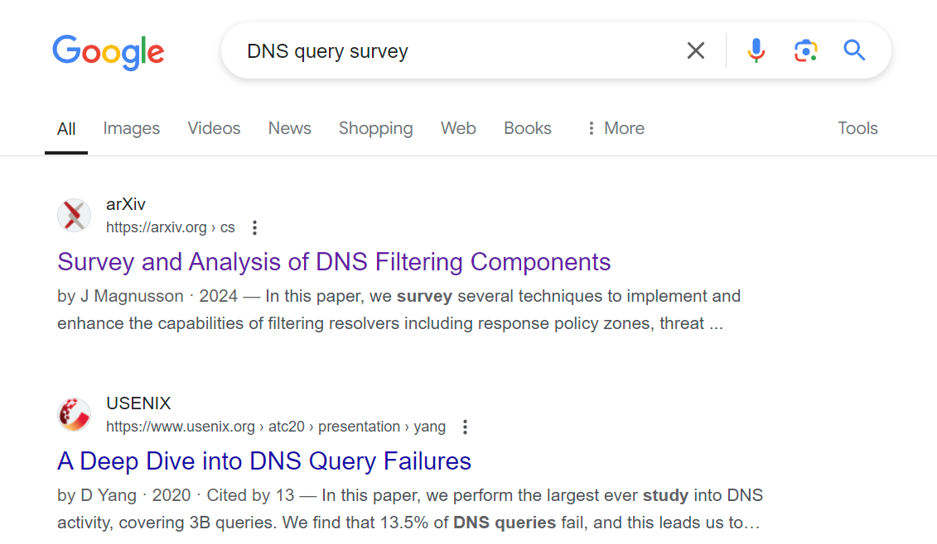

Limitation
Attack rate should highly exceed original benign request
  If cache size is 1GB, attacker’s request rate should be 10,000 times higher than benign request
Public DNS is highly distributed, it’s hard to attack specific query
10 queries per second.
Ad
X 10,000
Ad
100,000 queries per second
100,000,000 queries/s for attack

Slide 22
Conclusion
BIND and UNBOUND were vulnerable to cache flushing attack
Since DNS has had no restrictions on CNAMEs and NSs, there is no obvious choice but to impose hard limits
  The pattern of using CNAME and NS is highly scattered
For small name servers, a small amount of computing power can cause most queries to cache miss
  University, company’s centralized resolver
For large name servers, such as public resolver, it’s hard to succeed the attack

Slide 23
Thank you

Slide 24
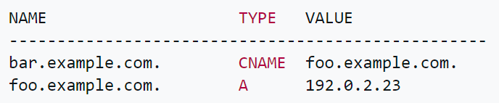
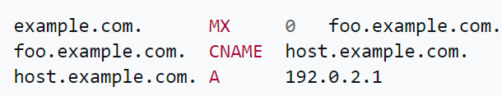
CNAME
DNS uses CNAME record to offer canonical name associated with an alias name
CNAME CAN point to another CNAME record
CNAME CAN make unresolvable loops, while it is not recommended
MX and NS records must NEVER point to CNAME RR
hello.example.com. CNAME bar.example.com
Notes:
Wiki, possible confusion
https://datatracker.ietf.org/doc/html/rfc2181#section-10.3

Slide 25
NSCacheFlush Attack
Authoritative NS
Resolver
1.2.3.4
e1.attack.com A
e1.attack.com A
+60KB
SERVFAIL
+60KB
Zonefile
e2.attack.com
+60KB
e3.attack.com
e4.attack.com
Benign Cache
Zonefile
e1.attack.com NS c0001.del.c
e1.attack.com NS c0002.del.c
e1.attack.com NS c0003.del.c
...
e1.attack.com NS c1500.del.c
c0001.del.c A 1.2.3.4
...
c0020.del.c A 1.2.3.4
usenix.org A 23.185.0.4
e1.attack.com NS c0001.del.c
e1.attack.com NS c0002.del.c
e1.attack.com NS c0003.del.c
...
e1.attack.com NS c1500.del.c
e2.attack.com NS c1501.del.c
e2.attack.com NS c1502.del.c
...
c0001.del.c A 1.2.3.4
40 bytes each
40 bytes * (1500 + 20) $≈$ 60KB
Hard limit
NRDelegation attack (23’)
NXNS Attack (20’)
Notes:
A레코드에는 방비가 되어 있다
42 bytes = TTL 등 포함
65 query to fullfill the benign cache

