Slide 1
Let’s Downgrade Let’s Encrypt
[2024.03.28] Main Seminar
CCS ‘21
Tianxiang Dai, Haya Shulman, Michael Waidner
Jungbum Lee
jblee@mmlab.ac.kr

Slide 2






Authorities in Let’s Encrypt
Certificate authority (CA) signs and issues a digital certificate
Registration authority (RA) delegates the tasks from CA
Validation authority (VA) validate domain?
ACME
Registration
Authority
Certificate
Authority
Yep!
It’s valid
Validate
domain ownership
Client
Validation
Authority
Notes:
Emphasize domain validation explanations

Slide 3
Contents
Introduction
Domain validation system - SingleVA
➔Attacking SingleVA
Domain validation system - MultiVAs
➔Attacking MultiVAs “Let’s Downgrade Let’s Encrypt”
Evaluation
Critiques and conclusion

Slide 4

Domain validation with SingleVA - DNS challenge
Send a request and get a response
Check the DNS TXT record
Authoritative NS
Create DNS TXT records
I’m ready
Create a DNS TXT record containing the following…
Could I get a certificate for
example.com
Web server
Domain Owner

Slide 5

Domain validation with SingleVA
The objective of Let’s Encrypt is to obtain a browser-trusted certificate without any human intervention
Let’s Encrypt’s servers validate the control of domain names in that certificate using “challenges,” as defined by the ACME standard
HTTP-01 challenge | Challenge using a file on the host’s web server
DNS-01 challenge | Challenge using DNS TXT record
TLS-SNI-01 challenge | Challenge using SNI
TLS-ALPN-01 challenge | … with ALPN
Notes:
Link 만들기 / return 만들기

Slide 6
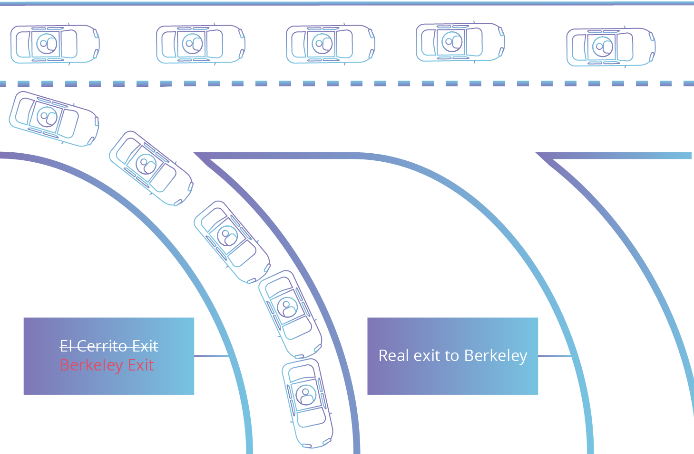
BGP hijacking
Before 2018, only a single validation authority is used for certificate issuance
Single VA is vulnerable to BGP hijacking (Henry Birge-Lee et al., 2018)
This exit has shorter path!
Exit to
San Francisco
Real exit to
Berkely (10km)
Exit to
Berkely (2km)

Slide 7

Attacking SingleVA
AS 3
AS 1
AS 5
AS 2
AS 4
Adversary

Slide 8
MultiVAs to the rescue
MultiVA
AS 1
AS 5
AS 2
MultiVA
Adversary

Slide 9

Is multiVAs the complete solution? - Naive algorithm
Some queries and server selection algorithms are also well-known
  Unbound DNS server has the exact same pattern as Let’ Encrypt’s VA server
Server selecting algorithm
RTT
NS 1
400ms
NS 2
Server
NS 1
NS 2
NS 3
Fastest RTT
NS 3
Notes:
Left figure

Slide 10
Is multiVAs the complete solution? - Well-known server
The location of the VAs is well-known (only 4 VAs in Let’s Encrypt)
If the target DNS nameserver is down, the VA is not considered when evaluating consistency
Valid!
BGP hijacking
Nameserver
elimination
Authoritative
NS
Adversary
Loss via fragments mis-association
Loss via excess query rate
Loss via router buffer overflow
Well-known &
Only 4 VAs
Domain Owner
Notes:
target domain 에 대하여 nameserver elimination을 한다
3가지가 있다

Slide 11

1. Loss via fragments mis-association
Forget about the nameserver for 15 minutes
Server that fragment response
Servers with predictable IP ID
Request
1.88% of certified domain
1
2
Authoritative NS
ICMP fragmentation needed
2
Wrong checksum
VA’s DNS resolver
Request
Sends a fragment to the VA
Adversary
1
2
2
An Attacker requests a certificate of the target domain
IP defragmentation cache
Notes:
Fragmentation Avoidance in DNS (ietf.org)

Slide 12
2. Loss via excess query rate
Ban IP from the resolver
Forget about the nameserver for 15 minutes
24% of nameserver in TLD
23% of certified domain
Authoritative NS
Request
Send multiple requests to the target nameserver using a IP of resolver
VA’s DNS resolver
An Attacker requests a certificate of the target domain
Adversary

Slide 13

3. Loss via router buffer overflow
Forget about the nameserver for 15 minutes
Authoritative NS
Send a burst of packets to the target router
Request
VA’s DNS resolver
An Attacker requests a certificate of the target domain
Adversary
Notes:
버퍼 사이즈가 10MB 보다 작은건 100%, 그 이상은 90% 이상의 loss rate

Slide 14
‘Two-sided’ evaluation method
To prove the attacks are valid without ethical issues, the authors suggest ‘two-sided’ evaluation method
 | CA and VA | Domain
Ideal method (but not ethical) | Real-world CA and VA (Let’s Encrypt) | Real-world domains (such as google.com, etc.)
First method | Real-world CA and VA (Let’s Encrypt) | Simulated (RIPE NCC)
Second method | Simulated (step-ca) | Real-world domains (such as google.com, etc.)

Slide 15
First method - Real-world CA with simulated domains
DNS nameservers
NS 1
NS 2
NS 3
Buy IP prefixes
and ASes
Real-world
CA and VA
Adversary
Request certificate
example.com

Slide 16



Second method - Simulated CA with real-world domain
DNS nameservers
NS 1
NS 2
NS 3
Buy IP prefixes
and ASes
Simulate based on open-source
Simulated Private CA
Adversary
Request Google’s certificate

Slide 17
Countermeasures
Resilient nameserver-selection.
VA should choose the nameserver carefully, such as randomizing the selection of nameserver
Unpredictable VAs selection.
Enlarge the size of VAs and choose carefully which VAs to perform validation
Fix the underlying issues
  DNSSEC
  RPKI
Notes:
DNSSEC RRset (TXT) record is signed
RPKI prevents BGP hijacking

Slide 18
Critique
The solution to the underlying problem is not widely used
  DNSSEC, RPKI, etc.
The solutions authors suggested are not clean workarounds
  Still have room for nameservers elimination
No active action by Let’s Encrypt

Slide 19

Conclusion
Fragments mis-association attack
Excess query rate attack
Router buffer overflow attack
NEW!
BGP hijacking
Henry Birge-Lee et al., 2018
DNS server elimination attack
Dai, Tianxiang et al., 2021
Need for issuance automation
Let’s encrypt with
a single VA validation
Multi VAs validation
(now)
$$≡$$

Slide 20



Server name indication (SNI)
A single server (IP address) may host multiple websites
SNI indicates the server which certificate to give the client
www.example.com
Want to go to
abc.nemo.com
abc.nemo.com
hello.semo.com
172.74.50.1
TLS handshake
TLS Client Hello
…
SNI: abc.nemo.com
Server Certificate

Slide 21

TLS-SNI-01 challenge - Intended situation
Add a certificate to the same IP as example.com
with domain test.acme.invalid
To: example.com
SNI: test.acme.invalid.
Self-signed certificate
test.acme.invalid
Make a new page domain test.acme.invalid
example.com
Issue self-signed certificate
Web server
Domain owner
I want a certificate of
example.com
Notes:
curl certificate gitlab
self-signed = Don’t care CoT at the point
GitLab logic (Heroku etc)

Slide 22
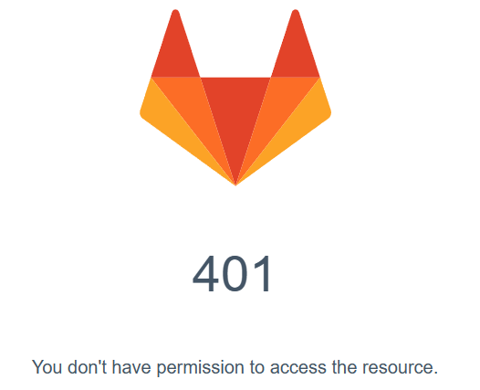

TLS-SNI-01 challenge - Attack to gitlab
104.18.34.164
Add a certificate to the same IP as doc.gitlab.com
with domain test.acme.invalid
To: 104.18.34.164
SNI: doc.example.com.
doc.gitlab.com
104.18.34.164
Make a new page domain test.acme.invalid
test.acme.invalid
SNI: doc.example.com
I want a certificate of
doc.gitlab.com
104.18.34.164
104.18.34.164
Notes:
curl certificate gitlab
self-signed = Don’t care CoT at the point
GitLab logic (Heroku etc)

