Slide 1
NRDelegationAttack: Complexity DDoS attack on DNS Recursive Resolvers
[2024.07.09] Main Seminar
USENIX Security 23’ Fall
Yehuda Afek*, Anat Bremler-Barr*, Shani Stajnrod
Tel-Aviv University*, Reichman University
Jungbum Lee
jblee@mmlab.ac.kr

Slide 2
Delegation and referral in DNS
To answer the resolver’s query, an authoritative nameserver can choose whether to answer the question directly or delegate the answer to another nameserver
The delegation is mostly driven by performance gains and enables integration with third-party services
Referral response is a multiple delegation response
Motivated by fault-tolerance and managing latency
Delegation has been a vulnerable attack vector in DNS

Slide 3
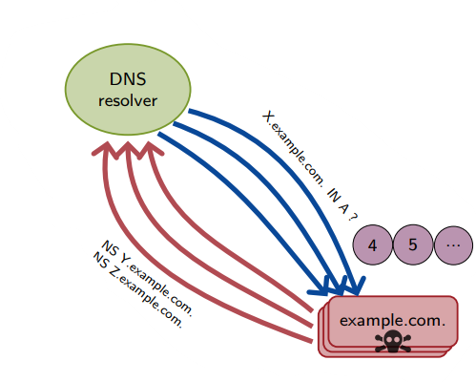
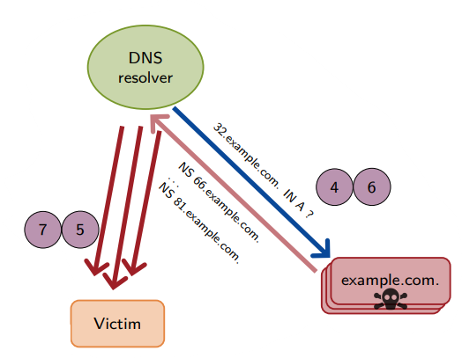
Amplification attack on DNS
x10+
x1600
x500+
x5600*
iDNS
OARC 15’
NXNS
Security 20’
tsuNAME
IMC 20’
NRDelegation
Security 23’

Slide 4

Amplification attack on DNS (cont.)
x10+
x1600
x500+
x5600*
iDNS
OARC 15’
NXNS
Security 20’
tsuNAME
IMC 20’
NRDelegation
Security 23’

Slide 5
Contents
Background Dig into DNS query
Prior delegation response attack - NXNSAttack (Usenix Security 20’)
Latest delegation response attack - NRDelegation Attack
Solutions
Evaluation

Slide 6


Background
DNS is a distributed database that stores some values (such as IP address) that map domain names to the values
Ask .test zone
example.test A?
example.test A?
Ask example.test zone
NO CACHE
10.98.9.9

Slide 7
Dig into query
DNS server sends authority sections list to the resolver
Resolver selects a server based on its own internal policy
  Usually choose the server with the fastest response time
Servers sometimes glue IP addresses together for efficiency (optional)
Resolver
Root Server
;; AUTHORITY SECTION:
com. NS a.gtld-servers.net.
com. NS b.gtld-servers.net.
com. NS c.gtld-servers.net.
Q. google.com A
A. referral response
;; ADDITIONAL SECTION:
a.gtld-servers.net. A 192.5.6.30
b.gtld-servers.net. A 192.33.14.30
c.gtld-servers.net. A 192.26.92.30
Query each entry in the list parallel

Slide 8


NXNS Attack (Security 20’)
Recent DNS attack, NXNS attack employs a malicious NS referral response using a long list of non-existing name server names
Until 20’, resolvers query domain names in referral response ALL in parallel
ns#.fake.test. are NOT exist
Resolver
Authoritative NS
Q. fake.test A
;; AUTHORITY SECTION:
fake.test. NS ns1.fake.test.
fake.test. NS ns2.fake.test.
fake.test. NS ns3.fake.test.
. . .
fake.test. NS ns14999.fake.test.
fake.test. NS ns15000.fake.test.
A. referral response
Queries “15000” entries in parallel

Slide 9
NXNS Attack (Security 20’) - Solution
To mitigate the attack, some limits are introduced
;; AUTHORITY SECTION:
fake.test. NS ns1.fake.test.
fake.test. NS ns2.fake.test.
fake.test. NS ns3.fake.test.
fake.test. NS ns4.fake.test.
fake.test. NS ns5.fake.test.
fake.test. NS ns6.fake.test.
fake.test. NS ns7.fake.test.
...
fake.test. NS ns1499.fake.test.
fake.test. NS ns1500.fake.test.
fake.test. NS ns1501.fake.test.
Only query 5 domains
in parallel
Maximum
Ignore

Slide 10
NXNS Attack (Security 20’) - Solution
Process only five queries in parallel at a time
If all five queries fail, the next five are fetched and queried
This method can still occupy the resolver's resources for a long time, but it doesn’t consume more than a limited amount of resources.
ns#.fake.test. are NOT exist
Resolver
Authoritative NS
Q. fake.test A
;; AUTHORITY SECTION:
fake.test. NS ns1.fake.test.
fake.test. NS ns2.fake.test.
fake.test. NS ns3.fake.test.
fake.test. NS ns4.fake.test.
fake.test. NS ns5.fake.test.
fake.test. NS ns6.fake.test.
fake.test. NS ns7.fake.test.
...
A. referral response
Works “5” entries in parallel

Slide 11
What if the malicious nameserver responds?
The previous attack assumed that the malicious nameserver doesn’t respond at all
What happens if the server sends a referral response to another malicious server?
And what happens if the server sends multiple referral responses recursively?
It's not up to us.
It's not up to us.
It's not up to us.
Resolver
DNS server

Slide 12
If not fail but success with delegation response?
The resolver handles each referral response processing independently
This means that the previous limits worked independently
  Query count increased in logarithmic scale
fake.test. NS ns6.fake.test.
fake.test. NS ns7.fake.test.
fake.test. NS ns8.fake.test.
fake.test. NS ns9.fake.test.
fake.test. NS ns10.fake.test.
;; AUTHORITY SECTION:
fake.test. NS ns1.fake.test.
fake.test. NS ns2.fake.test.
fake.test. NS ns3.fake.test.
fake.test. NS ns4.fake.test.
fake.test. NS ns5.fake.test.
fake.test. NS ns6.fake.test.
fake.test. NS ns7.fake.test.
...
fake.test. NS ns999.fake.test.
fake.test. NS ns1000.fake.test.
fake.test. NS ns11.fake.test.
fake.test. NS ns12.fake.test.
fake.test. NS ns13.fake.test.
fake.test. NS ns14.fake.test.
fake.test. NS ns15.fake.test.
fake.test. NS ns16.fake.test.
fake.test. NS ns17.fake.test.
fake.test. NS ns18.fake.test.
fake.test. NS ns19.fake.test.
fake.test. NS ns20.fake.test.

Slide 13
Is the attack feasible?
We don't actually need N servers for all N servers to get a response
Servers sometimes glue IP addresses together for efficiency (optional)
If an IP address in ADDITIONAL SECTION is the same, the resolver uses the data in its own cache rather than querying other nameservers
Resolver
DNS Server
;; AUTHORITY SECTION:
fake.test. NS ns1.fake.test.
fake.test. NS ns2.fake.test.
fake.test. NS ns3.fake.test.
Q. fake.test A
A. referral response
;; ADDITIONAL SECTION:
ns1.fake.test. A 192.9.9.9
ns2.fake.test. A 192.9.9.9 ns3.fake.test. A 192.9.9.9

Slide 14
Is the attack feasible?
Omit the corresponding IP addresses (IP glue) of the NS record
The resolver then should traverse all the NS by itself, without help from the cache
;; AUTHORITY SECTION:
fake.test. NS ns1.fake.test.
fake.test. NS ns2.fake.test.
fake.test. NS ns3.fake.test.
fake.test. NS ns4.fake.test.
fake.test. NS ns5.fake.test.
fake.test. NS ns6.fake.test.
fake.test. NS ns7.fake.test.
...
fake.test. NS ns999.fake.test.
fake.test. NS ns1000.fake.test.
ns1.fake.test.
NS ns1.fake.test., ns2. ...
ns2.fake.test.
NS ns1.fake.test., ns2. ...
ns3.fake.test.
NS ns1.fake.test., ns2. ...
ns4.fake.test.
NS ns1.fake.test., ns2. ...
ns5.fake.test.
NS ns1.fake.test., ns2. ...
ns6.fake.test.
NS ns1.fake.test., ns2. ...
ns7.fake.test.
NS ns1.fake.test., ns2. ...

Slide 15
Solutions
Consider only k of the NS names in the referral response
fake.test. NS ns6.fake.test.
fake.test. NS ns7.fake.test.
fake.test. NS ns8.fake.test.
fake.test. NS ns9.fake.test.
fake.test. NS ns10.fake.test.
;; AUTHORITY SECTION:
fake.test. NS ns1.fake.test.
fake.test. NS ns2.fake.test.
fake.test. NS ns3.fake.test.
fake.test. NS ns4.fake.test.
fake.test. NS ns5.fake.test.
fake.test. NS ns6.fake.test.
fake.test. NS ns7.fake.test.
...
fake.test. NS ns999.fake.test.
fake.test. NS ns1000.fake.test.
Total 15
fake.test. NS ns11.fake.test.
fake.test. NS ns12.fake.test.
fake.test. NS ns13.fake.test.
fake.test. NS ns14.fake.test.
fake.test. NS ns15.fake.test.
fake.test. NS ns16.fake.test.
fake.test. NS ns17.fake.test.
fake.test. NS ns18.fake.test.
fake.test. NS ns19.fake.test.
fake.test. NS ns20.fake.test.

Slide 16
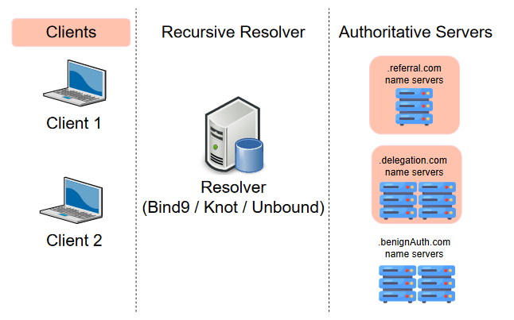

Measurement and Setups
Placed the client, resolver, and authoritative servers in the same cloud region (Azure)
  Simulated environment
Intel Xeon Platinum 8272CL (only 4 vCPU), 16GB RAM

Slide 17
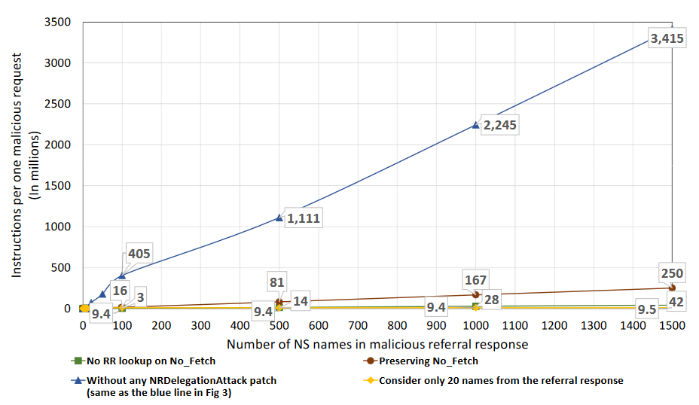
Complexity factor
Solution | Factor
- | x17,000
Consider only 20 names from RR | x1,282
No RR lookup on No_Fetch | x200
Preserving No_Fetch | x50
Amplification factor
x5,600
Benign Query
0.195

Slide 18
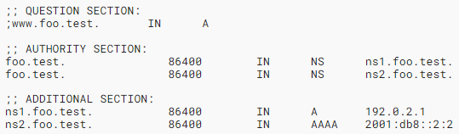
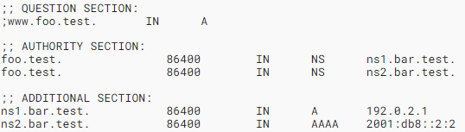
Appendix. DNS glue requirements in referral responses
Published in September 2023 (after paper) - RFC 9471
Name server MUST include all available glue records for in-domain name servers
Name server SHOULD include all available glue records for sibling domain name servers
In-domain (In-bailiwick) name server
Sibling name server

Slide 19
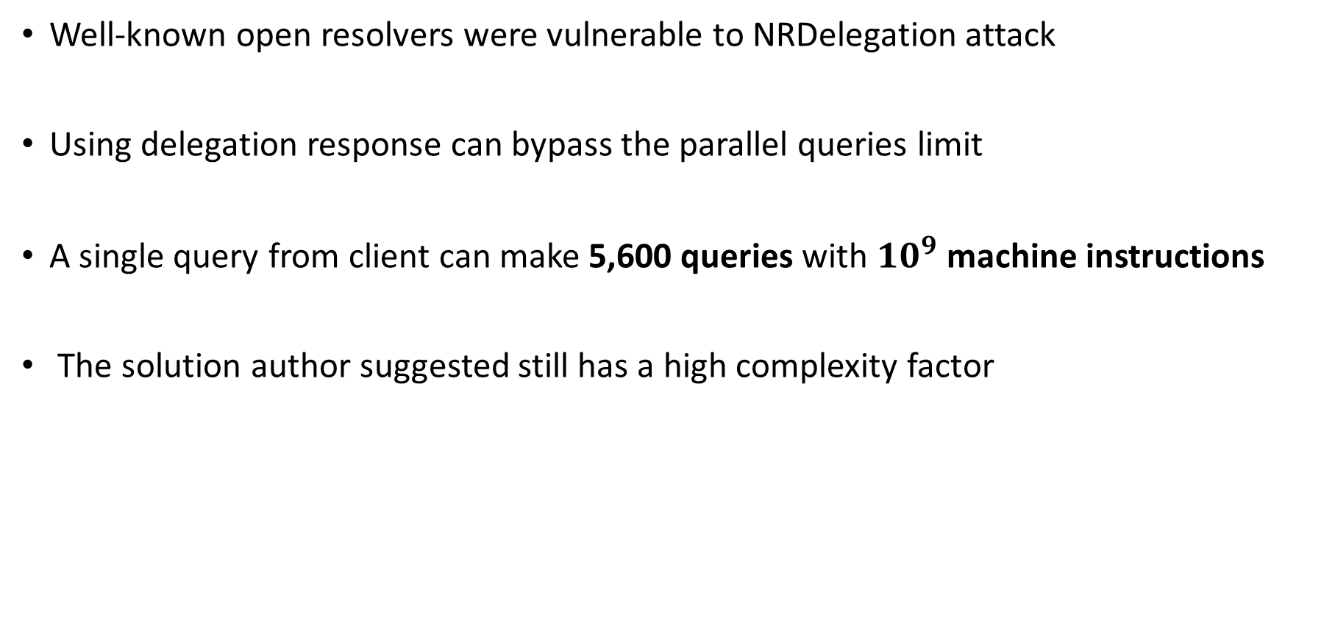
Conclusion
Well-known open resolvers were vulnerable to NRDelegation attack
Using delegation response can bypass the parallel queries limit
A single query from client can make 5,600 queries with ${10}^{9}$ machine instructions
The solution author suggested still has a high complexity factor

Slide 20
Thank you

