Slide 1


Extended Hell(o):
A Comprehensive Large-Scale Study on
Email Confidentiality and Integrity Mechanisms in the Wild
Aug 3, 2023
USENIX Security 2023
Birk Blechschmidt (Saarland Univ.) and Ben Stock (CISPA Helmholtz Center for Information Security)
MMLAB Seminar
Hyeonmin Lee
hmlee@mmlab.snu.ac.kr

Slide 2
Contents
Introduction
Backgrounds
  STARTTLS, DANE, MTA-STS, SPF, DKIM, and DMARC
  SMIMEA and OPENPGPKEY
Email Security Measurements
  Provider-Scoped Test
  Domain-Scoped Tests
  MX-Scoped Tests
Conclusion

Slide 3
Introduction
Email still is a cornerstone of digital communication
  Even in days of instant messaging or Slack
The first standardization of Simple Mail Transfer Protocol (SMTP) dates back to the 1980s
  Security did not play a significant role at that time..
Thus, SMTP does not protect the integrity or confidentiality of transmitted messages
This insecurity motivated the introduction of various security measures
  To support encryption or fight against impersonation

Slide 4
Introduction
Email security mechanisms
2002
2006
2011
2012
2015
2016
2017
2018
year
STARTTLS
(RFC 3027)
SPF
(RFC 4408)
DKIM
(RFC 6376)
DANE
(RFC 6698)
DMARC
(RFC 7498)
OPENPGPKEY
(RFC 7929)
SMIMEA
(RFC 8162)
MTA-STS
(RFC 8461)
Goal
Providing a comprehensive overview of the current state of email confidentiality and integrity measures

Slide 5
Backgrounds
Email security protocols
Email Confidentiality
Email Authenticity
Email Protection Between End-Users

Slide 6








Email Confidentiality (1/2)
Simple Mail Transfer Protocol (SMTP)
Hmm..
It’s a secret..
I won the lottery!
SMTP Client
SMTP Server
Sender
Receiver
Wow!

Slide 7

Email Confidentiality (1/2)
STARTTLS (RFC 3207)
  Support opportunistic encryption of email transmission
TCP handshake
It’s a secret..
I won the lottery!
220 Service Ready
EHLO
250 STARTTLS
SMTP Client
SMTP Server
STARTTLS
TLS

Slide 8
Email Confidentiality (1/2)
STARTTLS (RFC 3207)
  Support opportunistic encryption of email transmission
Vulnerable to Downgrade Attacks
Plain-text
TCP handshake
220 Service Ready
EHLO
250 STARTTLS
SMTP Client
SMTP Server
STARTTLS
TLS

Slide 9

Email Confidentiality (1/2)
STARTTLS (RFC 3207)
  Support opportunistic encryption of email transmission
Vulnerable to Downgrade Attacks
TCP handshake
No STARTTLS
220 Service Ready
EHLO
250 STARTTLS
SMTP Server
SMTP Client
Plain-text
It’s a secret..
I won the lottery!

Slide 10
Email Confidentiality (2/2)
To combat downgrade attacks, two competing standards have been proposed
DANE (DNS-based Authentication of Named Entities)
  Provide a way to authenticate a communication peer without relying on CAs
  Leverage the integrity guarantees of DNSSEC by publishing signed TLSA records
  Could be leveraged as a downgrade-resistant mechanism for SMTP
  → A TLSA record is an explicit signal of TLS support
MTA-STS (Mail Transfer Agent Strict Transport Security)
  An alternative security measure for environments in which “deploying DNSSEC is undesirable or impractical” (DANE and DNSSEC deployment is very rare)
  Publish a TXT record indicating that a domain makes use of MTA-STS
  Publish a policy to a known HTTPS URL (e.g., https://mta-sts.example.org/.well-known/...)
    Policy: list of valid MX servers, cache duration, ...

Slide 11
Email Authenticity
To fight against impersonation attacks, three security extensions have been proposed
SPF (Sender Policy Framework)
  Publish a TXT record contains IP addresses of mail servers to allowed to send emails from a domain
DKIM (DomainKeys Identified Mail)
  Generate a signature of email contents and add it to an email header
  Publish a public key which is used to generate the signature as a TXT record
DMARC (Domain-based Message Authentication, Reporting and Conformance)
  Built on top of SPF & DKIM; DMARC is not a standalone protocol
  Publish a policy as a TXT record that can be used by receivers to determine what actions they take when an incoming mail fails SPF/DKIM check
    E.g., an email fails SPF (or DKIM) validation → reject or quarantine email

Slide 12
Email Protection Between End-Users
STARTTLS does not protect confidentiality against the provider of the email infrastructure
  It only protects the confidentiality between MTAs
S/MIME and OpenPGP
  Both provide encryption and signing capabilities using asymmetric cryptographic
  A traditional way of key distribution
    A mail sender shares its public key to receivers through a third channel (e.g., through an email)
  New standards for key distribution – leverage DNS
    SMIMEA records and OPENPGPKEY records contain certificates or public keys
    They leverage the security guarantees of DNSSEC

Slide 13
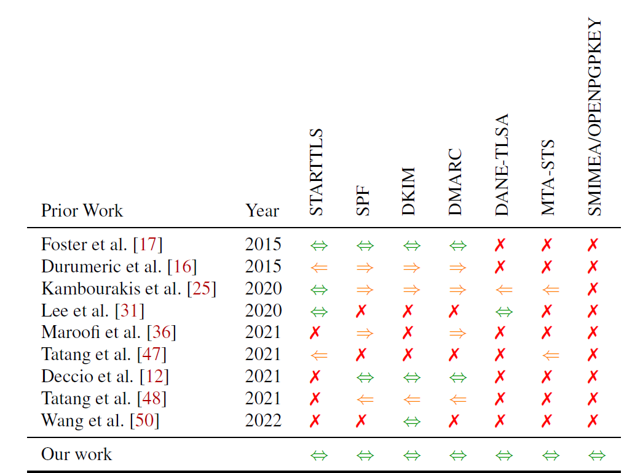
Related Work
This paper
replicates and extends experiments from [17], [31], …
Hyeonmin Lee et al.
“A Longitudinal and Comprehensive Study of the DANE Ecosystem in Email.” USENIX Security 2020
This paper
2022-2023
⇐ inbound ⇒ outbound ⇔ both
Notes:
comprehensive analysis of email security by late 2022 to mid-2023.

Slide 14
Email Security Measurements
Provider-Scoped Test
Domain-Scoped Test
MX-Scoped Test

Slide 15
Methodology
Provider-Scoped
Domain-Scoped
MX-Scoped
Test 47 email providers known to be security-aware or popular
- Sep 2022 ~ Nov 2022
Test MXs (mail servers) of DomCop Top 10M domains
- Jun 2023
Test DomCop* Top 10M domains
- Jun 2023
Outbound scenarios
  Send emails from (misconfigured) test servers to the accounts of each provider
Inbound scenarios
  Send emails from accounts of each provider to (misconfigured) test servers
Deployment
  Check how many domains support security mechanisms
Correctness
  Validate whether domains correctly support security mechanisms
Same as
Domain-Scoped test
except
Domain → MX
[Protocols]
  SPF, DKIM, and DMARC
  STARTTLS, DANE (+ DNSSEC), and MTA-STS
[Protocols]
  SPF and DMARC
  MTA-STS
  SMIMEA and OPENPGPKEY
[Protocols]
  STARTTLS
  DANE
*DomCop. Download list of top 10 million domains based on open data from common crawl & common search.

Slide 16
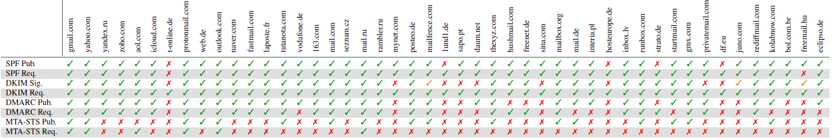
Provider-Scoped Test Results
Provider-Scoped
Domain-Scoped
MX-Scoped
Overview of SPF, DKIM, DMARC, and MTA-STS support (Total 47 Providers)
 | Publish | Request
SPF | 42 | 45
DKIM | 38 (signing) | 47
DMARC | 34 | 30
MTA-STS | 17 | 6
SPF and DKIM supports are great
Discrepancy btw. DKIM signing and request
  The lack of a DKIM signature for outbound mail has no immediate effect as SPF is sufficient pass DMARC
Discrepancy btw. MTA-STS publish and request
  MTA-STS request/validation is error-prone and complex because it is often not supported by MTA software natively
- Publish: # of providers publish the corresponding DNS records
- Request: # of providers request them for incoming email

Slide 17
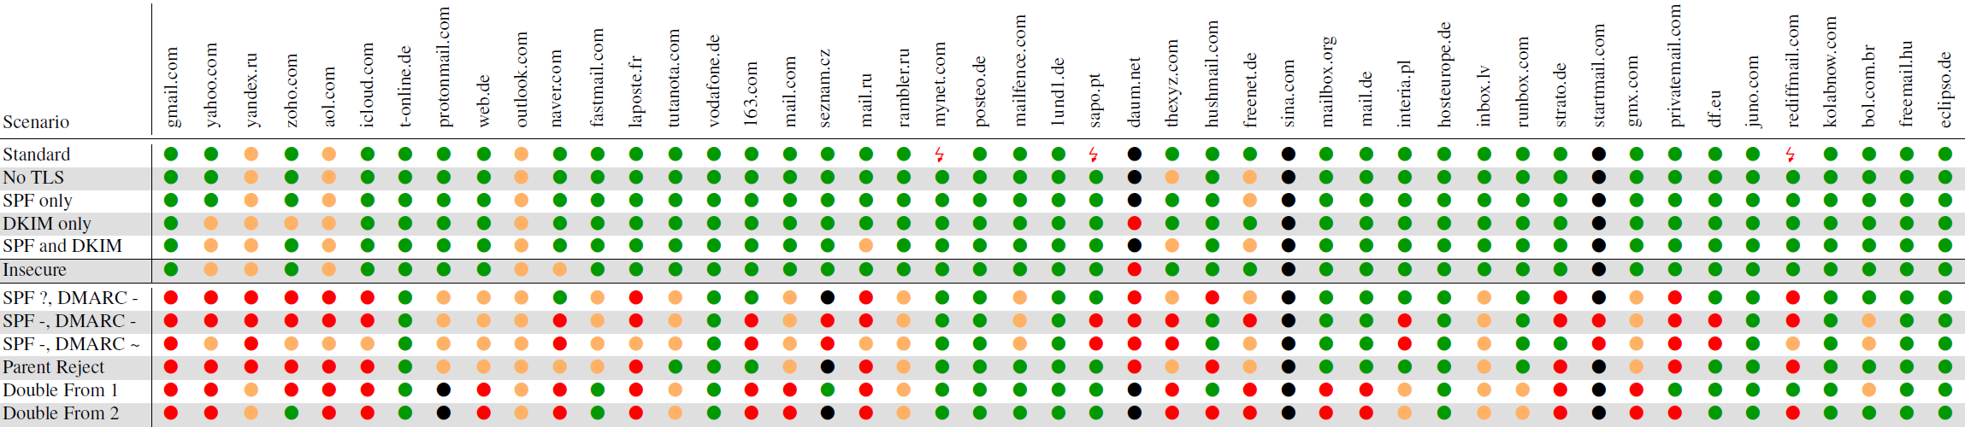

Provider-Scoped Test Results – Outbound (1/2)
Provider-Scoped
Domain-Scoped
MX-Scoped
Outbound scenarios (a test server → mail accounts of each provider)
● delivery to the inbox ● delivery to the spam folder ● rejection during the SMTP session
● blackholing (e.g., acceptance during the SMTP session without delivery) too weak TLS parameters
Email is not always delivered even though the test server is correctly configured (Standard)
  Too weak DH key
  Test server’s IP/domain reputation issue (blackholing)
Most emails are delivered well even when no security mechanism is used at all (Insecure)

Slide 18
Provider-Scoped Test Results – Outbound (2/2)
Provider-Scoped
Domain-Scoped
MX-Scoped
Outbound scenarios (a test server → mail accounts of each provider)
● delivery to the inbox ● delivery to the spam folder ● rejection during the SMTP session
● blackholing (e.g., acceptance during the SMTP session without delivery) too weak TLS parameters
Misconfiguration scenarios (the last 6 rows)
  If a provider honor SPF and DMARC policies, mails must be rejected
10 (out of 47) providers deliver emails to an inbox in all (misconfigured) scenario
  Senders can be trivially spoofed

Slide 19
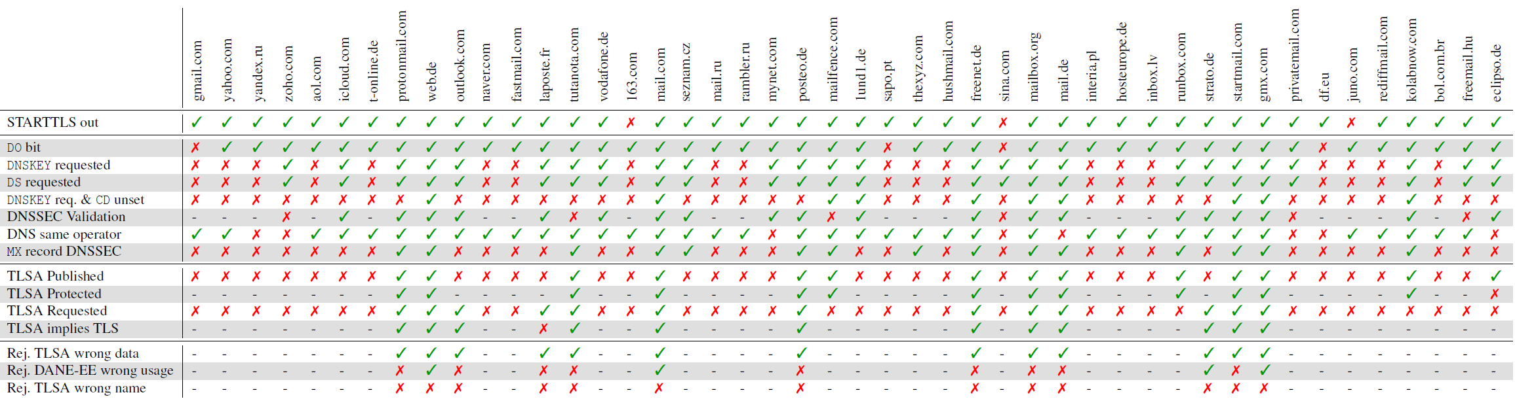
Provider-Scoped Test Results – Inbound (1/2)
Provider-Scoped
Domain-Scoped
MX-Scoped
Inbound scenarios (mail accounts of each provider → a test server)
[STARTTLS] | 3 providers do not support STARTTLS
[DNSSEC] | 15 (out of 47) providers have DNSSEC signature for their MX records 20 (out of 47) providers perform DNSSEC validation 6 (out of 47) providers fetch DNSSEC-related records but do not perform validation

Slide 20
Provider-Scoped Test Results – Inbound (2/2)
Provider-Scoped
Domain-Scoped
MX-Scoped
Inbound scenarios (mail accounts of each provider → a test server)
[DANE] | The top 7 providers do not support DANE 14 (out of 47) providers published TLSA and 13 (out of 47) providers requested TLSA Most providers do not validate TLSA records correctly

Slide 21
Domain-Scoped Test Results
Provider-Scoped
Domain-Scoped
MX-Scoped
Test DomCop Top 10M domains (SPF, DMARC, MTA-STS, SMIMEA, and OPENPGPKEY)
SPF support – 4,167,633 (41.7%)
DMARC support – 882,183 (8.8%)
SPF policy when validation failed | # of domains
Reject | 1,583,269 (37.99%)
Softfail* | 1,939,796 (46.54%)
Pass | 4,183 (0.1%)
Others | 640,385 (15.37%)
DMARC policy | # of domains
Valid | 867,506 (98.33%)
Syntax errors | 9,873 (1.12%)
Other errors | 4,804 (0.54%)
SMIMEA and OPENPGPKEY
*Softfail: leave the choice of failing to a checking mail server
Obtain SMIME certificates and OPENPGP keys through subdomain enumeration (e.g., NSEC walking), …
MTA-STS – 6,948 (0.07%)
Protocol | # of zones
SMIMEA | 26
OPENPGPKEY | 100
569 actually have a policy file

Slide 22
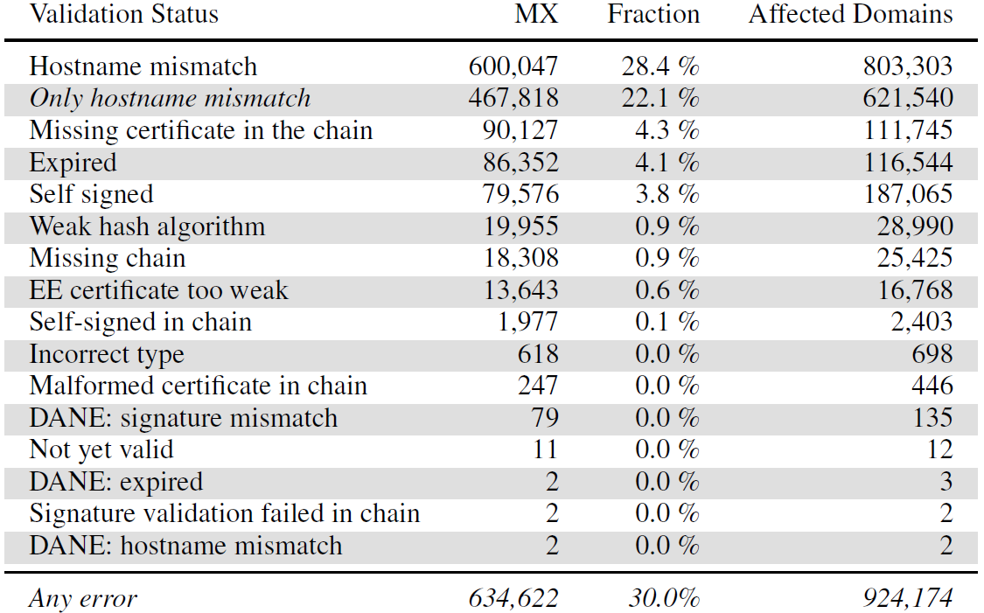
MX-Scoped Test Results
Provider-Scoped
Domain-Scoped
MX-Scoped
Test MXs (mail servers) used by DomCop Top 10M domains
  2,194,910 connectable mail servers → 2,112,682 (96.3%) of them support STARTTLS
 | # of MXs
Correctly validate certificate | 1,478,060 (70%)
Incorrectly validate certificate | 634,622 (30%)
Hostname mismatching occurs most frequently
  Names in a certificate are not matched with a domain name (or a MX record)
Other prevalent issues are stems from self-signed certificates
Accepting email delivery despite
failed validation is a necessary evil
to allow “utility”
Notes:
Not a single email providers reject mail delivery to mail servers with self-signed certificates

Slide 23
Conclusion
Provide a holistic overview of the support of email security protocols of late 2022
  Based on measurements from 47 popular email providers and DomCop 10M domains
Paints a grim yet slightly improving picture for the state of email security
  SPF, DKIM, and DMARC are supported by most popular email providers but their adoption by domains are still low (e.g., SPF adoption rate is 40%, exactly as in 2015)
  DANE support by providers has increased (since 2020) but some of them still not validating DNSSEC-related records
  STARTTLS is supported by 96% of mail servers (up from 35% in 2015) but 30% of them fail certificate validation
  MTA-STS deployment is still in its early stage

Slide 24
Q & A
Thank you!

