Slide 1
LightBox: Full-stack Protected Stateful Middlebox at Lightning Speed
Hyunwoo Lee
Seoul National University
Notes:
Good afternoon.
My name is Hyunwoo Lee, a Ph D. student at Network Convergence and Security Lab.
The paper for my qualification exam is titled “The effect of DNS on Tor’s Anonymity” which was published at NDSS 2017

Slide 2
Introduction
A paradigm shift of migrating software middleboxes (virtual network functions) to professional service providers is taking place
Its potential to enable billion-dollar marketplace has already been widely recognized
Security concern
How can end users be assured that their private information buried in the huge volumes of traffic, is not unauthorizedly leaked while being processed by the service provider?
LightBox
LightBox prioritizes the consideration of handling the intrinsic complexity and stringent performance requirements of middleboxes
LightBox leverages the SGX enclave as a starting point to develop a secure middlebox system
LightBox addresses two important aspects that are overlooked by many previous systems

Slide 3
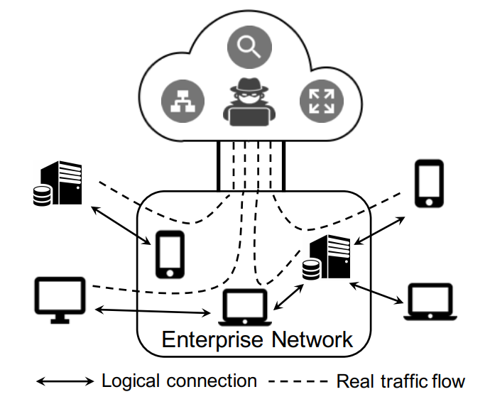
Motivation
Necessity for metadata protection
Most existing designs only consider the protection of application payloads (not traffic metadata)
“If you have enough metadata, you don’t really need content”
Aggregating tremendous user traffic to the middlebox service provider creates a unique vantage point for traffic analysis
We should protect not only application payloads but all the traffic metadata (full-stack protection)
Necessity for stateful middlebox
Advanced middleboxes need to track various flow-level states
Supporting stateful processing is an essential functionality requirement
A secure yet efficient solution is challenging with trusted hardware
A performance baseline that should be respected even if strong security guarantees are favored

Slide 4
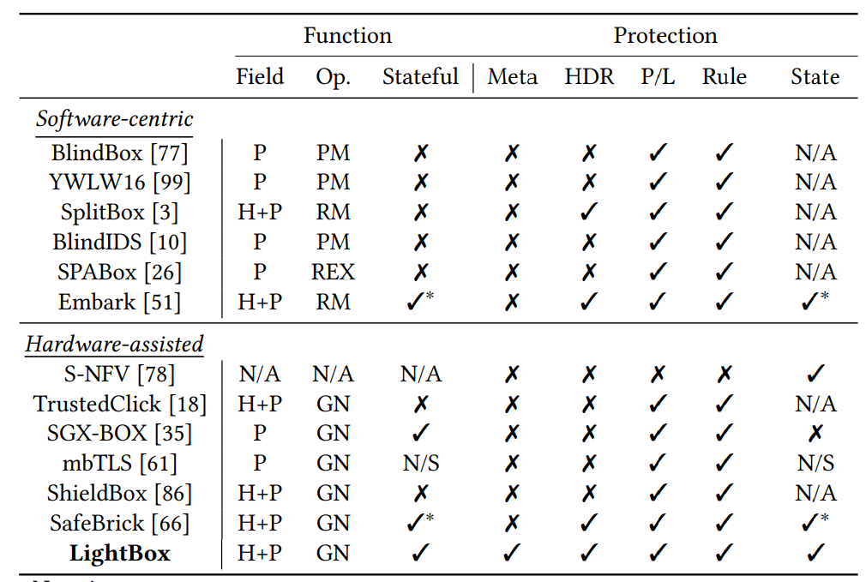
Characterization of Prior Arts

Slide 5
Characterization of Prior Arts
Which fields are processed
H: L2-L4 headers
P: L4 payload

Slide 6
Characterization of Prior Arts
Supported Operation
PM: Pattern Matching
RM: Range Matching
REX: Regular Expression Matching
GN: Generic Functions

Slide 7
Characterization of Prior Arts
Whether generic flow-level stateful processing is supported

Slide 8
Characterization of Prior Arts
Packet size, count, and timestamp

Slide 9
Characterization of Prior Arts
L2-L4 headers

Slide 10
Characterization of Prior Arts
L4 Payload

Slide 11
Characterization of Prior Arts
Middlebox Processing Rule

Slide 12
Characterization of Prior Arts
Flow-level states
N/A: Not considered by design
N/S: May be potentially supported, but not described

Slide 13
LightBox
The first SGX-enabled secure middlebox system
Near-native speed
Stateful processing
Full-stack protection
Two research questions
How to securely forward raw packets to a remote enclave, without leaking their low-level metadata, while still making them conveniently accessible at line rate?
How to enable the resource-demanding stateful middlebox processing within the highly constrained enclave space, without incurring unreasonably high overhead?
Experiment
Extensive evaluations show that etap allows in-enclave packet I/O at 10 Gbps rate with full-stack protection

Slide 14
Service Model
The enterprise redirects its traffic to the off-site middlebox hosted by the service provider for processing
Bounce model / Direct model
etap
Middlebox
etap-cli
incoming
Gateway
Server
outgoing
Bounce model
etap-cli
etap
etap-cli
Gateway
Middlebox
Gateway
Server
Direct model

Slide 15
Limitation of SGX
Intel SGX
SGX introduces a trusted execution environment called enclave (trusted memory region) to shield code and data with on-chip security engines
Limitation 1: Common system services cannot be directly used inside the enclave
Access to them requires expensive context switching to exit the enclave, OCALL
Limitation 2: Memory access in the enclave incurs performance overhead
The protected memory region, Enclave Page Cache (EPC), has a limit of 128MB
Excessive memory usage in the enclave will trigger EPC paging, which can induce prohibitive performance penalties
The cost of cache miss while accessing EPC is higher than normal, due to the cryptographic operations involved during data transferring between CPU cache and EPC

Slide 16
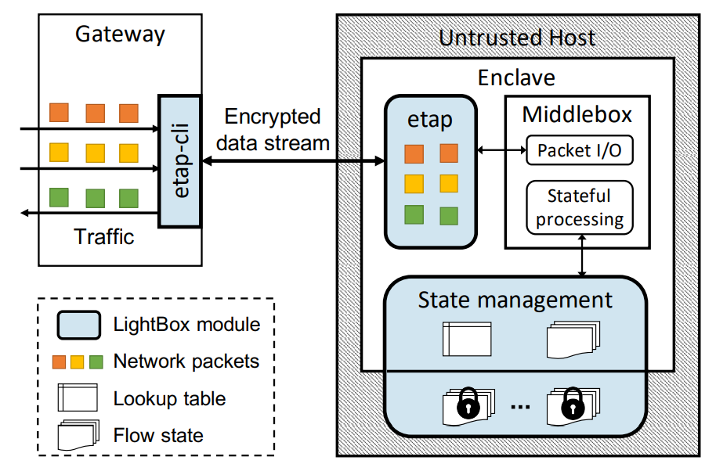
LightBox Overview

Slide 17
LightBox Overview
A virtual network interface that allows packets I/O at line rate within the enclave

Slide 18
LightBox Overview
A small flow cache in the enclave, a large encrypted flow store in the untrusted memory

Slide 19
Adversary Model
A powerful adversary
The adversary can gain full control over all user programs, OS and hypervisor, as well as all hardware components in the machine, with the exception of processor package and memory bus
The adversary can obtain a complete memory trace for any process, except those running in the enclave
The adversary is also capable of observing network communications, modifying and dropping packets at will
The adversary can log all network traffic and conduct sophisticated inference to mine useful information
Out-of-scope
Side channel attacks
Denial-of-service attacks
Assumption
The middlebox code is assumed to be correct
The enterprise gateway is always trusted

Slide 20
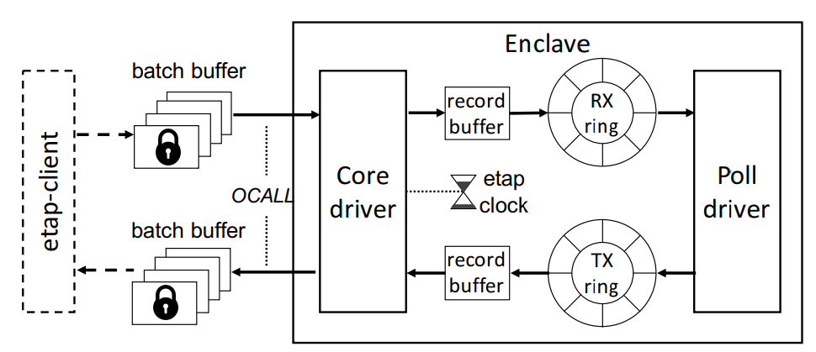
The ETAP Device
Goal
To enable in-enclave access to the packets intended for middlebox processing, as if they were locally accessed from the trusted enterprise networks
Design requirements
Full-stack protection: None of the packets’ metadata is directly leaked
Line-rate packet I/O: etap should deliver packets at a rate that can catch up with a physical NIC
High usability: To use etap, we need to impose as few changes as possible to the secured middlebox

Slide 21
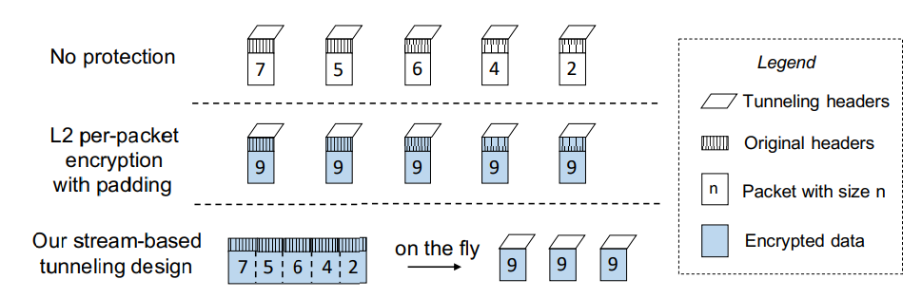
Full-stack Protection
The etap securely tunnel the packets between the gateway and the enclave
To hide information pertaining to individual packets, etap encodes the packets as a continuous stream, which is treated as application payloads

Slide 22
etap Architecture

Slide 23
etap Architecture
Every etap is peered with an etap-cli run by the gateway

Slide 24
etap Architecture
It coordinates networking, encoding, and cryptographic operations

Slide 25
etap Architecture
It is used by middleboxes to access packets
read_pkt to pop packets from RX ring
write_pkt to push packets to TX ring

Slide 26
Performance Boosting
etap is hardly useful if it cannot deliver packets at a practical rate
Lock-free ring
A classic single-producer-single-consumer lockless algorithm is used, since the trusted synchronization primitives of SGX are too expensive for the use of etap
Cache-friendly ring access
Frequent updates on control variables will trigger a high cache miss rate
A set of new control variables local to the threads is used to reduce the contention on shared variables
Disciplined record batching
The buffer size has to be properly set for best performance
If too small, the overhead of OCALL cannot be well amortized; if too large, the core driver needs longer time to perform I/O

Slide 27
Flow State Management
A naïve approach to get rid of the expensive EPC paging
An SGX application is partitioned into two parts, a small one in the enclave and a large one in the untrusted main memory, while ensuring data swapping between the two in an on-demand manner
A set of novel data structure for managing flow states in stateful middleboxes
It is compact in that by collectively adding a few tens of MBs overhead one million flows can be tracked concurrently
It is interlinked such that the data relocation and swapping involves only cheap pointer operations
The space-efficient cuckoo hashing is used to create a fast dual lookup algorithm
Altogether, the state management scheme introduces small and nearly constant computation cost to stateful middlebox processing, even with 100,000s of concurrent flows

Slide 28
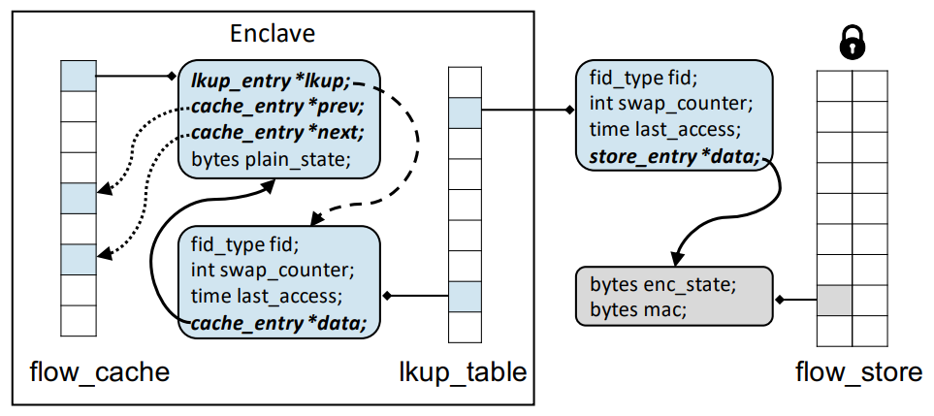
Data Structures
Three abstract tables of the state management
flow_cache: This maintains the states of a fixed number of active flows in the enclave
flow_store: It keeps the encrypted states of inactive flows in the untrusted memory
lkup_table: It allows fast lookup of all flow states from within the enclave
Design principle
Keeping the data structure of flow_cache and lkup_table functional and minimal

Slide 29
Data Structures
Three abstract tables of the state management
flow_cache: This maintains the states of a fixed number of active flows in the enclave
flow_store: It keeps the encrypted states of inactive flows in the untrusted memory
lkup_table: It allows fast lookup of all flow states from within the enclave
Design principle
Keeping the data structure of flow_cache and lkup_table functional and minimal
24B

Slide 30
Data Structures
Three abstract tables of the state management
flow_cache: This maintains the states of a fixed number of active flows in the enclave
flow_store: It keeps the encrypted states of inactive flows in the untrusted memory
lkup_table: It allows fast lookup of all flow states from within the enclave
Design principle
Keeping the data structure of flow_cache and lkup_table functional and minimal
33B

Slide 31
Data Structures
Three abstract tables of the state management
flow_cache: This maintains the states of a fixed number of active flows in the enclave
flow_store: It keeps the encrypted states of inactive flows in the untrusted memory
lkup_table: It allows fast lookup of all flow states from within the enclave
Design principle
Keeping the data structure of flow_cache and lkup_table functional and minimal
24B
16K cache entries with tracking 1M flows require only 33.8MB enclave memory
33B

Slide 32
Management Procedure
Flow tracking
The process of finding the correct flow state on a given fid
Procedure
Given a fid, it first searches through lkup_table to check if the flow has been tracked
If it is found in flow_cache, it is relocated to the front of the cache and the raw state data is returned
If it is found in flow_store, it is swapped with the LRU victim in flow_cache
In case of a new flow, an empty store_entry is created for the swapping
Tracking termination
On seeing FIN or RST flag, the tracking for the corresponding flow is terminated
Expiration checking
The checking routine peridodically purge expired flow states to avoid performance degradation

Slide 33
Fast Flow Lookup
Two requirements for the underlying lookup structure
Search efficiency
Space efficiency
Dual lookup design with cuckoo hashing
Cuckoo hashing has guaranteed O(1) lookup and superior space effiency
Cache-aware design
One downside with hashing is their inherent cache-unfriendliness, which incurs a higher cache miss penalty in the enclave
Therefore, lkup_table is split into a small table dedicated for flow_cache and a much larger one for flow_store
The large one is searched only after a miss in the small one

Slide 34
Middlebox Case Studies
Three middleboxes are introduced to evaluate LightBox
PRADS
A middlebox that is capable of detecting network assets in packets against predefined fingerprints
lwIDS
A lightweight IDS that can identify malicious patterns over reassembled data
mIDS
A comprehensive middlebox that is based on the mOS framework and the pattern matching engine DFC

Slide 35
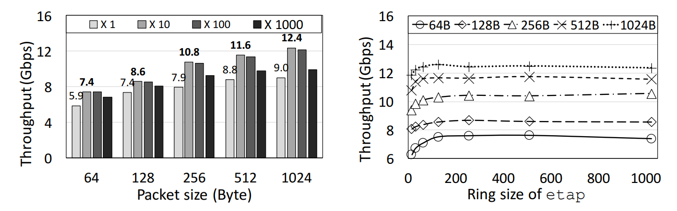
In-enclave Packet I/O Performance – Batching Size
How batching size affects etap performance

Slide 36
In-enclave Packet I/O Performance – Batching Size
The optimal size appears between 10 and 100 for all packet size

Slide 37
In-enclave Packet I/O Performance – Batching Size
With a batching size 10, etap can deliver small 64B packet at 7.4Gbpx and large 1024B packet at 12.4Gbps

Slide 38
In-enclave Packet I/O Performance – Ring Size
The throughput against the ring size

Slide 39
In-enclave Packet I/O Performance – Ring Size
The tipping point occurs around 256

Slide 40
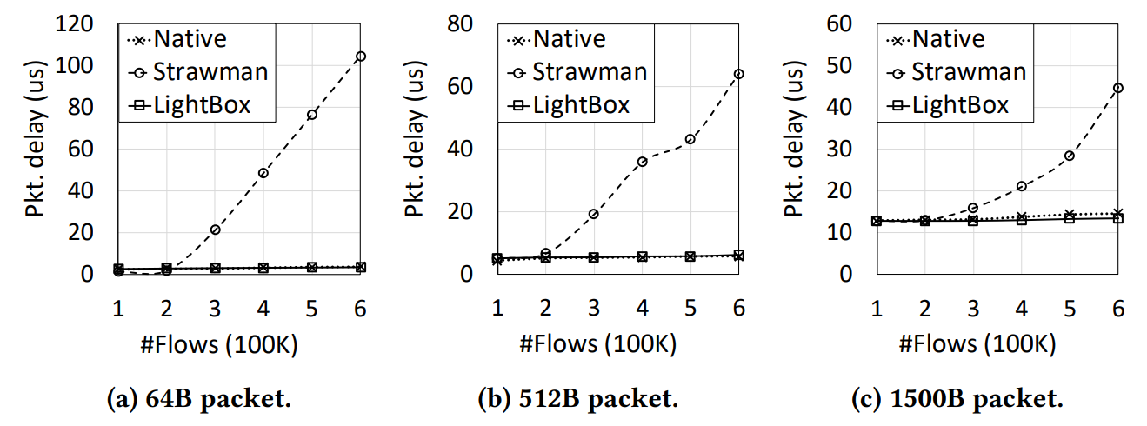
Middlebox Performance – PRADS

Slide 41
Middlebox Performance – PRADS
A middlebox program that runs as a normal program

Slide 42
Middlebox Performance – PRADS
A naïve SGX port that uses etap but relies on EPC paging

Slide 43
Middlebox Performance – PRADS
LightBox adds negligible overhead to native processing regardless of the number of flows

Slide 44
Middlebox Performance – PRADS
Strawman incurs significant and increasing overhead after 200K flows, due to the involvement of EPC paging

Slide 45
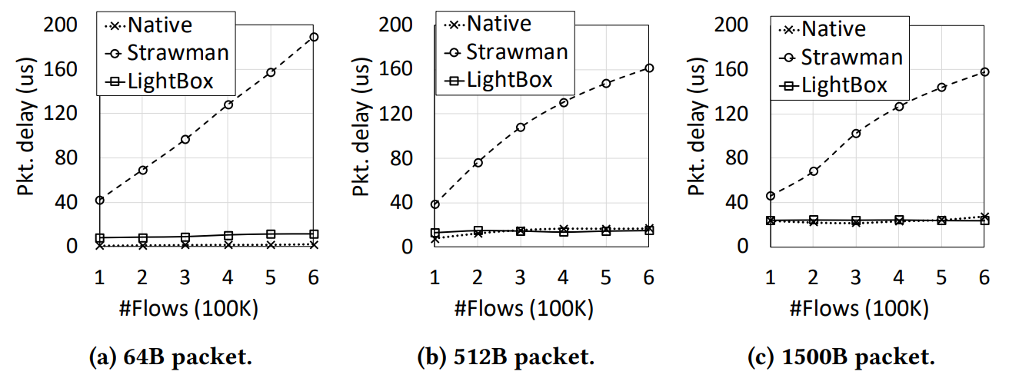
Middlebox Performance – lwIDS
The performance of Strawman is further degraded, since lwIDS has larger flow state size than PRADS and its memory footprint exceeds 550MB even when tracking only 100K flows

Slide 46
Middlebox Performance – lwIDS
LightBox introduces 6 – 8 us packet delay because the state management dominates the whole processing

Slide 47
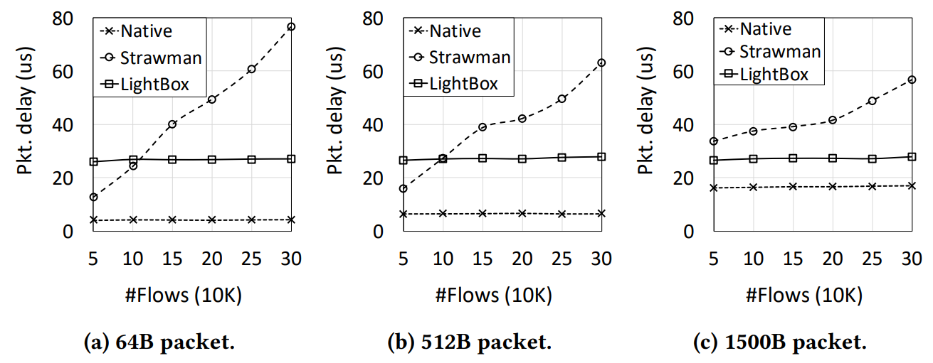
Middlebox Performance – mIDS
Native and LightBox are insensitive to the number of concurrent flows

Slide 48
Middlebox Performance – mIDS
The overhead of LightBox over Native becomes notable
mIDS’s large flow state size (11.4KB) leads to the substantial cost of encrypting/decrypting and copying states

Slide 49
Conclusion
LightBox
An SGX-assisted secure middlebox system
Two main technical contribution
An elegant in-enclave virtual network interface that is highly secure, efficient and usable
The flow state management scheme comprising data structures and algorithms optimized for the enclave space

